Slide 1
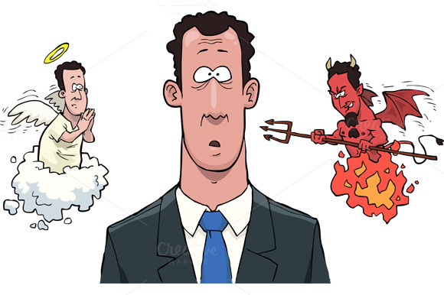
Blameless Conscience (Before God And Men) Text: Acts 24:16
Notes:
By Nathan L Morrison
All Scripture cited is from the NASU unless specifically stated otherwise
For further study, or if questions, please Call: 804-277-1983 or Visit www.courthousechurchofchrist.com

Slide 2
Intro
God has given all people a conscience
The English word conscience is a compound word:
“Con” (with) “science” (to know), literally, “a knowing
with”, or a self-knowledge.
The Greek word for “conscience” is a composition word
Gr. sun (G4862): “with; a marker which shows association with another thing or person.”
Gr. eido (G1492): “to know; to posses information; recognize, to realize, to come to know; to understand; to be able to use knowledge.”
Conscience = Gr. suneidesis (G4893): “with knowing; self-perception, moral consciousness; to see completely: -- conscience.”

Slide 3
Intro
The conscience has always been a subject of debate
Notes:
Images:
Jiminy Cricket from Disney’s Pinocchio
Kronk from Disney’s The Emperor’s New Groove
Disney’s Donald Duck

Slide 4
Intro
The New Testament has much to say about the conscience
The word is found 31 times in the New Testament.
Paul used the term about 20 times
Acts 24:16:
16. "In view of this, I also do my best to maintain always a blameless conscience both before God and before men.”
It is important to maintain a blameless conscience
before God and men!

Slide 5
Possibility: A Clear Conscience (II Tim. 1:3)
II Tim. 1:3:
3. I thank God, whom I serve with a clear conscience the way my forefathers did, as I constantly remember you in my prayers night and day,
The word “clear” = Gr. katharos (G2513):
“clean (literally or figuratively): -- clear, pure.”
(KJV: II Tim. 1:3 = “pure”)
I Tim. 1:5: One purpose of God’s word is to give us a
“good conscience”
Heb. 10:22: There are those who have an evil conscience. (Rom. 3:9-18)
Acts 23:1: Some, like Paul, have a “perfectly good conscience” because they thought what they were doing was right. (Acts 22:4; 26:9-11)

Slide 6
Possibility: A Clear Conscience (II Tim. 1:3)
Leaders in the Church are to have a “clear conscience”
(I Tim. 3:8-9: Deacons)
Men may obtain a good conscience:
I Peter 3:20-21: In obedience to God’s command to be baptized, people may obtain a good conscience. (One’s sins are washed away)
I Tim. 1:5, 19: The Christian must maintain a good conscience.
By obedience to the word of God, one may have a clear conscience!

Slide 7
Maintain: A Good Conscience (I Tim. 1:5, 18-19)
I Tim. 1:5, 18-19:
5. But the goal of our instruction is love from a pure heart and a good conscience and a sincere faith.
18. This command I entrust to you, Timothy, my son, in accordance with the prophecies previously made concerning you, that by them you fight the good fight,
19. keeping faith and a good conscience, which some have rejected and suffered shipwreck in regard to their faith.
Once obedient to God, must maintain a good conscience
to have:
Peace of mind (A troubled conscience often has no peace).
Confidence for living – Don’t violate your conscience! (James 4:17)

Slide 8
Maintain: A Good Conscience (I Tim. 1:5, 18-19)
The conscience is a personal guide, not the standard for
truth (Acts 26:9)
One with a good conscience will be guided by truth (Paul)
The conscience does not establish truth but follows it
Acts 23:1: Paul knew the value of a good conscience
Acts 26:9-23: Paul was set straight from the path he was on by his own thinking, and turned to the truth
Notes:
Image: Jiminy Cricket from Disney’s Pinocchio

Slide 9
Maintain: A Good Conscience (I Tim. 1:5, 18-19)
I Tim. 1:19: There is a correlation in holding faith and the
good conscience
Rom. 14:23: There is a grave danger in doing something that we believe is wrong (James 4:17)
I Tim. 1:19-20: If one does wrong and experiences guilt he may try to solve his conscience problem by denying his faith, or justifying his actions.
Acts 8:22; I Jn. 1:9: The real solution to the problem of sinful guilt in the life of a Christian is repentance, confession and prayer.
One who keeps the faith and abides by truth will have a good conscience!

Slide 10
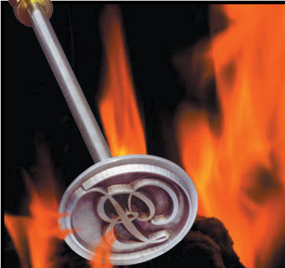
Problem: A Seared Conscience (I Tim. 4:1-2)
I Tim. 4:1-2:
1. But the Spirit explicitly says that in later times some will fall away from the faith, paying attention to deceitful spirits and doctrines of demons,
2. by means of the hypocrisy of liars seared in their own conscience as with a branding iron,
Cattle are branded – when healed, there is no longer any
nerve response
One may persist in a sinful practice until there is no more “nerve response” – There is no guilt or remorse
Eph. 4:17-19: A person may sin until he gets “past feeling” (KJV).
Vs. 19: “…having become callous…” = Sin without guilt.

Slide 11
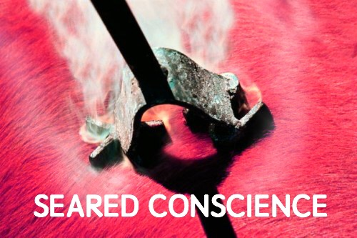
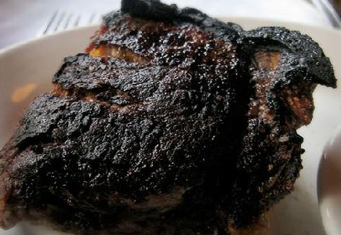
Problem: A Seared Conscience (I Tim. 4:1-2)
One with a seared conscience may live:
Heb. 6:4-6: Unfaithfulness to Christ and His church.
I Cor. 5:1: Some immoral practice(s).
I Tim. 4:1-4; II Tim. 4:3-4: False doctrine.
I Tim. 4:3-4: An acceptance of restrictions God has never imposed on people. (Mt. 15:8-9)
It is hard to bring one with a “seared conscience” back to God!
One with a seared conscience will not repent and ask for forgiveness
One may become so callous to sin that they no longer feel any shame or guilt!

Slide 12
Conclusion
Timothy was charged to live faithfully and to keep a good
conscience (I Tim. 1:18-19)
I Jn. 3:20-21: One who is condemned in his own heart is surely condemned of the Lord.
The conscience of a Christian is not cowardly – It gives
a measure of courage and comfort
I Tim. 1:18: “Fight the good fight.” Cowards don’t fight, they run.
II Tim. 4:7: Paul could say with confidence he fought the good fight.
Was Paul a coward, or was he courageous? (II Cor. 11)

Slide 13
Conclusion
Christians need to have the courage to maintain a good
conscience!
It takes courage to take a stand and not sin along with others.
It takes courage to live in such a way that you can say you have a blameless conscience before God and man! (Acts 24:16)
Make right decisions in order to maintain a good conscience before God and men!

Slide 14
“What Must I Do To Be Saved?”
Hear The Gospel (Jn. 5:24; Rom. 10:17)
Believe In Christ (Jn. 3:16-18; Jn. 8:24)
Repent Of Sins (Lk. 13:35; Acts 2:38)
Confess Christ (Mt. 10:32; Rom. 10:10)
Be Baptized (Mk. 16:16; Acts 22:16)
Remain Faithful (Jn. 8:31; Rev. 2:10)
For The Erring Child of God:
Repent (Acts 8:22), Confess (I Jn. 1:9),
Pray (Acts 8:22)

