Slide 1
What Are YOU Worth?
Text: I Pet. 1:17-19
Notes:
By Nathan L Morrison for Sunday
All Scripture given is from NASB unless otherwise stated
For further study, or if questions, please Call: 804-277-1983 or Visit www.courthousechurchofchrist.com

Slide 2
Intro
All things have value
Our economy is based on our ability to arrive at the value of most commodities
Gold & silver
Stocks
Cattle & grain
Real estate
Oil & gas
Commodities prized above others become the standard by
which the value of other things is established
For many years gold drove the economy standard.
Now, the world wants “dollars” or “pounds” or “euros.”
In the future, the standard may be something else.
The value of things changes
People have value too, and we’ll see what value from an
economic perspective & from God’s!

Slide 3
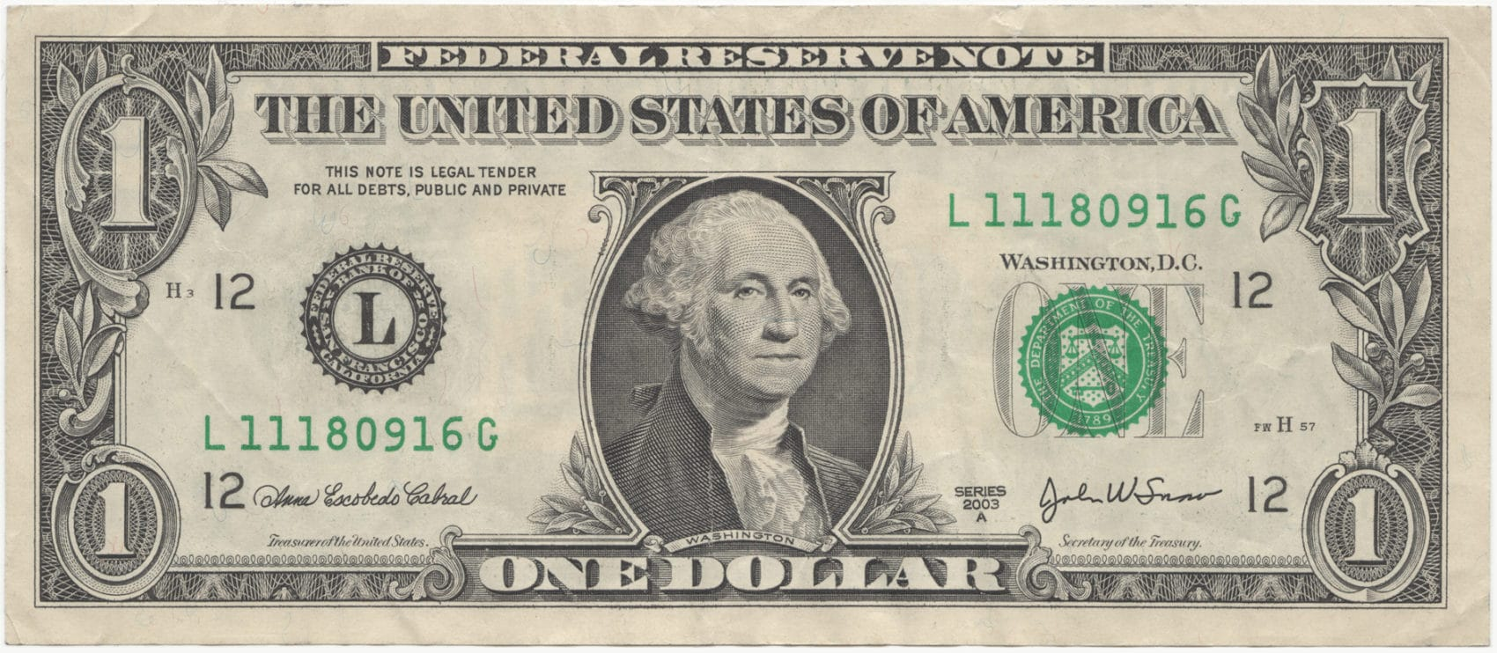
You Have Value
Human body made up of these approx. components:
65% Oxygen
18% Carbon
10% Hydrogen
3% Nitrogen
1.5% Calcium
1.1% Phosphorous
0.35% Potassium
0.25% Sulfur
0.15% Sodium
Also, trace quantities of fluorine, silicon, manganese, zinc, copper, aluminum, and arsenic.
Combined with all the above ingredients amounts to less than $1!

Slide 4
You Have Value
Man’s most valuable asset is our skin!
Cut and dried, the average person is the proud owner of 14 to 18 sq. ft. of skin!
Basing the skin’s value on the selling price of cowhide (approx. $.25 per sq. ft.), the average person’s skin amounts to $3.50!
Your worth from an economic perspective is greater:
Many have life insurance.
In addition to that, some people have certain body parts insured!
Thus, those who do are “worth more dead than alive.”
If you are healthy, individual organs may have monetary
value:
$10,000 - $35,000, depending on need for transplantation
Notes:
Sources:
www.becker-posner-blog.com
In 1983 a Virginia company, headed by H. Barry Jacobs, announced the 1st scheme to buy and sell human organs. Under his proposed arrangement, a healthy, live “donor” would set a price for a kidney up to $10,000 and the recipient would pay this amount plus a $2,000 - $5,000 broker fee to Jacobs
(Medscape Today, Gwen Mayes, www.medscape.com/viewarticle/465200).

Slide 5
You Have Value
We live in a time when that which should be prized the most (human life), is prized the least – “life is cheap”
To the evolutionist: “a further development.”
To the materialist: “just something to be adorned.”
To the atheist: “nothing more than an animal.”
To the ecologist: “a destabilizing influence on the environment.”
To the industrialist: “a cog in a big machine.”
To the militarist: “a fighting machine.”
To the government: “a taxpayer I.D. and potential voter.”
To the abortionist: “a mass of tissue.”
To the euthenist: “something to be put out of its misery.”

Slide 6
You Have Value
Your value is not determined by your body’s
element makeup or by the philosophies of the day
(Your real worth is determined by Him who created you)
Most of what we buy and sell is manufactured goods, raw materials transferred by process into usable substances that have additional value (wheat, cow’s milk, hen’s eggs, etc.)
The value of those things is set by the manufacturer and market conditions.
Man is the creation of God’s hands (Gen. 2:7) –
He determines the worth!

Slide 7
“What Is Man That You Take Thought Of Him?”
Ps. 8:3-9; Heb. 2:5-10: “What is man?”
Ps. 8:3-9
3. When I consider Your heavens, the work of Your fingers, The moon and the stars, which You have ordained;
4. What is man that You take thought of him, And the son of man that You care for him?
5. Yet You have made him a little lower than God, And You crown him with glory and majesty!
6. You make him to rule over the works of Your hands; You have put all things under his feet,
7. All sheep and oxen, And also the beasts of the field,
8. The birds of the heavens and the fish of the sea, Whatever passes through the paths of the seas.
9. O LORD, our Lord, How majestic is Your name in all the earth!

Slide 8
“What Is Man That You Take Thought Of Him?”
Ps. 8:3-9; Heb. 2:5-10: “What is man?”
Heb. 2:5-10
5. For He did not subject to angels the world to come, concerning which we are speaking.
6. But one has testified somewhere, saying, "WHAT IS MAN, THAT YOU REMEMBER HIM? OR THE SON OF MAN, THAT YOU ARE CONCERNED ABOUT HIM?
7. "YOU HAVE MADE HIM FOR A LITTLE WHILE LOWER THAN THE ANGELS; YOU HAVE CROWNED HIM WITH GLORY AND HONOR, AND HAVE APPOINTED HIM OVER THE WORKS OF YOUR HANDS;
8. YOU HAVE PUT ALL THINGS IN SUBJECTION UNDER HIS FEET." For in subjecting all things to him, He left nothing that is not subject to him. But now we do not yet see all things subjected to him.
9. But we do see Him who was made for a little while lower than the angels, namely, Jesus, because of the suffering of death crowned with glory and honor, so that by the grace of God He might taste death for everyone.
10. For it was fitting for Him, for whom are all things, and through whom are all things, in bringing many sons to glory, to perfect the author of their salvation through sufferings.

Slide 9
“What Is Man That You Take Thought Of Him?”
Ps. 8:3-9; Heb. 2:5-10: “What is man?”
Man is a living soul made in the image of God
Gen. 1:26-27; 2:7: God made man in His image & gave him the breath of life.
Gen. 1:28-30: God made man above the animals and made them subject to him.
Man is like the animals in that they both have “life.” (Gen. 1:30; 2:7)
There is a distinction between man & animals (Eccl. 3:19-21; 12:7) – both live and die, but man’s spirit returns to God, animals to the earth.

Slide 10
“What Is Man That You Take Thought Of Him?”
Man is body and soul, flesh and spirit
The body or flesh is the house/tent in which the spirit/soul dwells (II Pet. 1:14; II Cor. 5:1-9).
Our personality, will and desires are associated with the inner man, the spirit (I Cor. 9:27; II Cor. 5:2,4; II Pet. 1:12-16)
The inner man will survive the outer man in death (II Cor. 4:16; Js. 2:26; Mt. 10:28; Lk. 23:46; Eccl. 12:7)
As an order of being, man is “a little lower than the
angels” (Heb. 2:5-9)
Meaning our fleshly nature (Heb. 2:16; Js. 1:14).
Meaning the potential for salvation (Heb. 1:14; II Pet. 2:4).
Meaning our mortality (Gen. 2:17; Heb. 9:27).
God created man and provided the means for redemption
for him! (Eph. 1:7; Heb. 2:10)

Slide 11
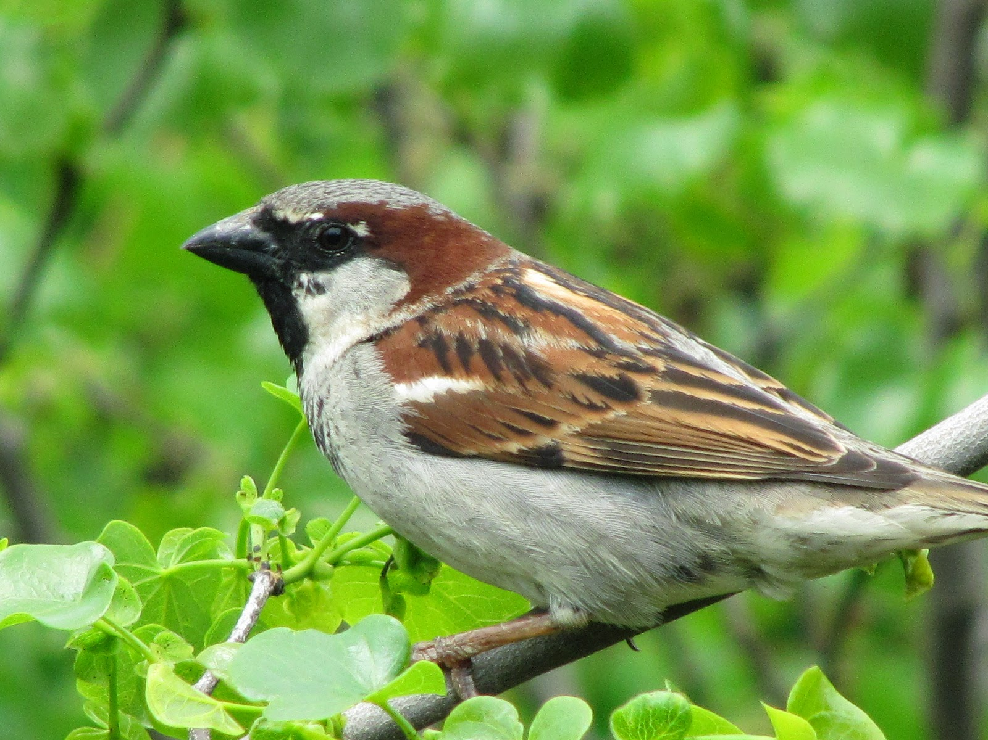
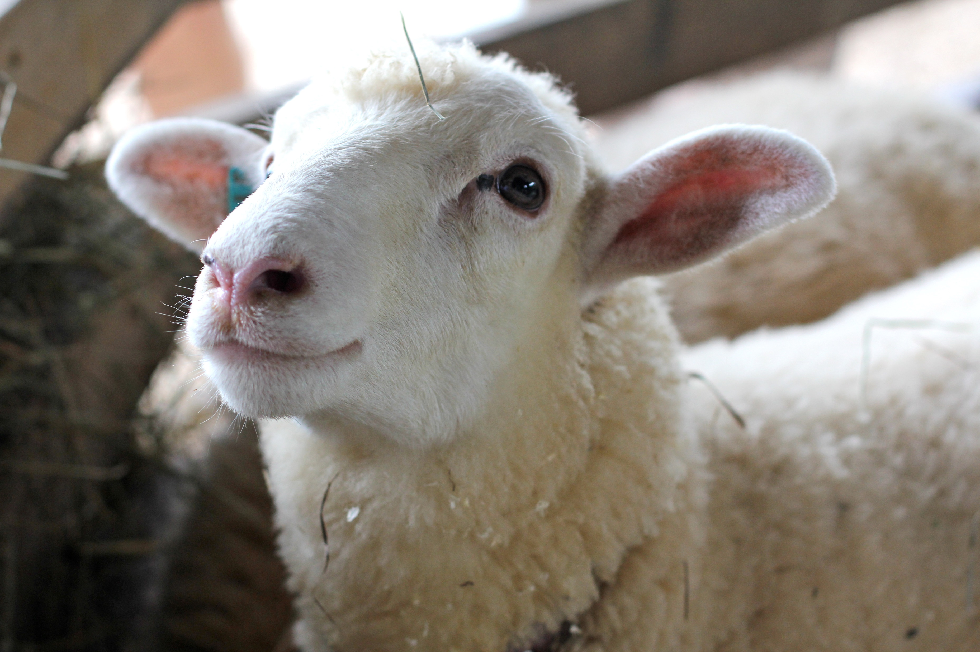
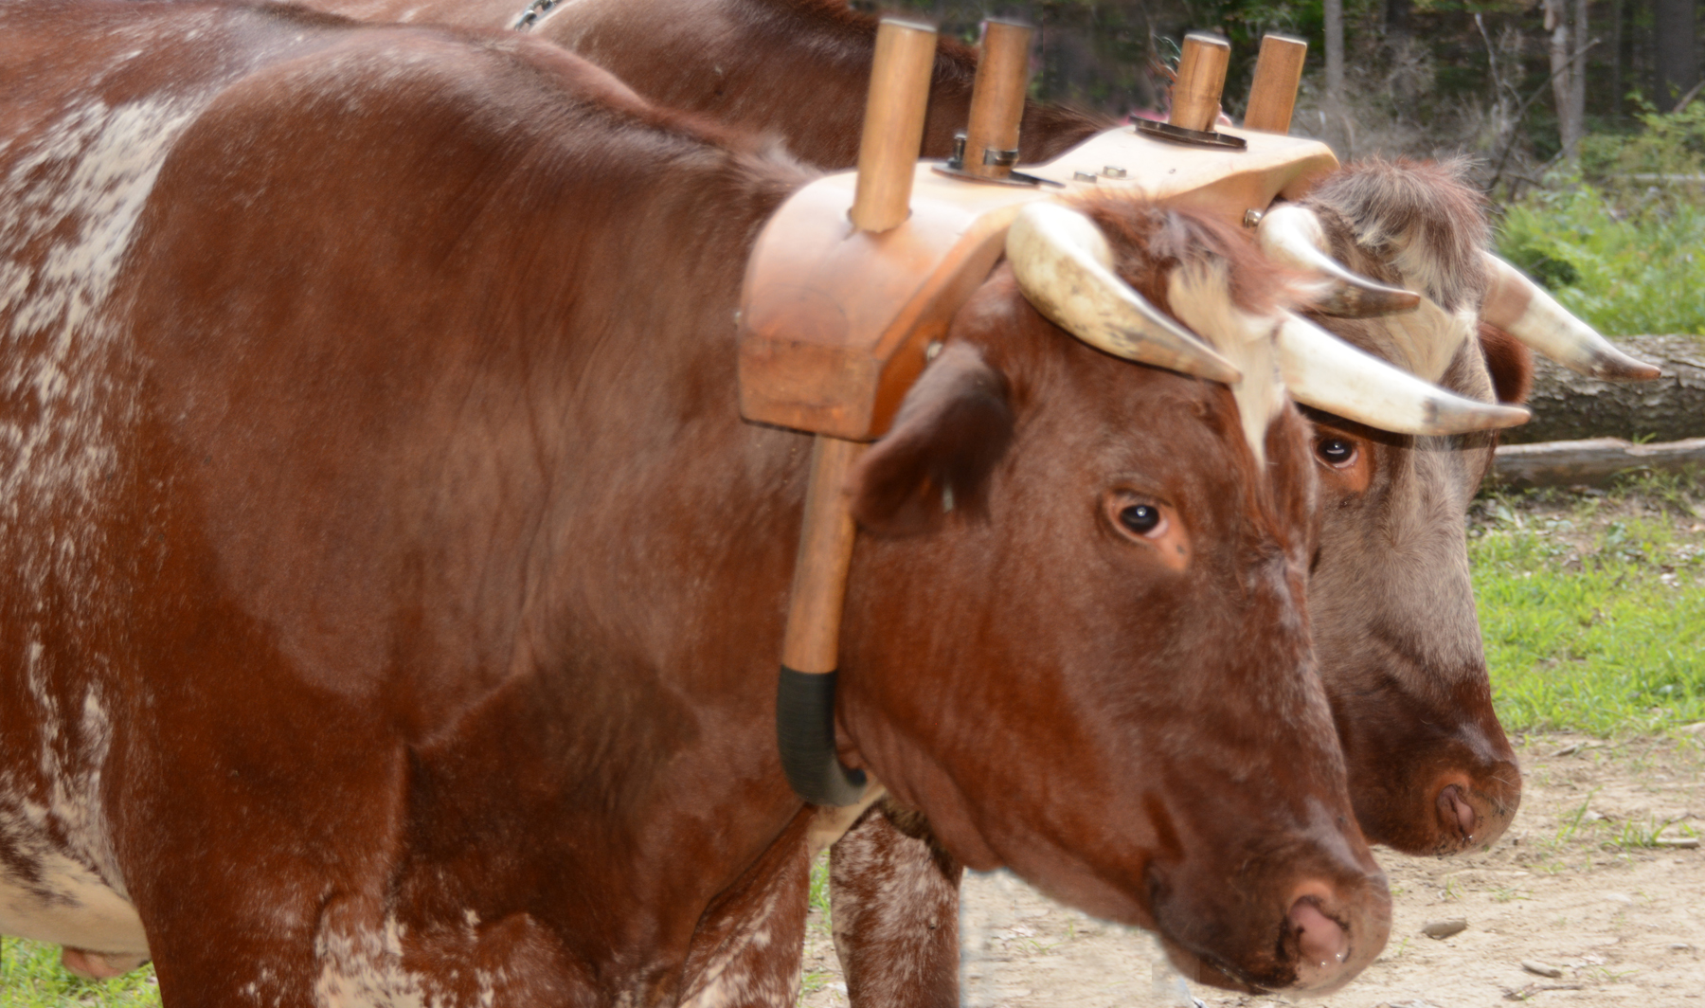
What Is Man Worth?
Man is worth more than the commodities of trade and
commerce:
Worth more than sparrows – Mt. 10:29-31
Worth more than sheep – Mt. 12:10-13
Worth more than an ox or donkey – Lk. 13:13-17
Worth more than combined riches of the world – Mt. 16:24-26

Slide 12
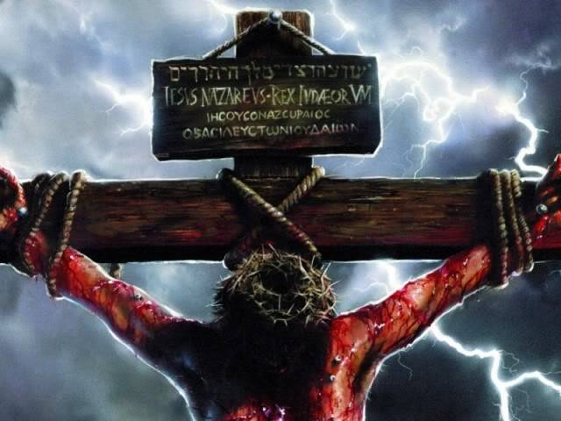
What Is Man Worth?
God declared the exact value of man on Calvary
Man is so valuable to God that He was willing to let His only begotten Son die for the sins of man (Jn. 3:16; Rom. 5:8-10; I Jn. 4:9-10).
Jesus didn’t die for sparrows, sheep, oxen, or for wealth!
God’s own Son is the price paid (I Cor. 6:19-20) for redemption (Eph. 1:7)

Slide 13
What Is Man Worth?
God declared the exact value of man on Calvary
The price was Christ’s precious blood (I Pet. 1:17-19) – Not gold or silver!
God declared to mankind the value of man – worth the blood of Jesus!
I Pet. 1:17-19
17. If you address as Father the One who impartially judges according to each one's work, conduct yourselves in fear during the time of your stay on earth;
18. knowing that you were not redeemed with perishable things like silver or gold from your futile way of life inherited from your forefathers,
19. but with precious blood, as of a lamb unblemished and spotless, the blood of Christ.

Slide 14
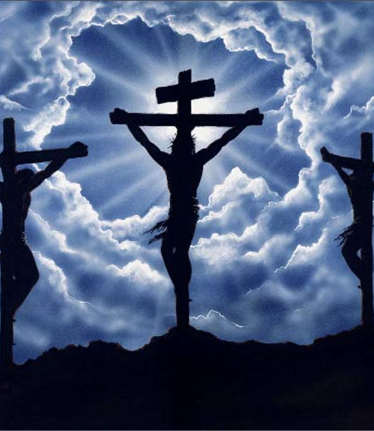
What Is Man Worth?
Since the value of any commodity is determined by the price men are willing to pay, we get an idea of what man is worth to God!

Slide 15
Conclusion
All things have value – what others are willing to pay for them
Gold & silver
Stocks
Cattle & grain
Real estate
Oil & gas

Slide 16
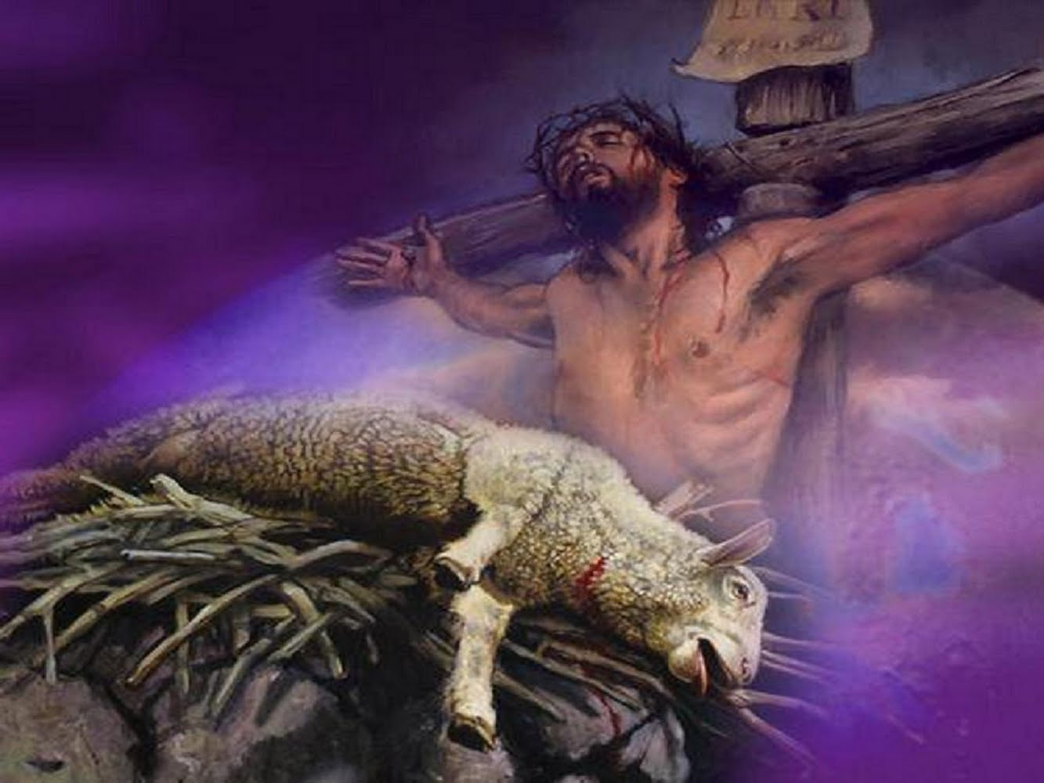
What Are You Worth?
The precious, innocent blood of Jesus, the Lamb of God Who takes away the sins of the world! (John 1:29)

Slide 17
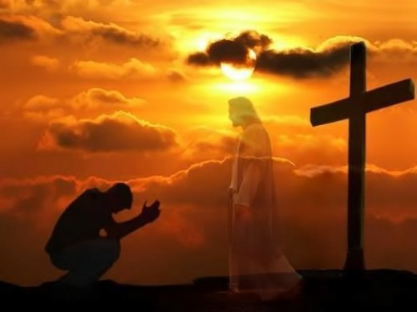
Conclusion
Despite the worth of man as measured by man, you have
great value to God!
Jesus shed His blood to redeem you that you might spend
eternity with Him!
Do you recognize your great value and serve Him who
redeemed you?

Slide 18
“What Must I Do To Be Saved?”
Hear The Gospel (Jn. 5:24; Rom. 10:17)
Believe In Christ (Jn. 3:16-18; Jn. 8:24)
Repent Of Sins (Lk. 13:35; Acts 2:38)
Confess Christ (Mt. 10:32; Rom. 10:10)
Be Baptized (Mk. 16:16; Acts 22:16)
Remain Faithful (Jn. 8:31; Rev. 2:10)
For The Erring Child of God:
Repent (Acts 8:22), Confess (I Jn. 1:9),
Pray (Acts 8:22)

