Slide 1
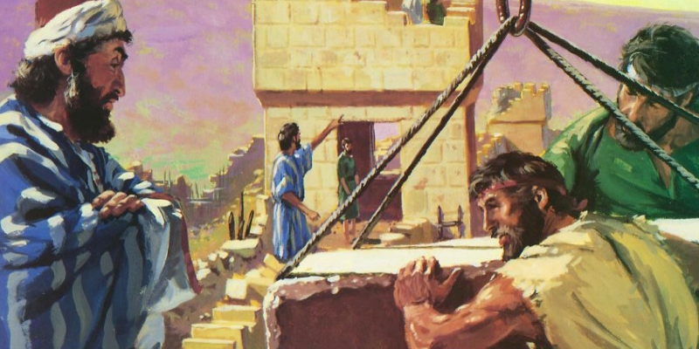
“A Mind To Work” Text: Nehemiah 4:6
Notes:
By Nathan L Morrison
All Scripture given is from NASB unless otherwise stated
For further study, or if questions, please Call: 804-277-1983 or Visit www.courthousechurchofchrist.com

Slide 2
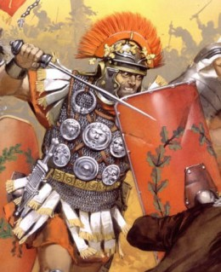
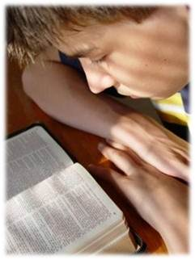
Intro
II Tim. 2:3-4; 4:6-8; I Tim. 6:12; Jude 3:
Soldiers of Christ are to fight, finish the course, and keep the faith, all while working as soldiers to please the Enlister by sharing the gospel (Mk. 16:15)

Slide 3
Intro
A great modern physical illustration of working and fighting at same time is the U.S. Navy Seabees!
“To which generous tribute I would
add that Nehemiah was the father of the first organized military force in recorded history whose function it was to build and fight. Therefore, he could be appropriately designated the patron saint of the Seabees, for he too, subscribed to the motto: Construimus, Batuimus;
We Build, We Fight!”
-Admiral Ben Moreell (1892-1978)-
Notes:
Quote by Admiral Moreell from: The King Bee: A Biography of Admiral Ben Moreell chapter IX

Slide 4
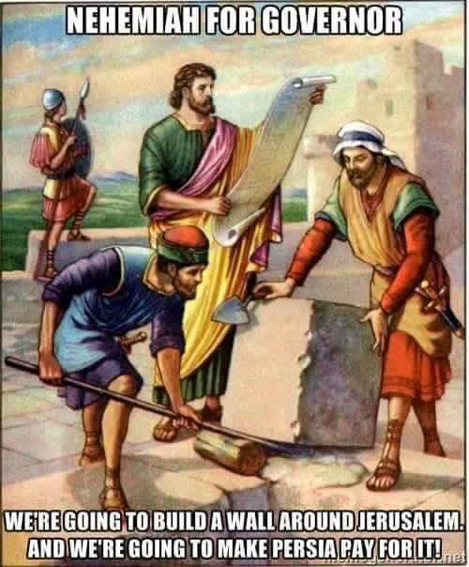
Intro
A great example of working under adversity and getting the job done is Nehemiah! (Rom. 15:4)
After being in captivity for 70 years (Jer. 25:11-12; 29:10) the Jews were freed by Cyrus in 538 B.C.
Notes:
After being in captivity for 70 years (Jer. 25:11-12; 29:10) the Jews were freed by Cyrus in 538 B.C.

Slide 5
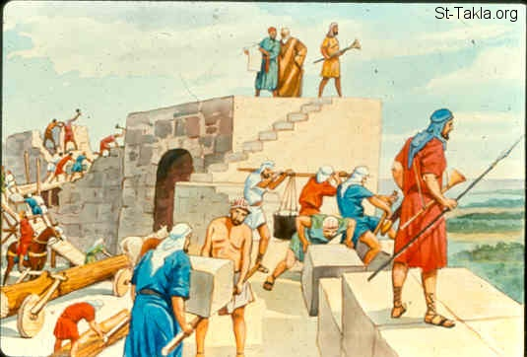
Intro
Nehemiah came about 94 years later (444 B.C.) to rebuild
Jerusalem and its walls (Neh. 2:1-5, 18)
Neh. 1:3; 2:13: The rubble of the walls and the burned gates were still visible (II Chr. 36:19)
Neh. 2:4-9: The king of Persia paid for the wall and sent protection!
Nehemiah and the Jews faced much opposition:
They were laughed at and scorned (Neh. 2:19)
They were ridiculed (Neh. 4:1-3)
They were planned to be attacked (Neh. 4:11)
Neh. 4:6 (Not easy but successful)
6. So we built the wall and the whole wall was joined together to half its height, for the people had a mind to work.
Great things were accomplished because
“the people had a mind to work!”

Slide 6
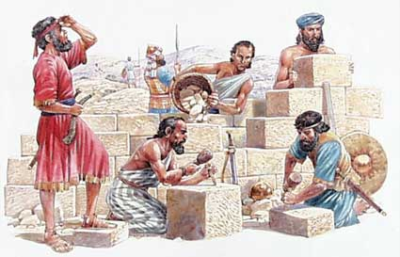
The People Had a Mind to Work
Need:
Perceived need: Walls needed rebuilt
Planned work: Laborers needed as well as guards for protection
Pursued the plan: Labored with tool in one hand and weapon in other, guarded by night, worked by day (Neh. 4:12-23)

Slide 7
The People Had a Mind to Work
Need – Neh. 4:12-23
Objective:
Neh. 4:6, 14-16: Rebuild the walls of Jerusalem and to protect the people
Neh. 4:22-23: People brought within the walls as it was being built
Neh. 4:22-23
22. At that time I also said to the people, "Let each man with his servant spend the night within Jerusalem so that they may be a guard for us by night and a laborer by day."
23. So neither I, my brothers, my servants, nor the men of the guard who followed me, none of us removed our clothes, each took his weapon even to the water.

Slide 8
The People Had a Mind to Work
Need – Neh. 4:12-23
Objective – Neh. 4:6, 14-16, 22-23
Purpose:
For protection from outside enemies!
Neh. 2:8, 18: Nehemiah revealed that God was with him in the building up of the walls (Completed it in 52 days – Neh. 6:15!).
They put their “hands to the good work” and were pleasing to God.
Neh. 2:18 (God was with them…)
18. I told them how the hand of my God had been favorable to me and also about the king's words which he had spoken to me. Then they said, "Let us arise and build." So they put their hands to the good work.

Slide 9
The People Had a Mind to Work
Need – Neh. 4:12-23
Objective – Neh. 4:6, 14-16, 22-23
Purpose – Neh. 2:18; 6:15
The work of the Lord will only get done when the
people have a mind to work!

Slide 10
Saints Are to Have a Mind to Work
We are told by God to work – Saints need to see the need!
Mt. 20:1
1. "For the kingdom of heaven is like a landowner who went out early in the morning to hire laborers for his vineyard.
I Cor. 15:58
58. Therefore, my beloved brethren, be steadfast, immovable, always abounding in the work of the Lord, knowing that your toil is not in vain in the Lord.
Eph. 2:10
10. For we are His workmanship, created in Christ Jesus for good works, which God prepared beforehand so that we would walk in them.

Slide 11
Saints Are to Have a Mind to Work
Need:
Physical
Mt. 25:34-40: Hungry, Thirsty, Stranger, Naked, Sick, Imprisoned
Js. 2:15-16: Not enough to see need – work to fill it (Mt. 10:42; I Jn. 3:17-18)
Js. 2:15-16
15. If a brother or sister is without clothing and in need of daily food,
16. and one of you says to them, "Go in peace, be warmed and be filled," and yet you do not give them what is necessary for their body, what use is that?
Spiritual
II Cor. 4:6; II Tim. 2:24-26: Saints are to be able to teach the gospel to the lost! (Mt. 28:18-20; Acts 16:9-10)
Phil. 2:14-16: We also teach by our influence!
II Cor. 4:6
6. For God, who said, "Light shall shine out of darkness," is the One who has shone in our hearts to give the Light of the knowledge of the glory of God in the face of Christ.

Slide 12
Saints Are to Have a Mind to Work
Need – Physical (Js. 2:15-16) & Spiritual (II Cor. 4:6)
Objective:
Jn. 9:4: Work till man can work no longer
Mt. 20:8: The laborers worked till the Master called them for their wages
II Cor. 5:9-11: Knowing the “fear of the Lord, we persuade men!”
I Tim. 2:4; II Pet. 3:9: All men to be saved and to repent!
II Cor. 5:9-11
9. Therefore we also have as our ambition, whether at home or absent, to be pleasing to Him.
10. For we must all appear before the judgment seat of Christ, so that each one may be recompensed for his deeds in the body, according to what he has done, whether good or bad.
11. Therefore, knowing the fear of the Lord, we persuade men, but we are made manifest to God; and I hope that we are made manifest also in your consciences.

Slide 13
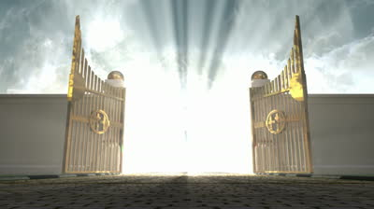
Saints Are to Have a Mind to Work
Need – Physical (Js. 2:15-16) & Spiritual (II Cor. 4:6)
Objective – “Persuade men” (II Cor. 5:9-11)
Purpose:
Mt. 25:34: The reward of heaven, our eternal home with God.
I Tim. 4:6-7, 10, 16: Purpose = Godliness for the hope of Heaven!
Rev. 3:5: To those who overcome will be confessed by Christ to the Father and will be arrayed in white garments
Mt. 25:34
34. "Then the King will say to those on His right, 'Come, you who are blessed of My Father, inherit the kingdom prepared for you from the foundation of the world.
The reward is why we endure the labor of life!

Slide 14
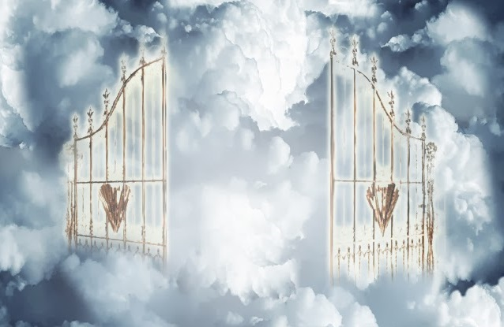
Saints Are to Have a Mind to Work
Need – Physical (Js. 2:15-16) & Spiritual (II Cor. 4:6)
Objective – “Persuade men” (II Cor. 5:9-11)
Purpose – Heaven (Mt. 25:34)
Our motivation is the reward of heaven, given to those
who are found faithful!

Slide 15
Specifics of the Work
The Scriptures instruct us on specific things we are to do
II Tim. 3:16-17 (NKJ)
16. All Scripture is given by inspiration of God, and is profitable for doctrine, for reproof, for correction, for instruction in righteousness,
17. that the man of God may be complete, thoroughly equipped for every good work.
Further specifics:
Mt. 28:18-20: Sharing the gospel; teaching new converts & faithful brethren (II Tim. 2:2)
Eph. 4:15-16: Edifying (If we are all working our part!)
Gal. 6:1: Restoring the fallen
I Thess. 5:14: Encouraging the discouraged
Js. 1:27: Helping those in need (Js. 2:15-16; I Jn. 3:17-18)
There is work that we all can do!

Slide 16
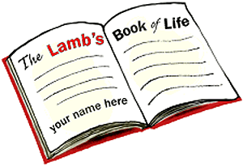
Conclusion
God knows the works (deeds) of His people!
Nehemiah 3 is a meticulous accounting of the people involved in the rebuilding of the walls – showed accountability, and may have slowed the work to take such a list.
Shows us God knows who is involved (Rechabites: Jer. 35:18-19; Neh. 3:14)!
Jesus “knows” the deeds of His saints, both good (Rev. 2:2: Ephesus, 19: Thyatira; 3:8: Philadelphia) and bad (Rev. 3:1: Sardis, 15: Laodicea)
Is your name recorded?
(Rev. 20:11-12)

Slide 17
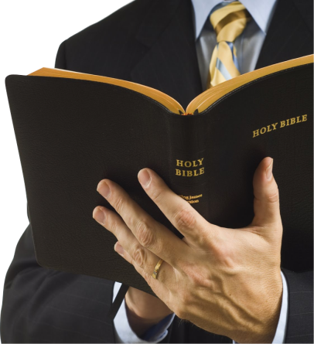
Conclusion
The wall of Jerusalem was built in 52 days (Neh. 6:15)
despite great opposition and adversity because
“the people had a mind to work!”
Col. 3:23-24
23. Whatever you do, do your work heartily, as for the Lord rather than for men,
24. knowing that from the Lord you will receive the reward of the inheritance. It is the Lord Christ whom you serve.
Great things can be accomplished by God’s people when
saints do their “work heartily, as for the Lord rather than
for men!”
Saints need to have “a mind to work!”

Slide 18
“What Must I Do To Be Saved?”
Hear The Gospel (Jn. 5:24; Rom. 10:17)
Believe In Christ (Jn. 3:16-18; Jn. 8:24)
Repent Of Sins (Lk. 13:35; Acts 2:38)
Confess Christ (Mt. 10:32; Rom. 10:10)
Be Baptized (Mk. 16:16; Acts 22:16)
Remain Faithful (Jn. 8:31; Rev. 2:10)
For The Erring Child:
Repent (Acts 8:22), Confess (I Jn. 1:9),
Pray (Acts 8:22)

