Slide 1
“Approved” For Eternal Life
Text: James 1:12; I Thess. 5:21
“Examine Everything Carefully”
(I Thessalonians 5:21)
“Examine yourselves!”
(II Corinthians 13:5)
Notes:
By Nathan L Morrison
All Scripture given is from NASB unless otherwise stated
For further study or if questions, Call: 804-277-1983, or Visit: www.courthousechurchofchrist.com

Slide 2
Intro
James 1:12
12. Blessed is a man who perseveres under trial; for once he has been approved, he will receive the crown of life which the Lord has promised to those who love Him.
I Thess. 5:21
21. But examine everything carefully; hold fast to that which is good;
Approved (Js. 1:12): dokimos [dok'-ee-mos] (G1384): tried, approved
Examine (I Thess. 5:21): dokimazo [dok-im-ad’-zo] (G1381)
From G1384; to test (literally or figuratively); to try, to examine, to prove, approve; having tested and tried, to show to be acceptable: - allow, discern, examine, (ap-) prove, try
Other uses of the word dokimazo
I Jn. 4:1: “Test the spirits.”
I Thess. 2:4: “…We have been approved (KJV: “allowed”)…we speak, not as pleasing men, but God who examines (KJV: “trieth”) our hearts.”
Phil. 1:9-10: “…That you may approve the things that are excellent.”
Notes:
Emphasis in Scripture mine!

Slide 3
Intro
We are to “examine everything carefully” so that we may
hold on to “that which is good!
We must “examine everything carefully” to be approved by God, and approved for eternal life!

Slide 4
Test Yourselves – To See If You Are In the Faith
II Cor. 13:5 (I Cor. 14:37-38)
5. Test yourselves to see if you are in the faith; examine yourselves! Or do you not recognize this about yourselves, that Jesus Christ is in you--unless indeed you fail the test?
Self-approval should only come when we are approved
according to God’s standards!
II Cor. 10:18: It is God who “commends” (approves).
We must examine
ourselves that we might
be approved by God!
Notes:
Emphasis in Scripture mine!

Slide 5
Prove the Sincerity of Your Love
II Cor. 8:8 (II Cor. 8:24)
8. I am not speaking this as a command, but as proving through the earnestness of others the sincerity of your love also.
Our love can and will be tested by others –
Do we mean what we say?
Our true (sincere) love will be shown in action
I Jn. 3:17-18: Love is seen in action toward others!
Jn. 14:15, 23: Love for Christ is seen in our obedience to His word!
II Tim. 2:15: Love of truth (word of God) is seen in how we study it!
Js. 1:12: Love for God is seen in how we endure for Him.
We must prove our love so that we will
be approved by God!
Notes:
Emphasis in Scripture mine!

Slide 6
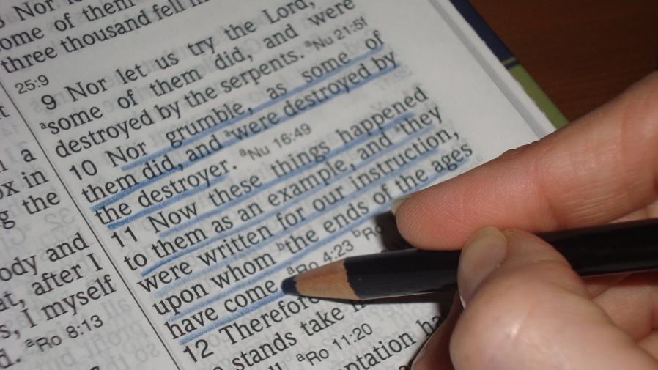
Prove What the Will of God Is
Rom. 12:2
2. And do not be conformed to this world, but be transformed by the renewing of your mind, so that you may prove what the will of God is, that which is good and acceptable and perfect.
We prove it by living it! (Action!)
Eph. 5:7-11: No longer of darkness, walk as lights! (Expose darkness)
Eph. 6:5-8: Whether slave or free, we must do the will of God from the heart!
II Cor. 6:14-18: “Come out from their midst and be separate.”
I Thess. 4:1-6: We need to live according to the will of God, which is sanctification – to be pure and unstained by the world
The way we live our lives
proves the will of God to the
world around us!
Notes:
Emphasis in Scripture mine!

Slide 7
Examine Your Own Work
Gal. 6:4
4. But each one must examine his own work, and then he will have reason for boasting in regard to himself alone, and not in regard to another.
This “examining” is done by measuring our selves (works)
by Christ’s words and examples
II Cor. 10:12: To be approved by God we must examine how we live by God’s word, not by others, else we will proved to be “unwise” (foolish).
Rom. 10:1-3: The Jews did not submit to God’s standard, but made their own
Examining our works will
tells us if our zeal is
according to God or from
ourselves!
Notes:
Emphasis in Scripture mine!

Slide 8
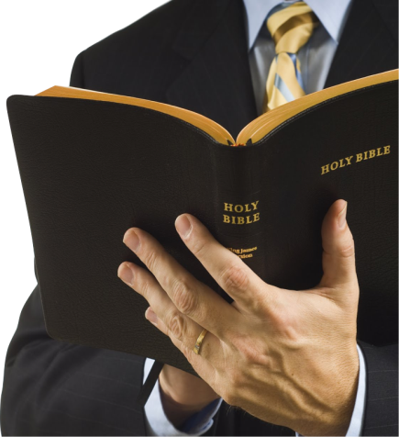
Proved In Order To Be Acceptable
Rom. 14:16-18
16. Therefore do not let what is for you a good thing be spoken of as evil;
17. for the kingdom of God is not eating and drinking, but righteousness and peace and joy in the Holy Spirit.
18. For he who in this way serves Christ is acceptable to God and approved by men.
Paul wrote to test (prove) the Corinthians!
II Cor. 2:9: Paul wanted to “test” their obedience
Paul tried to have “a blameless conscience both before
God and men” (Acts 24:16)
Our lives will be the proof of our faith: love and obedience to God and love for others!
Our lives and faith must be proved in
order to be acceptable to God!
Notes:
Emphasis in Scripture mine!

Slide 9
Conclusion
How will you stand the test when you are tried?
James 1:12
12. Blessed is a man who perseveres under trial; for once he has been approved, he will receive the crown of life which the Lord has promised to those who love Him.
After one has been “approved,” the
crown of life will be given!
“Approved” = dokimos [dok'-ee-mos] (G1384): From G1380; properly acceptable (current after assayal), that is, approved: - approved, tried.
Notes:
Emphasis in Scripture mine!

Slide 10
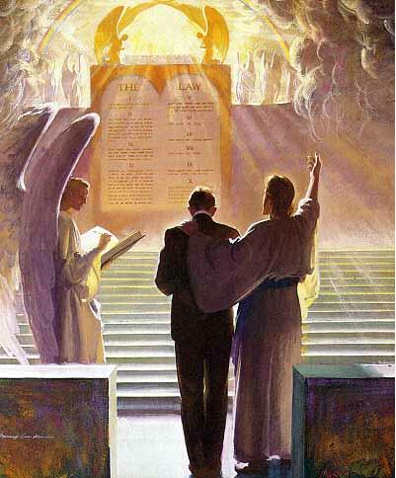
Conclusion
We know our works; others see the way we live our lives;
and God sees our hearts!
We are to “examine everything carefully”
because one day we will be examined by God!
(II Cor. 5:10)
Will we be approved for eternal life by God at the final
Examination?

Slide 11
“What Must I Do To Be Saved?”
Hear The Gospel (Jn. 5:24; Rom. 10:17)
Believe In Christ (Jn. 3:16-18; Jn. 8:24)
Repent Of Sins (Lk. 13:35; Acts 2:38)
Confess Christ (Mt. 10:32; Rom. 10:10)
Be Baptized (Mk. 16:16; Acts 22:16)
Remain Faithful (Jn. 8:31; Rev. 2:10)
For The Erring Child:
Repent (Acts 8:22), Confess (I Jn. 1:9),
Pray (Acts 8:22)

