Slide 1
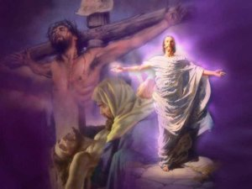
“One Day”
Text: I Cor. 15:1-4
Notes:
By Nathan L Morrison
All Scripture given is from NASB unless otherwise stated
For further study, or if questions, please Call: 804-277-1983 or Visit www.courthousechurchofchrist.com
Hymn:
“One Day” by J. Wilbur Chapman

Slide 2
Intro
I Cor. 15:1-4
1. Now I make known to you, brethren, the gospel which I preached to you, which also you received, in which also you stand,
2. by which also you are saved, if you hold fast the word which I preached to you, unless you believed in vain.
3. For I delivered to you as of first importance what I also received, that Christ died for our sins according to the Scriptures,
4. and that He was buried, and that He was raised on the third day according to the Scriptures,
I Cor. 15:16-19
16. For if the dead are not raised, not even Christ has been raised;
17. and if Christ has not been raised, your faith is worthless; you are still in your sins.
18. Then those also who have fallen asleep in Christ have perished.
19. If we have hoped in Christ in this life only, we are of all men most to be pitied.

Slide 3
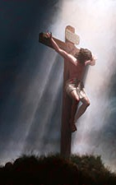
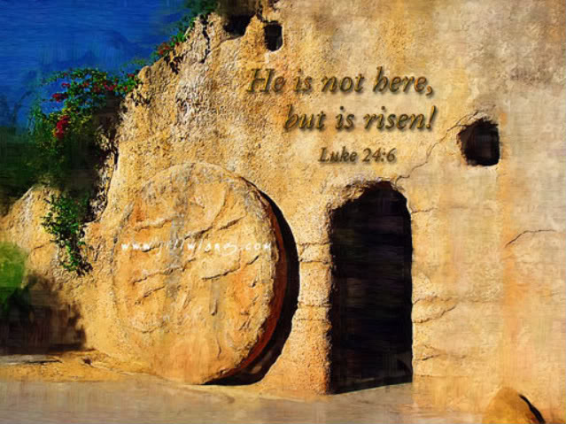
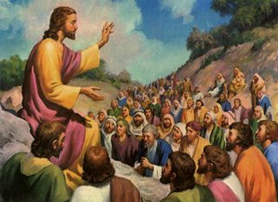
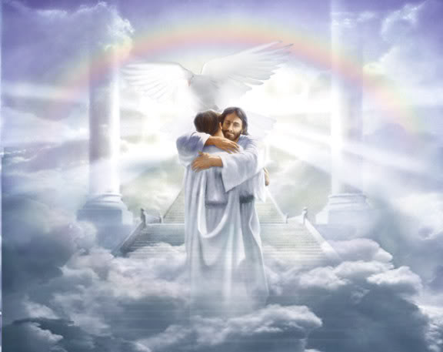
Intro
Jesus lived, died, was buried and arose, and promised to return to take His disciples home to Heaven!

Slide 4
One Day Jesus Lived As Our Example!
“One day when heaven was filled with His praises, One day when sin was as black as could be,
Jesus came forth to be born of a virgin: Dwelt among men, my example is He!”
The Scriptures say that Jesus would be born of a virgin: Mt. 1:22-23 (Is. 7:14); Gal. 4:4
As a human being, He dwelt among men: Phil. 2:5-9
The fact that Jesus was born of a woman and lived on earth made it possible for Him to be our perfect example: I Pet. 2:21 (Heb. 4:14-16)
I Pet. 2:21
21. For you have been called for this purpose, since Christ also suffered for you, leaving you an example for you to follow in His steps,
One day Jesus came as
the Creator among the
created and set the
example for godly living!

Slide 5
One Day Jesus Died On the Cross for Our Sins!
“One day they led Him up Calvary’s mountain; One day they nailed Him to die on the tree,
Suffering anguish, despised and rejected, Bearing my sins, my Redeemer is He!”
I Cor. 15:3
3. For I delivered to you as of first importance what I also received, that Christ died for our sins according to the Scriptures,
I Cor. 15:3:
Christ died for our sins ACCORDING to the Scriptures (Not by “accident”).
Paul explains the difference of the gospel from the Jewish expectation:
The Jews expected (wanted) the Messiah to establish an earthly, physical kingdom (Acts 1:6; Jn. 18:36)
The Scriptures never taught that, instead they taught a “suffering Savior” (Is. 53:11-12; Acts 3:18)
Jesus and the apostles taught that the Scriptures pointed to His death
(Lk. 24:44-46; I Pet. 1:10-12).

Slide 6
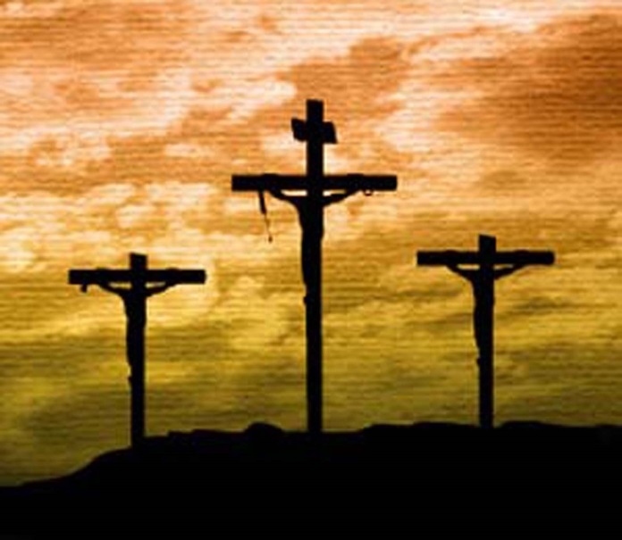
One Day Jesus Died On the Cross for Our Sins!
“One day they led Him up Calvary’s mountain; One day they nailed Him to die on the tree,
Suffering anguish, despised and rejected, Bearing my sins, my Redeemer is He!”
Jn. 19:17-18
17. They took Jesus, therefore, and He went out, bearing His own cross, to the place called the Place of a Skull, which is called in Hebrew, Golgotha.
18. There they crucified Him, and with Him two other men, one on either side, and Jesus in between.
Golgotha (Hebrew) & Calvary (Latin) = “The Skull”:
Lk. 23:33; Jn. 19:17-18: “There they crucified Him.”
Nailed to the cross
Jn. 20:25; Acts 2:23; Col. 2:14
He is our Redeemer
Rom. 3:24; Gal. 3:13; Eph. 1:7; 2:13-16
One day Jesus died to redeem mankind
from their sins & to reconcile us to God!

Slide 7
One Day Jesus Was Buried & Rose from the Dead!
“One day the grave could conceal Him no longer; One day the stone rolled away from the door.
Then He arose; over death He had conquered, Now is ascended, my Lord evermore!”
I Cor. 15:4
4. and that He was buried, and that He was raised on the third day according to the Scriptures,
I Cor. 15:4:
He was buried and rose on the third day ACCORDING to the Scriptures (Ps. 16:10; Mt. 12:40; Lk. 24:4-7, 44-46; Jn. 2:19-22).
Peter quoted from Ps. 16:10 in his sermon on Day of Pentecost (Acts 2:27).
Paul is strengthening their faith by stating these events were foretold in the Scriptures, and were revealed to him by Christ (I Cor. 15:3; Gal. 1:12).
Heb. 2:14-15: Jesus broke the power of death for everyone!
Original stanza 3: His burial in the tomb
“One day they left Him alone in the garden; One day He rested from suffering free. Angels came
down o'er His tomb to keep vigil; Hope of the hopeless, My Savior is He!”

Slide 8
One Day Jesus Was Buried & Rose from the Dead!
“One day the grave could conceal Him no longer; One day the stone rolled away from the door.
Then He arose; over death He had conquered, Now is ascended, my Lord evermore!”
The women were wondering who would roll away the
“extremely large” stone but found an angel had already
moved it
Mt. 28:1-4; Mk. 16:1-4; Lk. 24:1-3; Jn. 20:1
Following His resurrection, He ascended into heaven!
Acts 1:9-11
One day His resurrection from the
dead proved that He is both Lord
and Christ, the divine Son of God
and the Eternal Judge!
(Acts 2:36; Rom. 1:3-4; Acts 17:30-31)

Slide 9
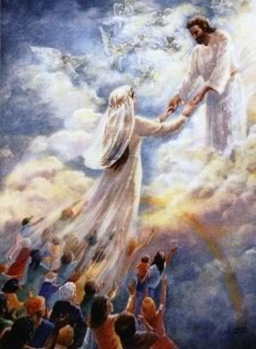
One Day Jesus Will Return to Take His Saints Home!
“One day the trumpet will sound for His coming; One day the skies with His glory will shine.
Wonderful day, my beloved ones bringing; Glorious Savior, this Jesus is mine!”
One day the trumpet will sound for His coming!
I Thess. 4:16-17
On that day, He will be glorified in His saints and be
marveled at by those who believe, and will raise the dead!
II Thess. 1:10; I Cor. 15:51-52
II Thess. 1:10
10. when He comes to be glorified in His saints on that day, and to be marveled at among all who have believed--for our testimony to you was believed.
One day the Lord will be revealed in His
fullness as our Savior (Rev. 1:7) because
He will be coming not in reference to sin
but for salvation! (Heb. 9:27-28)

Slide 10
Conclusion
“Living, He loved me; dying, He saved me; Buried, He carried my sins far away; Rising,
He justified, freely forever: One day He's coming--O glorious day!”
He came to earth because He loved us, He died & was
buried to save us & to take our sins away, He arose that
we might be justified, & He will return to take us home!
Rom. 6:8-13
8. Now if we have died with Christ, we believe that we shall also live with Him,
9. knowing that Christ, having been raised from the dead, is never to die again; death no longer is master over Him.
10. For the death that He died, He died to sin once for all; but the life that He lives, He lives to God.
11. Even so consider yourselves to be dead to sin, but alive to God in Christ Jesus.
12. Therefore do not let sin reign in your mortal body so that you obey its lusts,
13. and do not go on presenting the members of your body to sin as instruments of unrighteousness; but present yourselves to God as those alive from the dead, and your members as instruments of righteousness to God.

Slide 11
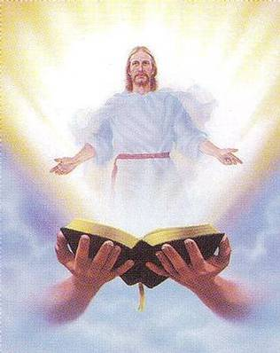
Conclusion
We can, and should, proclaim to the lost what Jesus has
done and will do for us “One Day!”

Slide 12
“What Must I Do To Be Saved?”
Hear The Gospel (Jn. 5:24; Rom. 10:17)
Believe In Christ (Jn. 3:16-18; Jn. 8:24)
Repent Of Sins (Lk. 13:35; Acts 2:38)
Confess Christ (Mt. 10:32; Rom. 10:10)
Be Baptized (Mk. 16:16; Acts 22:16)
Remain Faithful (Jn. 8:31; Rev. 2:10)
For The Erring Child:
Repent (Acts 8:22), Confess (I Jn. 1:9),
Pray (Acts 8:22)

