Slide 1
Eve: Mother Of All Living Text: Gen. 3:20
Godly Women Series Part 1
Notes:
By Nathan L Morrison
All Scripture given is from NASB unless otherwise stated
For further study, or if questions, please Call: 804-277-1983 or Visit www.courthousechurchofchrist.com

Slide 2
Intro
Rom. 15:4
4. For whatever was written in earlier times was written for our instruction, so that through perseverance and the encouragement of the Scriptures we might have hope.
Learn the lesson of Eve!
Eve is often remembered for her sin in failing to defeat
temptation
The story of Adam and Eve didn’t end in the Garden.
Eve showed faith after the Garden so can be an example of how to move on past sin.

Slide 3
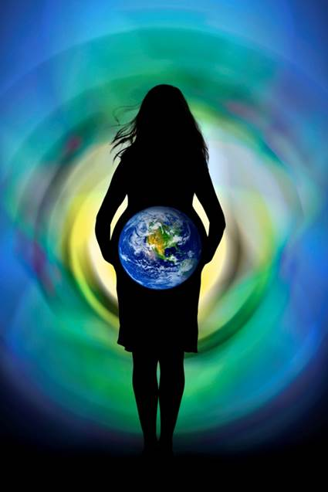
Intro
Gen. 3:20
20. Now the man called his wife's name Eve, because she was the mother of all the living.
Eve is called “the mother of all the living”
Eve: Chavvah (khav-vaw') H2332: “life-giver; Chavvah (or Eve), the first woman: - Eve.”
Her name means, “Life-Giver” so in that sense she is
the “Mother of all Living” for from her came life!
Eve is the “Mother of all the living” and
her example still affects us today!

Slide 4
Eve’s Creation
Gen. 2:18-25
18. Then the LORD God said, "It is not good for the man to be alone; I will make him a helper suitable for him."
19. Out of the ground the LORD God formed every beast of the field and every bird of the sky, and brought them to the man to see what he would call them; and whatever the man called a living creature, that was its name.
20. The man gave names to all the cattle, and to the birds of the sky, and to every beast of the field, but for Adam there was not found a helper suitable for him.
21. So the LORD God caused a deep sleep to fall upon the man, and he slept; then He took one of his ribs and closed up the flesh at that place.
22. The LORD God fashioned into a woman the rib which He had taken from the man, and brought her to the man.
23. The man said, "This is now bone of my bones, And flesh of my flesh; She shall be called Woman, Because she was taken out of Man."
24. For this reason a man shall leave his father and his mother, and be joined to his wife; and they shall become one flesh.
25. And the man and his wife were both naked and were not ashamed.

Slide 5
Eve’s Creation
Eve’s creation for Adam stands as testament against sins
of bestiality (Lev. 20:15-16) & homosexuality (Lev. 20:13;
Rom. 1:26-27) by men or women!
Gen. 1:26-28: Eve was given an honored position with Adam
Gen. 1:26: “Let them rule…”
Gen. 1:28: “God said to them, "…subdue it; and rule over…”

Slide 6
Eve’s Creation
Gen. 3:20: Adam named her “Eve” which means “Life-giver” (H2332)
As first woman, she is “the mother of all the living.”
Ever since, life has come from women!
Gal. 4:4-5
4. But when the fullness of the time came, God sent forth His Son, born of a woman, born under the Law,
5. so that He might redeem those who were under the Law, that we might receive the adoption as sons.
God gave to women the gift of bringing forth life;
Eve’s legacy is still felt today!

Slide 7
Eve’s Sin
Gen. 3:1-6: Eve’s temptation and sin
I John 2:15-17
15. Do not love the world nor the things in the world. If anyone loves the world, the love of the Father is not in him.
16. For all that is in the world, the lust of the flesh and the lust of the eyes and the boastful pride of life, is not from the Father, but is from the world.
17. The world is passing away, and also its lusts; but the one who does the will of God lives forever.
She gave in to three appeals – Gen. 3:6; Js. 1:14-15
Good food (I Jn. 2:16: Lust of the flesh)
Eye appeal (I Jn. 2:16; Lust of the eyes)
Desired wisdom (I Jn. 2:16: Boastful pride of life)

Slide 8
Eve’s Sin
Satan’s approach (Gen. 3:1-6)
Began by creating “innocent doubt,” “Has God said…?”
Two lies that still lure people away today:
“You will not get hurt.”
“You are cheating yourself out of the good life!”
He questioned God’s goodness – Gen. 3:4-5
He denied God’s word – Gen. 3:4
Once respect for God’s word is gone, temptation becomes more powerful and once we give in, we commit sin – Js. 1:14-17, 21
Eve was deceived by Satan – II Cor. 11:3
(II Cor. 10:3-5)

Slide 9
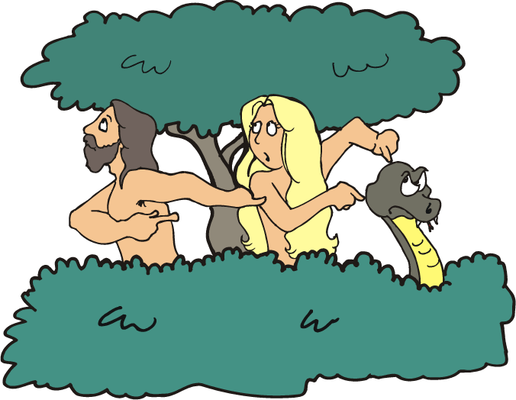
Eve’s Sin
Adam and Eve both sinned – Gen. 3:6
(Rom. 5:14-21: Paul mentions Adam for sin)
They both shifted blame – Gen. 3:11-13 (Adam was with her – didn’t stop her)
Gen. 3:11-13
11. And He said, "Who told you that you were naked? Have you eaten from the tree of which I commanded you not to eat?"
12. The man said, "The woman whom You gave to be with me, she gave me from the tree, and I ate."
13. Then the LORD God said to the woman, "What is this you have done?" And the woman said, "The serpent deceived me, and I ate."

Slide 10
Eve’s Sin
Adam and Eve both sinned – Gen. 3:6 (Rom. 5:14-21: Paul
mentions Adam for sin)
They both shifted blame – Gen. 3:11-13 (Adam was with her – didn’t stop her)
They both suffered the consequences – Gen. 3:16-17
Women would suffer pain in childbirth and are to be in subjection to their husbands – I Tim. 2:11-15
Men would have to work hard to eat – II Thess. 3:10
The consequences for Adam and
Eve’s sin are still felt today!

Slide 11
Eve’s Faith
There are many good things about Eve!
Gen. 3:20: She is the mother of all the living
From woman came the honor of giving life to the Light of the world! (Lk. 1:26-38; Jn. 8:12; Gal. 4:4)
Gen. 3:20
20. Now the man called his wife's name Eve, because she was the mother of all the living.
Gen. 4:1: Eve’s response to the birth of Cain
“I have gotten a manchild with the help of the Lord.” (Ps. 127:3)
She understood that the birth of a human child is the result of an act of God! (Not bitter towards God – gave glory and thanks to God!)
Gen. 4:1
1. Now the man had relations with his wife Eve, and she conceived and gave birth to Cain, and she said, "I have gotten a manchild with the help of the LORD."

Slide 12
Eve’s Faith
Gen. 4:25: Eve’s response to the birth of Seth
“God has appointed me another child in place of Abel, for Cain killed him.”
Rather than be bitter or angry at God for Abel’s death, she gave God glory!
Seth = Sheth (H8352): “appointed; substitute.” (Ps. 127:3)
Gen. 4:25
25. Adam had relations with his wife again; and she gave birth to a son, and named him Seth, for, she said, "God has appointed me another offspring in place of Abel, for Cain killed him."
Eve recognized the sanctity of life
(Her name: “Life-giver”) and that children
were gifts from God! (Gen. 5:4; Ps. 127:3-5)
If only more mothers today were like Eve in that respect!
Eve’s example is that one can move on
past sin and give glory & thanks to God!

Slide 13
Conclusion
Eve is an example still today:
To not be deceived one must hold fast to the word of God (Phil. 2:16; Gen. 3:2-3).
Once one has sinned, one must move past it and remain faithful to God (I Jn. 1:9).

Slide 14
Conclusion
We all feel the effects of the decisions made by Adam and
Eve, both good and bad
Making the best of the curse of Adam – Eccl. 3:12-13; 5:18-19: The fruits of our labor (our hard work) are our reward and is the “gift of God!”
Despite the pain of childbirth, children are gifts from God! – Ps. 127:3
Eccl. 3:12-13
12. I know that there is nothing better for them than to rejoice and to do good in one's lifetime;
13. moreover, that every man who eats and drinks sees good in all his labor--it is the gift of God.
Ps. 127:3
3. Behold, children are a gift of the LORD, The fruit of the womb is a reward.

Slide 15
Conclusion
What will be a lasting consequence of our actions?
Godly children?
Tarnished reputation?
Eternity with God?
Eternity with Satan?
Example of Eve: Avoid temptation (move on past sin) & give God the glory for all things He has blessed us with!

Slide 16
“What Must I Do To Be Saved?”
Hear The Gospel (Jn. 5:24; Rom. 10:17)
Believe In Christ (Jn. 3:16-18; Jn. 8:24)
Repent Of Sins (Lk. 13:35; Acts 2:38)
Confess Christ (Mt. 10:32; Rom. 10:10)
Be Baptized (Mk. 16:16; Acts 22:16)
Remain Faithful (Jn. 8:31; Rev. 2:10)
For The Erring Child of God:
Repent (Acts 8:22), Confess (I Jn. 1:9),
Pray (Acts 8:22)

