Slide 1

Pearl Of Great Price
Text: Mt. 13:44-46
Notes:
By Nathan L Morrison
All Scripture given is from NASB unless otherwise stated
For further study, or if questions, please Call: 804-277-1983 or Visit www.courthousechurchofchrist.com
Based on a lesson by Richard Thetford

Slide 2
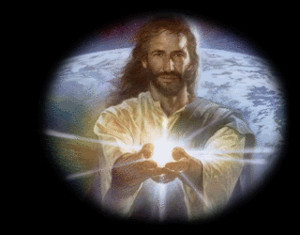
Intro
Mt. 13:44-46
44. "The kingdom of heaven is like a treasure hidden in the field, which a man found and hid again; and from joy over it he goes and sells all that he has and buys that field.
45. "Again, the kingdom of heaven is like a merchant seeking fine pearls,
46. and upon finding one pearl of great value, he went and sold all that he had and bought it.
We recognize treasure, and things of value in our own
lives and give up much to possess them

Slide 3
Intro
Do we recognize the treasure of the gospel and the church enough to prepare ourselves to give up all for it?
Jesus said to store up treasure in Heaven! (Mt. 6:19-21)
The church is the Pearl of Great Price
and is worth giving up all to
inherit Heaven!

Slide 4
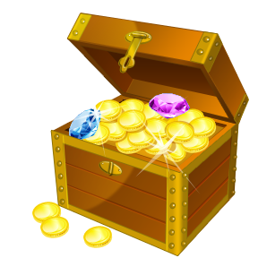
Paul’s Treasure
These parables describe the value of the kingdom to the
one who accidently finds it and for the one seeking it,
though he may not have known what he was seeking for
Salvation is precious, and identified as more valuable than anything we may own by those who discover it and take
possession of it!

Slide 5
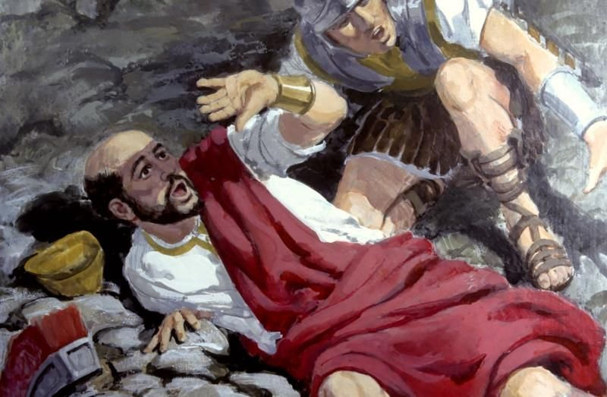
Paul’s Treasure
The apostle Paul discovered the treasure unexpectedly
while seeking something else!
Acts 9:1-2: On the road to Damascus to arrest Christians
Acts 26:9-11: He thought it was the right thing to do!
Acts 26:19-23: Once he met the Lord (Acts 22:16), he did not hesitate to carry out God’s will, even at great cost to him! (Acts 9:16)
Paul found the treasure that is salvation in Christ,
and was willing to give up everything for it!

Slide 6
What Paul Was Willing to Pay
Phil. 3:4-11
4. although I myself might have confidence even in the flesh. If anyone else has a mind to put confidence in the flesh, I far more:
5. circumcised the eighth day, of the nation of Israel, of the tribe of Benjamin, a Hebrew of Hebrews; as to the Law, a Pharisee;
6. as to zeal, a persecutor of the church; as to the righteousness which is in the Law, found blameless.
7. But whatever things were gain to me, those things I have counted as loss for the sake of Christ.
8. More than that, I count all things to be loss in view of the surpassing value of knowing Christ Jesus my Lord, for whom I have suffered the loss of all things, and count them but rubbish so that I may gain Christ,
9. and may be found in Him, not having a righteousness of my own derived from the Law, but that which is through faith in Christ, the righteousness which comes from God on the basis of faith,
10. that I may know Him and the power of His resurrection and the fellowship of His sufferings, being conformed to His death;
11. in order that I may attain to the resurrection from the dead.
Notes:
Emphasis in Scripture mine!

Slide 7
What Paul Was Willing to Pay
He “suffered the loss of all things”
to win Christ!
Notes:
Emphasis in Scripture mine!

Slide 8
What Paul Was Willing to Pay
II Cor. 4:7:
Writing of “the gospel of the glory of Christ” (4:4), Paul calls it “treasure.”
Col. 2:1-3
1. For I want you to know how great a struggle I have on your behalf and for those who are at Laodicea, and for all those who have not personally seen my face,
2. that their hearts may be encouraged, having been knit together in love, and attaining to all the wealth that comes from the full assurance of understanding, resulting in a true knowledge of God's mystery, that is, Christ Himself,
3. in whom are hidden all the treasures of wisdom and knowledge.
Paul considered Christ and His kingdom a “treasure” worth giving up all that one has, if necessary, to obtain!
Notes:
Emphasis in Scripture mine!

Slide 9
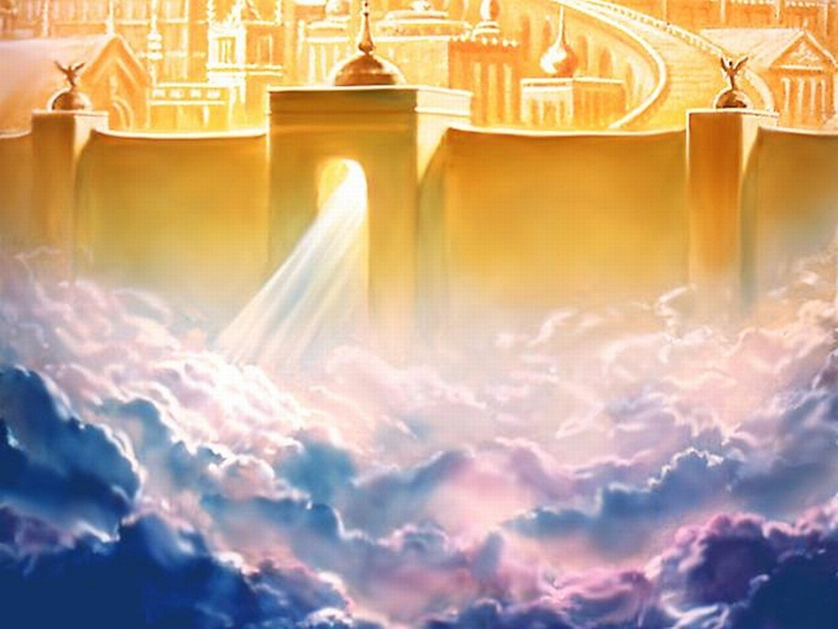
The Kingdom of Great Value
A Refuge from the Powers of Darkness
Col. 1:13-14
Outside the kingdom of God, one is in the kingdom of Satan – Eph. 2:1-3
The kingdom of God offers deliverance and refuge from the guilt and dominion of sin (Rom. 6:17-18, 22), and the outcome is eternal life!
Col. 1:13-14
13. For He rescued us from the domain of darkness, and transferred us to the kingdom of His beloved Son,
14. in whom we have redemption, the forgiveness of sins.

Slide 10
The Kingdom of Great Value
A Domain of Righteousness, Peace and Joy
Rom. 14:17
Righteousness through faith in Christ – Phil. 3:8-9
Peace from God (knowing our souls are secured) – Phil. 4:6-7
Joy in the Lord, no matter the circumstances – Phil. 4:4; 2:17-18
Rom. 14:17
17. for the kingdom of God is not eating and drinking, but righteousness and peace and joy in the Holy Spirit.

Slide 11
The Kingdom of Great Value
An Unshakeable Kingdom
Heb. 12:25-29
II Pet. 1:10-11: Saints are part of an “eternal kingdom” (I Pet. 1:4).
Heb. 12:27-29
27. This expression, "Yet once more," denotes the removing of those things which can be shaken, as of created things, so that those things which cannot be shaken may remain.
28. Therefore, since we receive a kingdom which cannot be shaken, let us show gratitude, by which we may offer to God an acceptable service with reverence and awe;
29. for our God is a consuming fire.

Slide 12

The Kingdom of Great Value
Destined for Eternal Glory
I Cor. 15:21-26
Mt. 13:41-43: At the Judgment Day the wicked will be punished, and “the righteous will shine forth as the sun in the kingdom of their Father.”
From that time forward, those in the kingdom will always be in the presence of God – I Thess. 4:17; Rev. 21:1-5, 9-12, 22-27
I Cor. 15:22-26
22. For as in Adam all die, so also in Christ all will be made alive.
23. But each in his own order: Christ the first fruits, after that those who are Christ's at His coming,
24. then comes the end, when He hands over the kingdom to the God and Father, when He has abolished all rule and all authority and power.
25. For He must reign until He has put all His enemies under His feet.
26. The last enemy that will be abolished is death.

Slide 13
The Kingdom of Great Value
A Refuge from the Powers of Darkness (Col. 1:13-14)
A Domain of Righteousness, Peace and Joy (Rom. 14:17)
An Unshakeable Kingdom (Heb. 12:25-29)
Destined for Eternal Glory (I Cor. 15:21-26)
The kingdom of God is worth any
price (sacrifice) we may have to
pay to obtain it!

Slide 14
Conclusion
What is the value of the kingdom?
If only we could ask…
Stephen, the first Christian martyr recorded – Acts 7
The early Christians who experienced persecution – Acts 8:1-4; Heb. 10:32-39
The apostle Paul, who suffered the loss of all things for Christ –
  II Tim. 3:10-11; 4:6-8
Our loved ones who died in Christ – Rev. 7:9-17
Our Lord Jesus, Who gave up all to make it happen – Phil. 2:5-8
They would all agree it is worth it all!

Slide 15
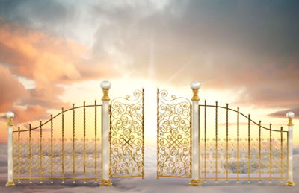
Conclusion
How about us? Where is your treasure? (Mt. 6:19-21)
Are we willing to pay the full price to obtain the
“treasure” of the kingdom?
Our time, our priorities, our pride, our repentance, our lives, if necessary?
Our response to the gospel and the way we live our lives demonstrates our true estimation of the “treasure” of the kingdom!
Are you willing to pay the price
for the eternal kingdom
of Christ?

Slide 16
“What Must I Do To Be Saved?”
Hear The Gospel (Jn. 5:24; Rom. 10:17)
Believe In Christ (Jn. 3:16-18; Jn. 8:24)
Repent Of Sins (Lk. 13:35; Acts 2:38)
Confess Christ (Mt. 10:32; Rom. 10:10)
Be Baptized (Mk. 16:16; Acts 22:16)
Remain Faithful (Jn. 8:31; Rev. 2:10)
For The Erring Child:
Repent (Acts 8:22), Confess (I Jn. 1:9),
Pray (Acts 8:22)

