Slide 1
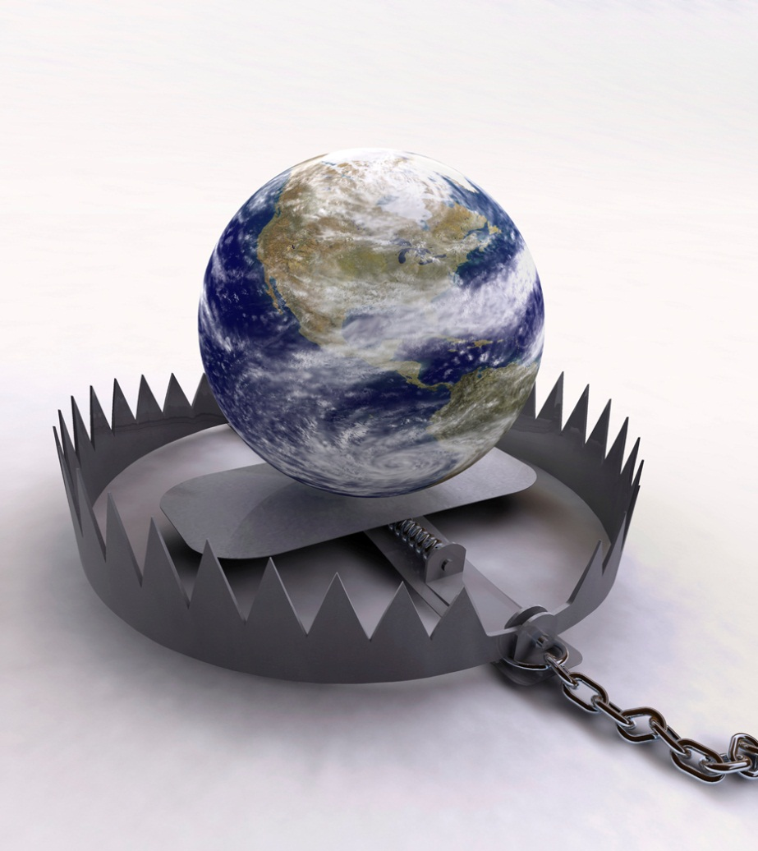
Escaping The Snare Of Satan
Text: II Tim. 2:26
Notes:
By Nathan L Morrison
All Scripture given is from NASB unless otherwise stated
For further study, or if questions, please Call: 804-277-1983 or Visit www.courthousechurchofchrist.com

Slide 2
Intro
Some people after hearing the gospel and counting the
cost of becoming a Christian, reject it and choose their
own way instead
People have done that since the early days of the
gospel!
Acts 17:32: The Athenians – “We shall hear you again concerning this.”
Acts 24:25: Felix – “Go away for the present, and when I find time I will summon you.”
Acts 26:28: King Agrippa – “In a short time you will persuade me to become a Christian.”

Slide 3

Intro
II Tim. 2:24-26 (Jn. 8:31-32)
24. The Lord's bond-servant must not be quarrelsome, but be kind to all, able to teach, patient when wronged,
25. with gentleness correcting those who are in opposition, if perhaps God may grant them repentance leading to the knowledge of the truth,
26. and they may come to their senses and escape from the snare of the devil, having been held captive by him to do his will.
If one is to come to his senses, or to escape, it means
what he was doing before was wrong, or not working –
being held captive by Satan to do his will!
Obeying the gospel, or coming back to
God, is to escape Satan’s snare!

Slide 4

Coming to the Senses
One who “comes to their senses” is one who formerly
chose to be dominated by the devil!
II Tim. 2:26
26. and they may come to their senses and escape from the snare of the devil, having been held captive by him to do his will.
Eph. 4:17-19: The devil uses ignorance to deceive minds!
I Pet. 1:14
14. As obedient children, do not be conformed to the former lusts which were yours in your ignorance,
Eccl. 8:11: Sin deceives one into thinking that there are no
consequences to sinful living! (II Thess. 2:8-10)
Coming to the senses is to no longer let Satan control your life!
Notes:
Emphasis in Scripture mine!

Slide 5
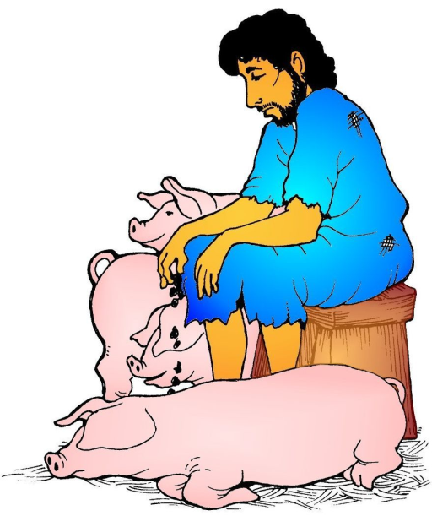
Escaping the Snare of the Devil
Lk. 15:11-32: Jesus told the story of the “prodigal son”
The prodigal son was not with his senses (in his right
mind) when he:
Demanded his inheritance while his father was yet living. (Lk. 15:12)
Went into a foreign country. (Lk. 15:13)
Squandered his inheritance “with loose living.” (Lk. 15:13)
Lk. 15:17
17. "But when he came to his senses, he said, 'How many of my father's hired men have more than enough bread, but I am dying here with hunger!
Where was he when he “came to his
senses?”
Lk. 15:13-14: Far away from his father. Poor & hungry. No friends – alone!
Lk. 15:16: In the fields feeding swine and wishing he could eat as good as they!
Notes:
Emphasis in Scripture mine!

Slide 6
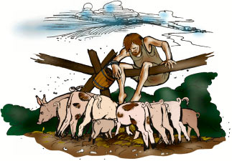
Escaping the Snare of the Devil
He took stock of his life – recognized his miserable state:
The pigs were eating better than he was! (Lk. 15:16)
His father’s hired help were fed better than he was. (Lk. 15:17)
He realized how good a life he had left behind to follow his own will!
He had to humble his heart in subjection to his father’s will, and not his own – “Father, I have sinned against heaven, and in your sight; I am no longer worthy to be called your son; make me as one of your hired men." (Vss. 18-19)
When he submitted himself under the will of his father,
Satan was subdued, and he escaped from his snare!
Lk. 15:16
16. "And he would have gladly filled his stomach with the pods that the swine were eating, and no one was giving anything to him.

Slide 7
Escaping the Snare of the Devil
The parallel is when we submit to God, we escape the
snares of Satan!
Mt. 26:39: Jesus, our example, submitted His will to God the Father’s.
Prov. 3:7: “Do not be wise in your own eyes; Fear the LORD and turn away from evil.”
Js. 4:6-8: When we submit to God, and draw near to Him, we can resist the devil and he will flee from us! (I Cor. 10:13)
I Pet. 5:9 (Eph. 6:11)
9. But resist him, firm in your faith, knowing that the same experiences of suffering are being accomplished by your brethren who are in the world.
He escaped his old life (his miserable state)
because he came to his senses!

Slide 8
Held Captive
II Tim. 2:26: Those who do not escape are still held
captive to do Satan’s will!
Rom. 6:20-21
20. For when you were slaves of sin, you were free in regard to righteousness.
21. Therefore what benefit were you then deriving from the things of which you are now ashamed? For the outcome of those things is death.
People may destroy their health/bodies by:
Alcohol
Drugs
Sexual immorality
Greed may cause one to:
Steal (Embezzle)
Lie
Abuse the helpless
Commit murder (Js. 4:2)

Slide 9
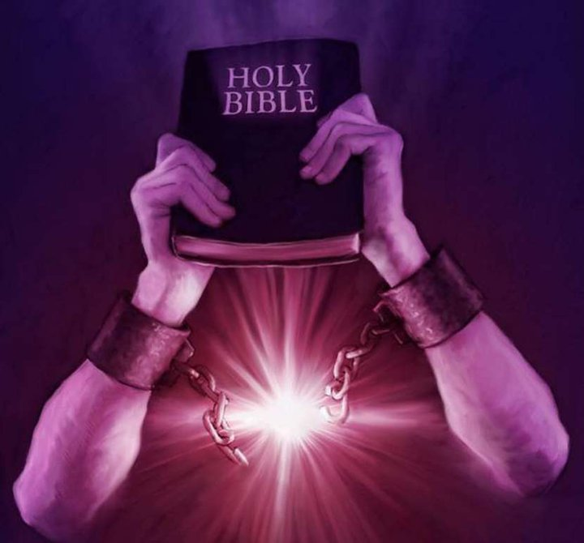

Held Captive
One may be so attached to the here and now that they:
Heb. 2:1-3: Neglect their own salvation (II Pet. 3:9; Mk. 16:16)
Rev. 2:5: Neglect being restored to their “first love.”
II Pet. 1:5-11: Neglect the “Christian virtues” which allows entrance to the kingdom of God. (Vss. 10-11)
One must come to their senses to obey the gospel or
repent, and doing so allows one to escape the
snares of the devil!

Slide 10

Conclusion
People who “come to their senses” make preparation for
eternity! (Mt. 7:13-14)
Mk. 5:15: Jesus and His Word can put a person in his/her
“right mind”
The demon-possessed man was insane and caused himself harm (Mk. 5:5)
Once the demon was cast out, he was in his right mind (Mk. 5:15)
So it is for the one who no longer lets Satan control him/her!
All comes down to choice!
Rom. 6:16, 20: Slave to sin = Death!
Rom. 6:17-19, 22: Slave to righteousness = Life!

Slide 11

Conclusion
Rom. 6:23
23. For the wages of sin is death, but the free gift of God is eternal life in Christ Jesus our Lord.
Escape the snares of Satan and choose life
instead of death!
Come to your senses and escape
the snare of Satan!

Slide 12
“What Must I Do To Be Saved?”
Hear The Gospel (Jn. 5:24; Rom. 10:17)
Believe In Christ (Jn. 3:16-18; Jn. 8:24)
Repent Of Sins (Lk. 13:35; Acts 2:38)
Confess Christ (Mt. 10:32; Rom. 10:10)
Be Baptized (Mk. 16:16; Acts 22:16)
Remain Faithful (Jn. 8:31; Rev. 2:10)
For The Erring Child:
Repent (Acts 8:22), Confess (I Jn. 1:9),
Pray (Acts 8:22)

