Slide 1
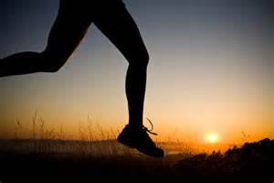
Pursue Righteousness Text: I Timothy 6:9-12
Notes:
By Nathan L Morrison
All Scripture given from NASB unless otherwise stated
For further study, or if questions, please Call: 804-277-1983 or Visit: www.courthousechurchofchrist.com

Slide 2
Intro
No matter what the world around us does saints should be striving daily to flee certain things and pursue after righteousness!
I Tim. 6:6-8: There is great gain found in contentment!

Slide 3
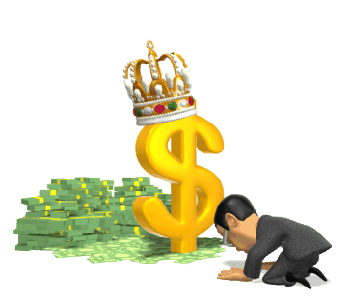
Intro
I Tim. 6:9-10
9. But those who want to get rich fall into temptation and a snare and many foolish and harmful desires which plunge men into ruin and destruction.
10. For the love of money is a root of all sorts of evil, and some by longing for it have wandered away from the faith and pierced themselves with many griefs.
Many people look to the material things of the world to
seek “great gain”

Slide 4
Intro
I Tim. 6:11-12
11. But flee from these things, you man of God, and pursue righteousness, godliness, faith, love, perseverance and gentleness.
12. Fight the good fight of faith; take hold of the eternal life to which you were called, and you made the good confession in the presence of many witnesses.
Where is great gain attained?
In the pursuit of righteousness! The saint must:
Flee (Vs. 11)
Pursue (Vs. 11)
Fight (Vs. 12)
There is great gain to be had in the pursuit of righteousness!

Slide 5
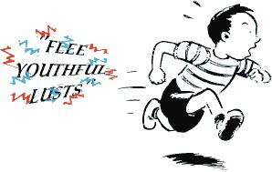
Flee
I Tim. 6:9-10: Christians are to flee (I Tim. 6:11) certain things:
Flee from the snare of the love of money
Flee from harmful desires
Flee from plunging into ruin and destruction
It is no sign of weakness to run from danger, when that
danger can destroy our souls! (Mt. 16:26)
Flee from temptation so we do not fall into sin!
II Tim. 2:22: “Flee from youthful lusts”
(Heb. 13:4)
I Cor. 10:13: We will not be tempted above
and beyond what we can handle, so that means
there is an escape, and we must take it!

Slide 6
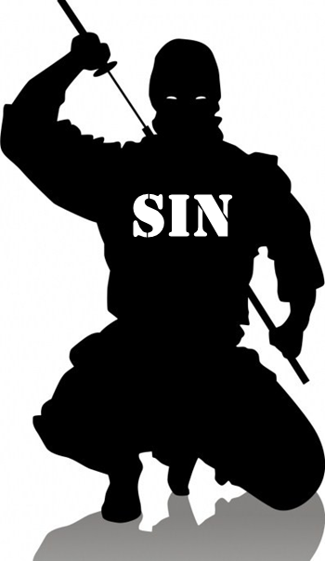
Flee
There is danger in not fleeing from temptation and lust:
Js. 1:14-15: Lust (not checked) turns into sin, which brings forth death.
Spiritual L.S.D., which can eternally destroy a soul if not repented for.
Sin crouching at the door! (Gen. 4:7)
Ruin, not “great gain,” comes to those who
do not flee from sin!

Slide 7
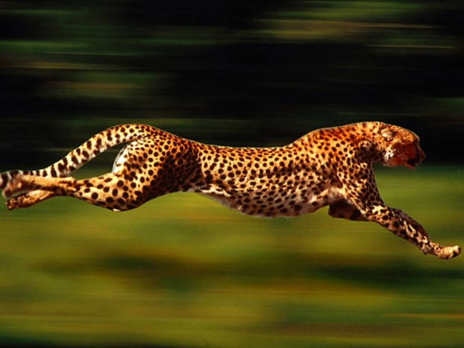
Pursue
I Tim. 6:11
11. But flee from these things, you man of God, and pursue righteousness, godliness, faith, love, perseverance and gentleness.
There are certain things in God’s word we should be
following after:
After righteousness:
Rom. 6:16: We are to be obedient to it to become slaves to it.
Mt. 6:33: We are to “seek after” it!
After godliness:
Tit. 2:11-12: This is to be like God (Eph. 5:1: “Imitate God”).
In “godliness” comes “great gain” (I Tim. 6:6) with contentment.

Slide 8
Pursue
I Tim. 6:11
11. But flee from these things, you man of God, and pursue righteousness, godliness, faith, love, perseverance and gentleness.
There are certain things in God’s word we should be
following after:
After faith:
I Jn. 5:4: Faith is behind everything and overcomes the world!
Eph. 6:16: To have faith as a shield will defeat Satan.
After love:
Gal. 5:6: We show how faith ought to work!
II Jn. 6: We show God our love when we obey Him.
Col. 3:14: Love is the bond that unites us and holds it all together.

Slide 9
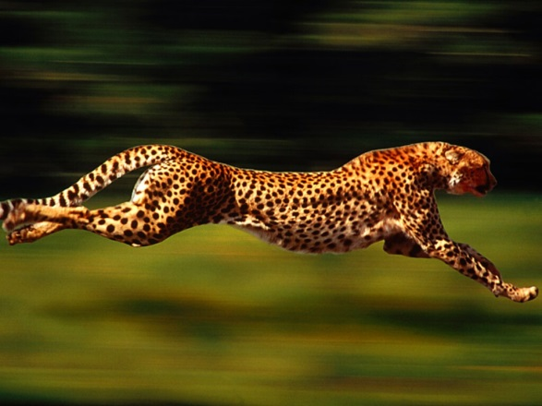
Pursue
I Tim. 6:11
11. But flee from these things, you man of God, and pursue righteousness, godliness, faith, love, perseverance and gentleness.
There are certain things in God’s word we should be
following after:
After perseverance:
Heb. 12:1; Js. 1:2-7: It is endurance to finish the course.
Heb. 10:35-36: The “great reward” comes to those with endurance!
After gentleness (II Tim. 2:24-26):
Gal. 5:22-23: This involves the right kind of attitude.
These things are part of living “by the
Spirit” (Gal. 5:25) and we ought to
pursue them!

Slide 10
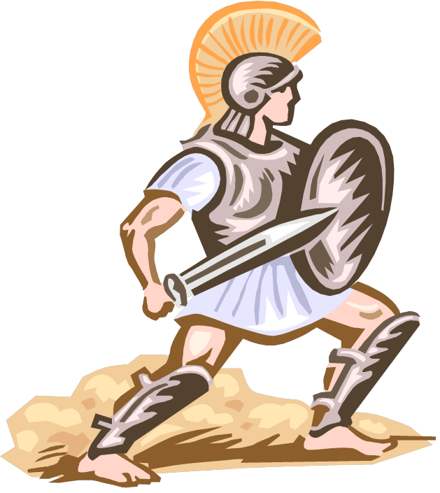
fight
I Tim. 6:12
12. Fight the good fight of faith; take hold of the eternal life to which you were called, and you made the good confession in the presence of many witnesses.
We cannot run away from every confrontation:
Js. 4:7: Life is a battle against the enemy.
I Pet. 5:8-9: “Resist,” “Firm in your faith.”
Heb. 10:39:
We must have the endurance to “not shrink back” but “have faith to the preserving of the soul” no matter life’s adversities
Jude 3:
We are to “contend earnestly for the faith.
I Tim. 1:18-19: To fight the good fight of faith one must have a “good conscience.”

Slide 11
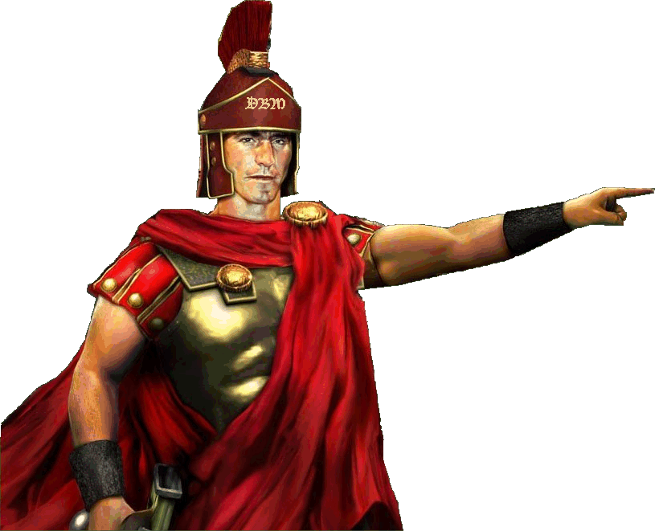
fight
I Tim. 6:12
12. Fight the good fight of faith; take hold of the eternal life to which you were called, and you made the good confession in the presence of many witnesses.
“Contending earnestly for the faith” includes pointing out
error and correcting it:
I Tim. 4:6: Pointing out the things in Vss. 1-5.
II Tim. 1:7: God has granted to us power, love, and discipline.
II Tim. 4:1-5: Charged with not compromising with error, but to stand against it.
Fight for the faith so you can
“take hold” of eternal life, and
truly have “great gain!”

Slide 12
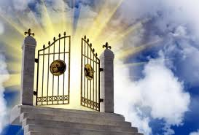
conclusion
To truly have “great gain” the Christian is to flee lusts,
pursue righteousness, and fight for faith:
I Tim. 6:12: Eternal life is the result.
To take hold of eternal life, one must fight the good fight of faith!
To be rewarded with eternal life is to truly have
“great gain”! (I Tim. 6:6)

Slide 13
conclusion
There are those who are rich in the world but poor in God:
Rev. 3:17: In Laodicea the church was materially rich and they thought they had everything they needed.
Jesus said: They were “wretched and miserable and poor and blind and naked.”
God said they needed to be zealous and repent (Rev. 3:19).
There are those who are poor to the world’s standards but
rich in God!
Rev. 2:9: The church at Smyrna was poor materially, but their faith and perseverance made them rich to God.
Their reward for remaining faithful: The crown of life (Rev. 2:10)

Slide 14
Conclusion
In the pursuit of righteousness is found “great gain”: Eternal life!
What are your pursuits?
Will they make you rich or poor in the eyes of God?!

Slide 15
“What Must I Do To Be Saved?”
Hear The Gospel (Jn. 5:24; Rom. 10:17)
Believe In Christ (Jn. 3:16-18; Jn. 8:24)
Repent Of Sins (Lk. 13:35; Acts 2:38)
Confess Christ (Mt. 10:32; Rom. 10:10)
Be Baptized (Mk. 16:16; Acts 22:16)
Remain Faithful (Jn. 8:31; Rev. 2:10)
For The Erring Child:
Repent (Acts 8:22), Confess (I Jn. 1:9),
Pray (Acts 8:22)

