Slide 1
Child Of God OR Child Of Satan?
Text: Jn. 8:44
Notes:
By Nathan L Morrison
All Scripture given is from NASB unless otherwise stated
For further study, or if questions, please Call: 804-277-1983 or Visit: www.courthousechurchofchrist.com
Based on a lesson by Ron Halbrook

Slide 2
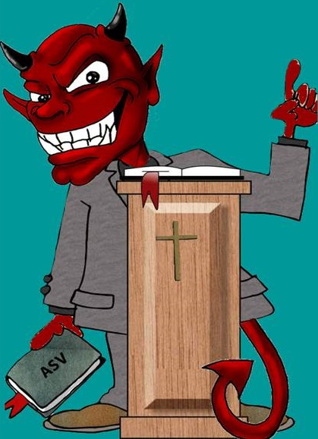
Intro
Who is Satan?
Leader of angels who sinned!
Mt. 25:41
41. "Then He will also say to those on His left, 'Depart from Me, accursed ones, into the eternal fire which has been prepared for the devil and his angels;
II Pet. 2:4
4. For if God did not spare angels when they sinned, but cast them into hell and committed them to pits of darkness, reserved for judgment;

Slide 3
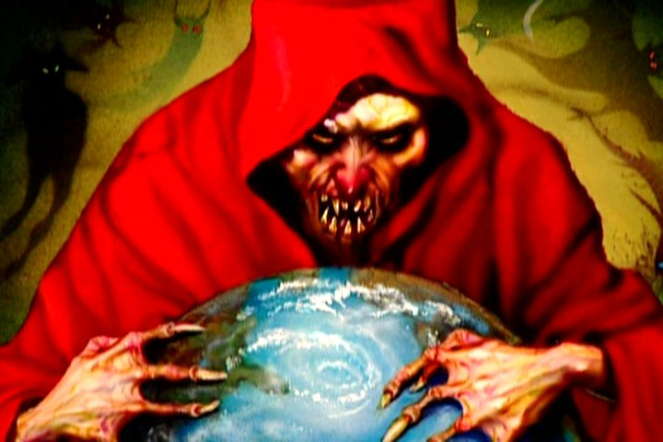
Intro
Satan’s character:
The Author of Sin – Gen. 3:1-6
Satan, Adversary, Enemy – Rev. 12:9
Devil, Accuser, Slanderer – Rev. 12:9
Beelzebub, Prince of Demons – Mt. 12:24
Prince of the Powers of the Air – Eph. 2:2; 6:12
The Great Dragon – Rev. 12:9
That Old Serpent – Rev. 12:9
The Father of Lies – Jn. 8:44
A Murderer – Jn. 8:44
The Wicked One – Mt. 13:38
Belial: Extremely Wicked, Stubborn, Destined for Ruin – II Cor. 6:15
The god of This World – II Cor. 4:4
Ruler or Prince Over This World’s Sin & Darkness – Jn. 12:31; Eph. 6:12
Deceives the Whole World – Rev. 12:9
The Tempter – I Thess. 3:5
The Enemy – Mt. 13:39
A Roaring Lion – I Pet. 5:8

Slide 4
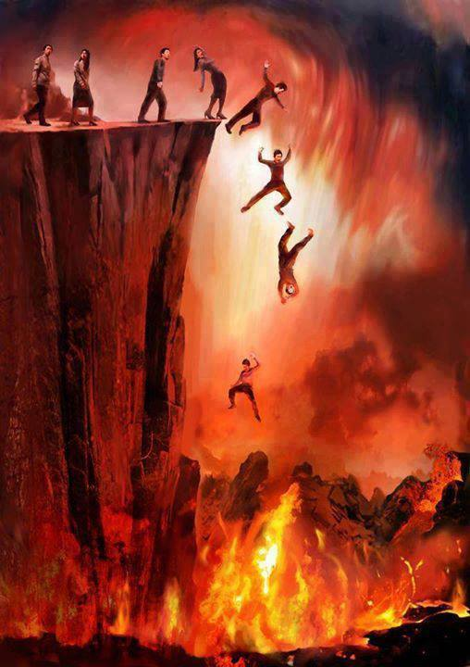
Intro
The children of Satan are all who follow him in sin
Jn. 8:38-47: Spiritual Genealogy & Lineage: Do you do the will of God OR of Satan?
Mt. 25:41: If you follow Satan, you will be cast into eternal fire with him!

Slide 5
Intro: Child of Satan and the Child of God
Child of Satan
Child of God
Jn. 8:41-47
Jn. 1:9-13
Mt. 6:24
Are you a child of Satan OR
a child of God?

Slide 6
Contrast Satan and His Children to God and His Children
Trait | Father Satan | Satan’s Children | Trait | Father God | God’s Children
Liar, Deceiver
Jn. 8:44; Rev. 12:9
Jn. 8:44; Rev. 21:8
Honest
Titus 1:1-2; Heb. 6:18
Eph. 4:15, 25; Col. 3:9
Murderer
Jn. 8:44
Jn. 8:44; Rom. 1:29; Mt. 5:21-22
Saves Life
Jn. 3:16; 10:10;
I Pet. 3:9
II Cor. 5:11;
II Tim. 2:24-26
Rebel Against God
II Pet. 2:4; Gen. 3:1-6
Rom. 3:23; Acts 13:7-10
Faithful
II Tim. 2:13; I Jn. 1:9
Rev. 2:10; II Tim. 4:7-8
Destroyer
I Pet. 5:8
Mt. 18:6; Jude 8
Edifier
Js. 4:8,10; Eph. 2:19-22
Eph. 4:29;
I Thess. 5:11
Thief
Mt. 13:19
I Cor. 6:9-10; I Pet. 4:15
Share
Jn. 10:10; Col. 1:12
Gal. 6:6; Eph. 4:28

Slide 7
Contrast Satan and His Children to God and His Children
Trait | Father Satan | Satan’s Children | Trait | Father God | God’s Children
Love Darkness & Sin
Jn. 3:19-21; Rom. 1:29-32
Love Light & Obedience
Js. 1:17; Phil. 2:8
Col. 1:13
Jn. 3:21; Mt. 5:16
Hate, Bitterness
Jn. 8:44; I Pet. 5:8
Rom. 1:30; Gal. 5:19-21; Col. 3:8
Love, Forgiveness
Jn. 3:16; I Jn. 1:9
Jn. 13:35; Eph. 4:32; Col. 3:13
False Religion
II Cor. 11:13-15; Eph. 4:14
Sound Doctrine
Eph. 4:14-16; I Tim. 4:6; Titus 2:1
II Cor. 11:14
Jn. 17:17; I Thess. 1:9-10
Bound
Rev. 1:18; 20:1-2
II Pet. 2:9, 19
Free
Acts 17:31;
I Pet. 4:4-6
Jn. 8:31;
Gal. 5:1, 13
Defeated
Rev. 1:18; 20:10
Mt. 25:41; Rev. 21:8
Exalted
Ps. 57:5; Is. 57:15; Js. 1:17
Mt. 25:34; Js. 4:10;
I Pet. 5:6

Slide 8
Conclusion
If one follows the way of sin then Satan (NOT God) is their father!
I Jn. 3:4-10 (3:4, 7-8, 10)
4. Everyone who practices sin also practices lawlessness; and sin is lawlessness.
7. Little children, make sure no one deceives you; the one who practices righteousness is righteous, just as He is righteous;
8. the one who practices sin is of the devil; for the devil has sinned from the beginning. The Son of God appeared for this purpose, to destroy the works of the devil.
10. By this the children of God and the children of the devil are obvious: anyone who does not practice righteousness is not of God, nor the one who does not love his brother.

Slide 9
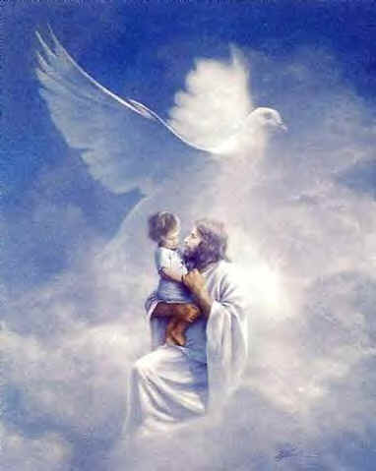
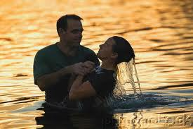
Conclusion
If one obeys the gospel they change their father from Satan to God!
Col. 1:13
13. For He rescued us from the domain of darkness, and transferred us to the kingdom of His beloved Son,
II Cor. 6:2
2. for He says, "AT THE ACCEPTABLE TIME I LISTENED TO YOU, AND ON THE DAY OF SALVATION I HELPED YOU." Behold, now is "THE ACCEPTABLE TIME," behold, now is "THE DAY OF SALVATION"--

Slide 10
Conclusion
Child of Satan
Child of God
Mt. 25:41, 46
Mt. 25:34, 46
The child of Satan will inherit an eternal fire, which is eternal punishment (Mt. 25:41, 46), but the child of God inherits eternal rest (Mt. 25:34, 46)!

Slide 11
Conclusion
Are you a child of Satan OR a child of God?
Child of Satan
Child of God
Mt. 25:41, 46
Mt. 25:34, 46
Obedience!

Slide 12
“What Must I Do To Be Saved?”
Hear The Gospel (Jn. 5:24; Rom. 10:17)
Believe In Christ (Jn. 3:16-18; Jn. 8:24)
Repent Of Sins (Lk. 13:35; Acts 2:38)
Confess Christ (Mt. 10:32; Rom. 10:10)
Be Baptized (Mk. 16:16; Acts 22:16)
Remain Faithful (Jn. 8:31; Rev. 2:10)
For The Erring Child:
Repent (Acts 8:22), Confess (I Jn. 1:9),
Pray (Acts 8:22)

