Slide 1
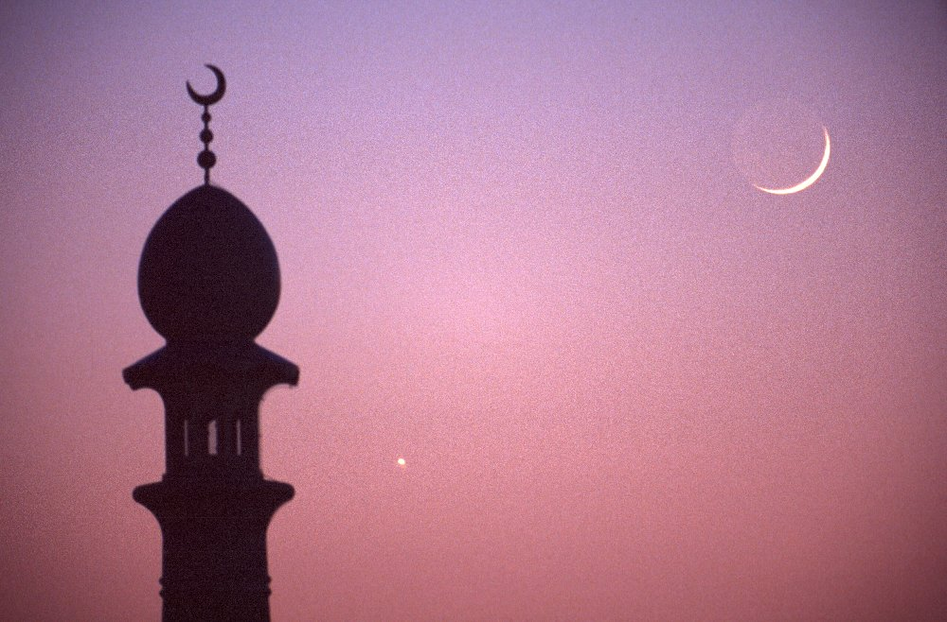
The Islamic Dilemma Text: Gal. 1:6-9; I Jn. 4:1
Notes:
By Nathan L Morrison for Sunday 08/26/2018
All Scripture given is from NASB unless otherwise stated
For further study, or if questions, please Call: 804-277-1983 or Visit: www.courthousechurchofchrist.com
Many sources referenced and used

Slide 2
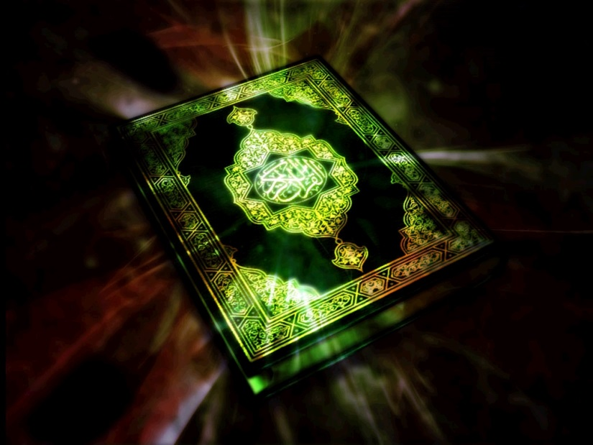
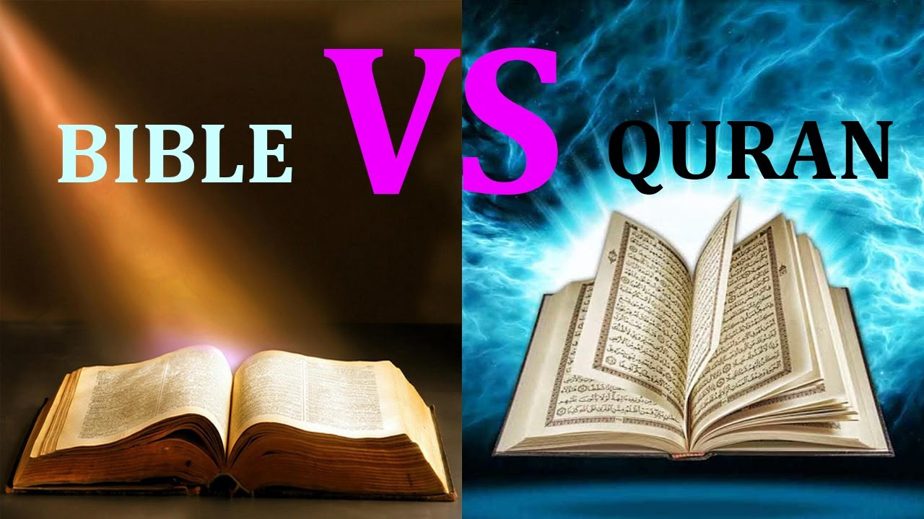
Intro
Islam teaches Muslims to believe that the Bible was the
true Word of God at some time in the past but was later
altered and corrupted
The Old Law (Torah) came by prophets, but Jews corrupted it—it’s unreliable
The Gospel came by Jesus, but Christians corrupted it—it’s unreliable
The Qur’an came by Mohammed, written down in his lifetime but compiled together 70-200 years after his death; unchangeable, not corrupted—it’s reliable
When the Qur’an and the Bible differ, the Qur’an is always right!
WHO CAN BELIEVE IT?

Slide 3
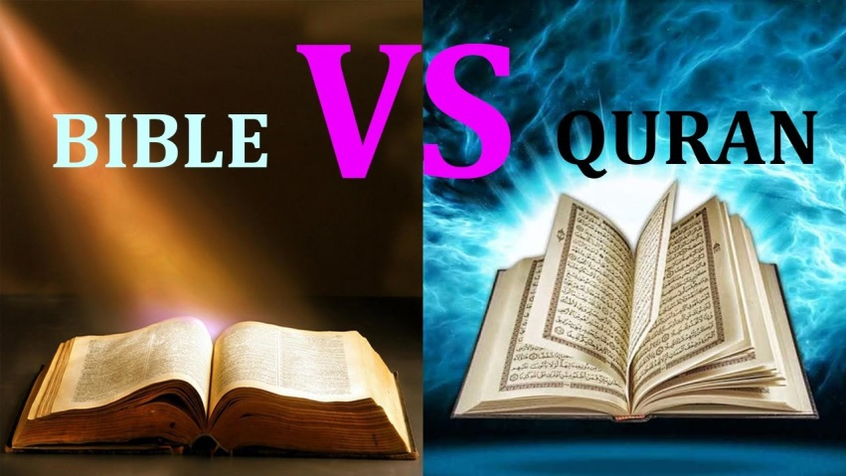
Intro
If the Bible was changed as Muslims believe, then Muslims
must also believe that an all-knowing and all-powerful
god was unable to protect his own word from corruption
Muhammad claimed Allah is the God of the O.T. & N.T. and that both are true, and that Muslims are to read and know them! (Suras 5:68; 29:46)
Yet, according to the Qur’an itself, “none can change his
words: for he is the one who heareth and knoweth all”
(Sura 6:115-116)
If the Bible was the true word of God (Allah) at some time in the past, and if “none can change his words” as the Qur’an claims, then by logical extension the Bible either remains his word today, or the Qur’an is wrong!
Which is it?

Slide 4
The Gospels Are Authoritative
Muslims are told to say to Christians
“We believe in the revelation which has come down to us and in that which came down to you. Our God and your God is one. To him we submit.”
(Sura 49:26)
Many Muslims today say something different,
“We don’t believe in your book because it has been corrupted, and your God is a false god.”
If Muslims are commanded to say they believe in what
has been revealed to Christians, then why do they instead
say they don’t believe in the Bible, the only revelation we
have?
If Muslims are commanded to say their god and our God
is One, why do they instead say that our God is
a false god?
Notes:
Sources:
Islamic Dilemma video:
• http://www.answeringmuslims.com/2014/09/the-quran-bible-and-islamic-dilemma.html
• http://www.answeringmuslims.com/search/label/Islamic%20Dilemma
• The Qur'an, the Bible, and the Islamic Dilemma Video: https://www.youtube.com/watch?v=nNAS0aaViM4
Quotes from the Qur’an:
• From a 1995 Revised Edition (Unless otherwise stated) with Arabic text, English translation and Commentary provided by Maulana Muhammad Ali
• Sahih International Qur’an
• http://quran.com

Slide 5
The Gospels Are Authoritative
God is a triune-God (Mt. 28:18-20; Lk. 3:22), one God in
nature or essence but 3 in person:
Father – Jn. 8:42
Son – Jn. 1:1-15; Titus 2:13-14
Jesus came in the flesh, fully man & fully God – Jn. 1:1-14; Phil. 2:5-8
Jesus died on the cross for sins of the world – (All 4 Gospels); Mk. 10:32-34, 45
Jesus rose from the dead the 3rd day – (All 4 Gospels); Lk. 24:5-6
Holy Spirit – Jn. 16:13; Acts 5:3-4
The Qur’an denies all of this, so a Muslim cannot say they
believe the Gospels or that Allah and God are the same!
(Sura 4:171; 5:116)

Slide 6
The Gospels Are Authoritative
Muslims have to reject the Bible because it contradicts the
Qur’an, but that creates a problem for Muslims:
“He has revealed to you the Book with truth, verifying that which
is before it. And he revealed the Torah and the Gospel aforetime,
a guidance for the people, and he sent the Qur’an. Those who
disbelieve in the messages of Allah—for them is severe
chastisement. And Allah is Mighty, the Lord of retribution.”
(Sura 3:3)
Muslims teach that both Torah & Gospels were corrupted by men

Slide 7
The Gospels Are Authoritative
This should cause confusion since the Qur’an says Allah’s
words cannot be changed:
“And recite, [O Muhammad], what has been revealed to you of the Book of your Lord. There is no changer of His words, and never will you find in other than Him a refuge.”
(Sura 18:27)
According to the Qur’an the Torah
and the Gospels are Allah’s words!

Slide 8
The Gospels Are Authoritative
If the Gospels were corrupted, one can only wonder why
Christians still had the Gospels in the time of Muhammad:
“Those who follow the Messenger, the unlettered prophet, whom
they find written in what they have of the Torah and the
Gospel…it is those who will be the successful.”
(Sura 7:157)
How could Muhammad be
mentioned in the
corrupted Gospels?
If we did see Muhammad
mentioned in Scripture,
how would we know it
wasn’t one of the
corrupted parts?
Since the Scriptures
contradict Islam, why
would Allah appeal to
them as evidence of
Islam?
Muhammad not in Scriptures other than in general warning against false teachers! (Gal. 1:6-9; I Tim. 4:1-5; II Tim. 4:3-4; I Jn. 4:1)

Slide 9
The Gospels Are Authoritative
Allah commands Christians to judge by the Gospel!
“And let the People of the Gospel judge by what Allah has revealed therein. And whoever does not judge by what Allah has revealed - then it is those who are the defiantly disobedient.”
(Sura 5:47)
Islam is
FALSE!
Why does Allah command
Christians to judge by a corrupt
Book?

Slide 10
The Gospels Are Authoritative
Allah commands Christians to judge by the Gospel!
“Say: “O People of the Book! You have no ground to stand upon
unless you stand fast by the Torah, the Gospel, and all the
revelation that has come to you from your Lord.”
(Sura 5:68)
Why does Allah say we have
No “ground to stand upon”
unless we stand upon a
corrupt book?
If the Gospels corrupt (message from God) wouldn’t he just tell us to get rid of it and believe in the Qur’an?
The Qur’an maintains that the Gospels are authoritative
for Christians, and that only makes sense if the author
of the Qur’an believed that Christians have the
word of God!

Slide 11
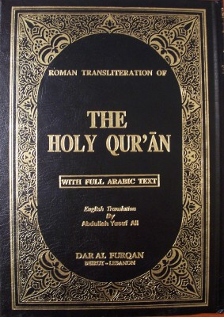
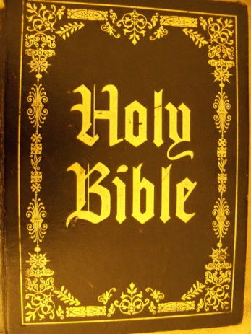
The Bible Judges the Qur’an
The Gospels were not just authoritative for Christians, but
also for Muhammad, and therefore for all Muslims:
“So if you are in doubt, [O Muhammad], about that which We
have revealed to you, then ask those who have been reading the
Scripture before you. The truth has certainly come to you from
your Lord, so never be among the doubters.”
(Sura 10:94)
Since
Muhammad kept on
preaching Islam
he apparently
never took this
command
seriously!
Islam is
FALSE!
JUDGES
JUDGES
Notes:
Sources:
Islamic Dilemma video:
• http://www.answeringmuslims.com/2014/09/the-quran-bible-and-islamic-dilemma.html
• http://www.answeringmuslims.com/search/label/Islamic%20Dilemma
• The Qur'an, the Bible, and the Islamic Dilemma Video: https://www.youtube.com/watch?v=nNAS0aaViM4
Quotes from the Qur’an:
• From a 1995 Revised Edition (Unless otherwise stated) with Arabic text, English translation and Commentary provided by Maulana Muhammad Ali
• Sahih International Qur’an
• http://quran.com

Slide 12
The Islamic Dilemma
Only two possibilities:
The Bible the Word of God
The Bible NOT
the Word of God
If we don’t have the inspired, preserved,
completed, authoritative word of God…
If we have the inspired, preserved,
completed, authoritative word of God…
Islam is
FALSE!
Islam is
FALSE!
Islam affirms the inspiration
(3:3-4), preservation (6:114-115;
10:94; 18:27) and authority (5:47;
5:68) of the Scriptures!
Islam contradicts the word of God
Notes:
Sources:
Islamic Dilemma video:
• http://www.answeringmuslims.com/2014/09/the-quran-bible-and-islamic-dilemma.html
• http://www.answeringmuslims.com/search/label/Islamic%20Dilemma
• The Qur'an, the Bible, and the Islamic Dilemma Video: https://www.youtube.com/watch?v=nNAS0aaViM4
Quotes from the Qur’an:
• From a 1995 Revised Edition (Unless otherwise stated) with Arabic text, English translation and Commentary provided by Maulana Muhammad Ali
• Sahih International Qur’an
• http://quran.com

Slide 13
The Islamic Dilemma
The Islamic Dilemma
Islam is
FALSE!
Islam is
FALSE!
If the Gospels are the word of God…
If the Gospels are
not the word of God…
Muslims that don’t want to
believe in a religion that
self-destructs will need to find
a new religion!
By affirming Scriptures that
contradict its core teachings,
Islam self-destructs!
Muslims have no rational choice but to reject Islam
and search for the truth!
Notes:
Sources:
Islamic Dilemma video:
• http://www.answeringmuslims.com/2014/09/the-quran-bible-and-islamic-dilemma.html
• http://www.answeringmuslims.com/search/label/Islamic%20Dilemma
• The Qur'an, the Bible, and the Islamic Dilemma Video: https://www.youtube.com/watch?v=nNAS0aaViM4
Quotes from the Qur’an:
• From a 1995 Revised Edition (Unless otherwise stated) with Arabic text, English translation and Commentary provided by Maulana Muhammad Ali
• Sahih International Qur’an
• http://quran.com

Slide 14
Conclusion
Muslim scholars claim these passages are taken out of
context or try to show in another way that the Qur’an
trumps the Bible, but they cannot get over the fact that
the Qur’an affirms the Gospels!
When a Muslim says that the Bible has been corrupted, he's contradicting his own revelations
While Muslims today often claim that the Bible has been corrupted, the Qur'an says something completely different
In the Qur'an, Allah affirms the inspiration (3:3-4), preservation (6:114-115; 10:94; 18:27) and authority (5:47; 5:68) of the Gospels

Slide 15
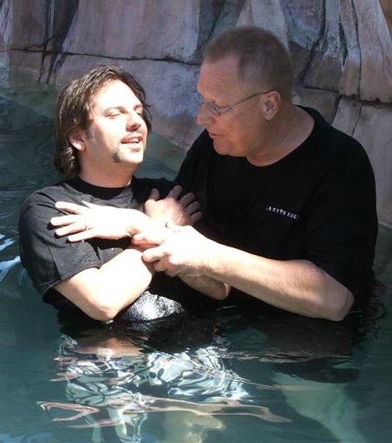
Conclusion
The Solution:
OBEY THE GOSPEL!
Mk. 16:16: Jesus said the one that believes and is baptized will be saved!
II Thess. 1:7-9: Eternal destruction awaits those who have not obeyed the gospel
After “testing the spirits to see if they are
from God” (I Jn. 4:1) – let us simply obey
the Gospel!

Slide 16
“What Must I Do To Be Saved?”
Hear The Gospel (Jn. 5:24; Rom. 10:17)
Believe In Christ (Jn. 3:16-18; Jn. 8:24)
Repent Of Sins (Lk. 13:35; Acts 2:38)
Confess Christ (Mt. 10:32; Rom. 10:10)
Be Baptized (Mk. 16:16; Acts 22:16)
Remain Faithful (Jn. 8:31; Rev. 2:10)
For The Erring Child of God:
Repent (Acts 8:22), Confess (I Jn. 1:9),
Pray (Acts 8:22)

