Slide 1
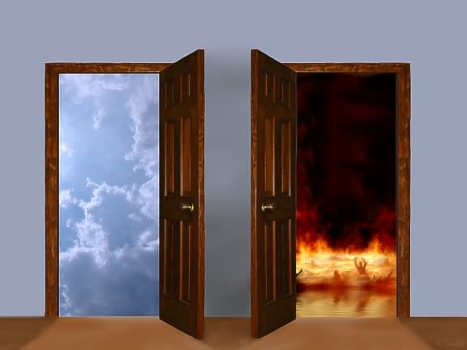
“If”
“IF”
Text: II Tim. 2:11-13
Notes:
Prepared by Nathan L Morrison
All Scripture given is from NASB unless otherwise stated
For further study, or if questions, please Call: 804-277-1983 or Visit www.courthousechurchofcrist.com

Slide 2
Intro
II Tim. 2:1-10: In his last letter to Timothy, Paul urged
him to be strong in the faith
Timothy was going to have to suffer hardship (Soldier, Athlete, Farmer), even imprisonment (Heb. 13:23).
Paul told Timothy to remember the resurrection of Jesus Christ.
Paul used himself as example of one who endured all things.
Why the need to be strong?
Suffer hardship?
Endure difficulties?

Slide 3
Intro
II Tim. 2:11-13
11. It is a trustworthy statement: For if we died with Him, we will also live with Him;
12. If we endure, we will also reign with Him; If we deny Him, He also will deny us;
13. If we are faithless, He remains faithful, for He cannot deny Himself.
“If” sets a condition, or stipulation
“If”: ei (G1487): “a primary particle of conditionality” (Strong’s)
If: “a condition, stipulation” (Webster).
The Scriptures can be understood (Eph. 3:4)
You can understand the Bible if you can understand a little two-letter word
“If” is such a small word yet it sets the conditions for eternity!

Slide 4
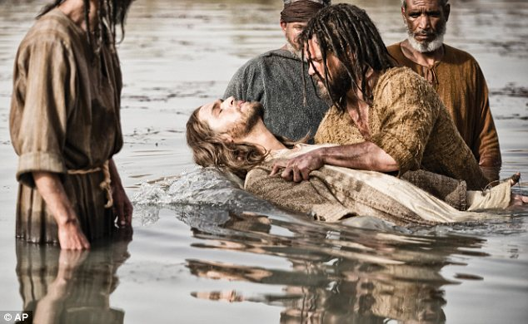
“IF” We Died With Him…
“IF”
Condition: “Die with Christ” (II Tim. 2:11)
“If we die with Christ” is a condition, a requirement, stipulation!
How can we die with Christ? (Rom. 6:3)
In Baptism!
When we die with Christ, we die to some things:
Gal. 2:20: To self
Gal. 5:24: To lusts
Gal. 6:14: To world

Slide 5
“IF” We Died With Him…
“IF”
Then: “Live with Christ”
(II Tim. 2:11)
If one does not meet the condition of dying with Christ, they cannot, and will not live with Christ.
Jn. 11:25: Christ made the promise of life.
Rom. 6:4-5: This new life begins at baptism.
What does this new
life mean?
II Cor. 5:17 (“In Christ” – Gal. 3:27)
17. Therefore if anyone is in Christ, he is a new creature; the old things passed away; behold, new things have come.

Slide 6
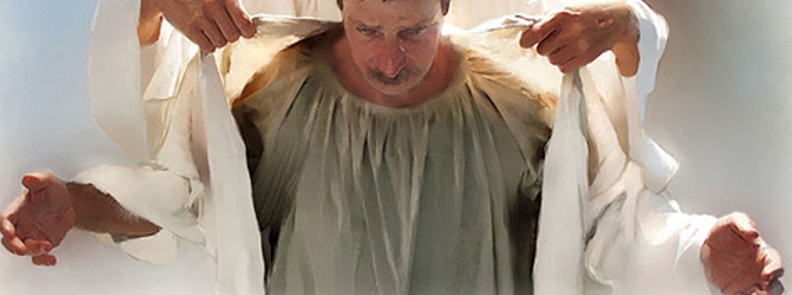
“IF” We Died With Him…
“IF”
What does this new
life mean?
Eph. 4:21-24
21. if indeed you have heard Him and have been taught in Him, just as truth is in Jesus,
22. that, in reference to your former manner of life, you lay aside the old self, which is being corrupted in accordance with the lusts of deceit,
23. and that you be renewed in the spirit of your mind,
24. and put on the new self, which in the likeness of God has been created in righteousness and holiness of the truth.
This new life will lead one to Heaven (Mt. 25:34)!

Slide 7
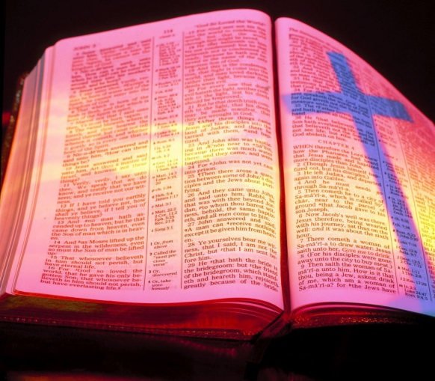
“IF” We Endure…
“IF”
Condition: “Endure” (II Tim. 2:12)
Once obeyed the gospel, must remain faithful, to endure, to be rewarded.
Mt. 10:22: “It is the one who has endured to the end who will be saved.”
We must endure hardship to gain glory (Heb. 12:1-3)
II Tim. 2:3: “Suffer hardship with me, as a good soldier of Christ Jesus.”
II Tim. 4:3: We must endure sound doctrine. Some will not.
II Tim. 4:5: Preaching the gospel would require endurance.
Js. 1:2-4: Test of faith = Endurance (Endurance = Complete)

Slide 8
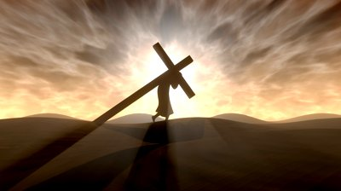
“IF” We Endure…
“IF”
Then: “Reign with Christ”
(II Tim. 2:12)
If we endure, we will reign with Christ.
Rom. 8:17: “If” we suffer with Him we will be glorified with Him (II Thess. 1:10).
Js. 5:11: Blessed are those who endure.
Rev. 2:10
10. 'Do not fear what you are about to suffer. Behold, the devil is about to cast some of you into prison, so that you will be tested, and you will have tribulation for ten days. Be faithful until death, and I will give you the crown of life.

Slide 9
“IF” We Endure…
“IF”
Rev. 3:21
21. 'He who overcomes, I will grant to him to sit down with Me on My throne, as I also overcame and sat down with My Father on His throne.
One must endure the trials of this life to enjoy the glory
of the life to come!

Slide 10
“IF” We Deny Christ…
“IF”
Condition: “Deny Christ” (II Tim. 2:12)
Mt. 10:33: If one denies Christ before men, Christ will deny him to God.
Lk. 9:23-26: “If” one wishes to follow Christ, one must deny self.
Jn. 3:18; 12:48: You do not have to say, “I deny Christ.” You deny Him if you do not accept Him and obey His word, which will judge mankind!
Jn. 3:18
18. "He who believes in Him is not judged; he who does not believe has been judged already, because he has not believed in the name of the only begotten Son of God.
Jn. 12:48
48. "He who rejects Me and does not receive My sayings, has one who judges him; the word I spoke is what will judge him at the last day.

Slide 11
“IF” We Deny Christ…
“IF”
Then: Christ will “deny us”
(II Tim. 2:12)
Mt. 25:41: “Depart from Me, accursed ones, into the eternal fire which has been prepared for the devil and his angels.” (Mt. 10:33)
The saddest words ever to be heard!
II Thess. 1:6-9
6. For after all it is only just for God to repay with affliction those who afflict you,
7. and to give relief to you who are afflicted and to us as well when the Lord Jesus will be revealed from heaven with His mighty angels in flaming fire,
8. dealing out retribution to those who do not know God and to those who do not obey the gospel of our Lord Jesus.
9. These will pay the penalty of eternal destruction, away from the presence of the Lord and from the glory of His power,
Those who are denied by Christ to the Father will be
eternally separated from God!

Slide 12
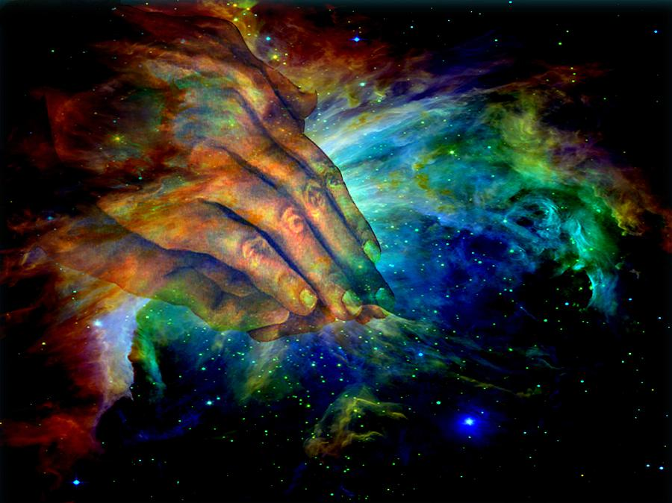
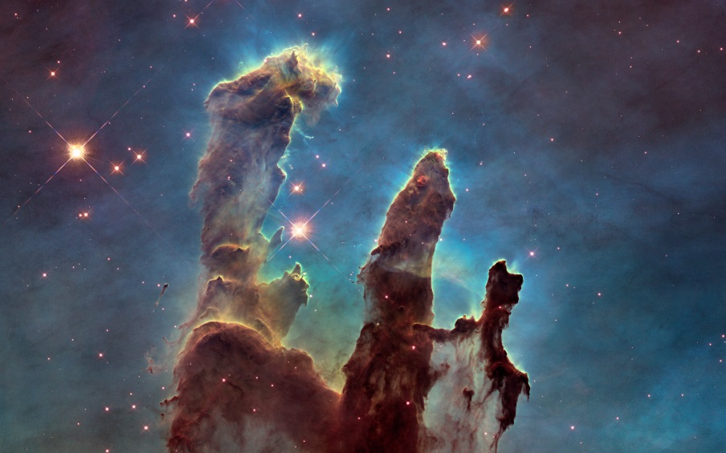
“IF” We Are Faithless…
“IF”
Condition: Faithlessness (II Tim. 2:13)
Some have the idea that if they don’t believe in God, somehow He will cease to exist or maybe He will overlook or excuse their unbelief.
Acts 17:30: God no longer overlooks ignorance.
Creation alone gives man no excuse for faithlessness –
Rom. 1:20
Mk. 16:16: The one who does not believe is condemned!
Notes:
Image 1: “Hands of Creation” by Evelyn Patrick
Image 2: Close-up of the so-called “Pillars of Creation,” aka “Hand of Creation.” This spectacular Hubble Space Telescope image shows the pillar structure and embryonic stars in the Eagle Nebula. See history.nasa.gov for more!

Slide 13
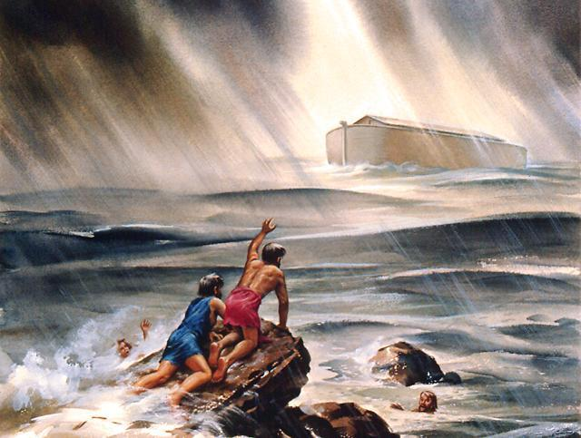
“IF” We Are Faithless…
“IF”
Yet: God “remains Faithful”
(II Tim. 2:13)
God will do just exactly as He has promised in His word.
Acts 17:31: God will judge the ignorant and the faithless!
It would not matter whether every man upon the face of
the earth rejected God – God would still keep His word!
Rom. 3:3-4 (Gen. 6-9: The flood); Heb. 10:23; II Pet. 3:3-7, 10-12

Slide 14
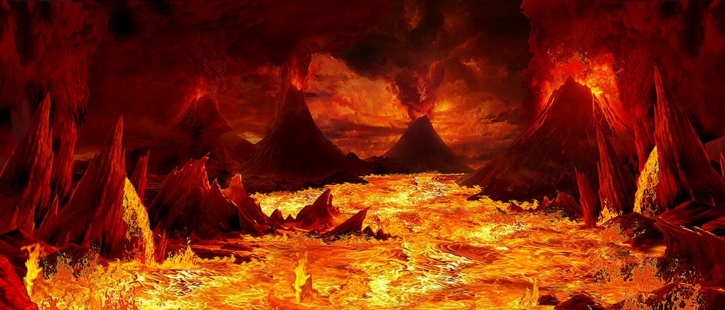
“IF” We Are Faithless…
“IF”
Mt. 25:41, 46
41. "Then He will also say to those on His left, 'Depart from Me, accursed ones, into the eternal fire which has been prepared for the devil and his angels;
46. "These will go away into eternal punishment, but the righteous into eternal life.
Condemnation falls upon those who do not know God
& those who do not obey the gospel!
Notes:
Image: “Lake of Fire” by Mary K. Baxter

Slide 15
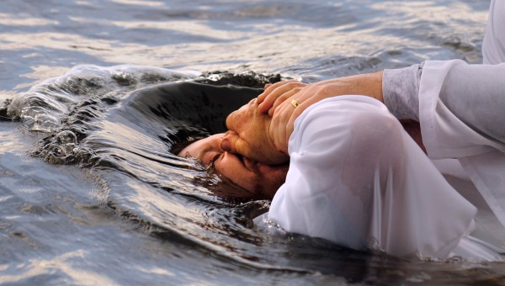
Conclusion
Have you met the “if” of life and glory?
Die with Christ in baptism!
Endure with Christ through the trials of life till the end!

Slide 16
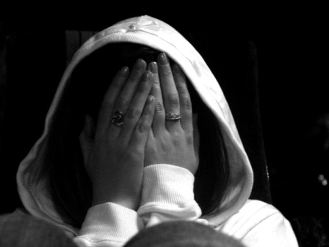
Conclusion
Have you met the “if” of denial and condemnation?
Deny Christ and do not obey the gospel?
Be faithless, and hide your eyes against the truth?

Slide 17
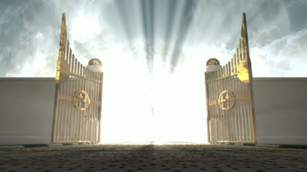
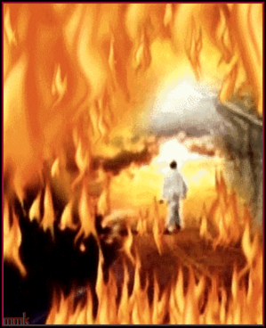
Conclusion
“IF”
You meet the conditions for life with Christ then you will live and reign with Christ forever!
“IF”
You meet the conditions for Christ’s denial then you will live forever in eternal punishment!

Slide 18
“What Must I Do To Be Saved?”
Hear The Gospel (Jn. 5:24; Rom. 10:17)
Believe In Christ (Jn. 3:16-18; Jn. 8:24)
Repent Of Sins (Lk. 13:35; Acts 2:38)
Confess Christ (Mt. 10:32; Rom. 10:10)
Be Baptized (Mk. 16:16; Acts 22:16)
Remain Faithful (Jn. 8:31; Rev. 2:10)
For The Erring Child:
Repent (Acts 8:22), Confess (I Jn. 1:9),
Pray (Acts 8:22)

