Slide 1
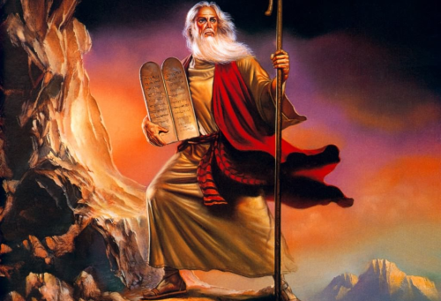
Choose Like Moses!
Text: Heb. 11:23-27
Notes:
By Nathan L Morrison for 08/26/2018
All Scripture given is from NASB unless otherwise stated
For further study, or if questions, please Call: 804-277-1983 or Visit: www.courthousechurchofchrist.com

Slide 2
Intro
“Back-To-School” season can be both exciting and nervous for parents (students too!)
They take what they have learned at home into an environment out of the parents’ control!
“Choose like Moses!”
Notes:
Wise advice from an older Christian woman about going back to school: “Choose like Moses!”

Slide 3
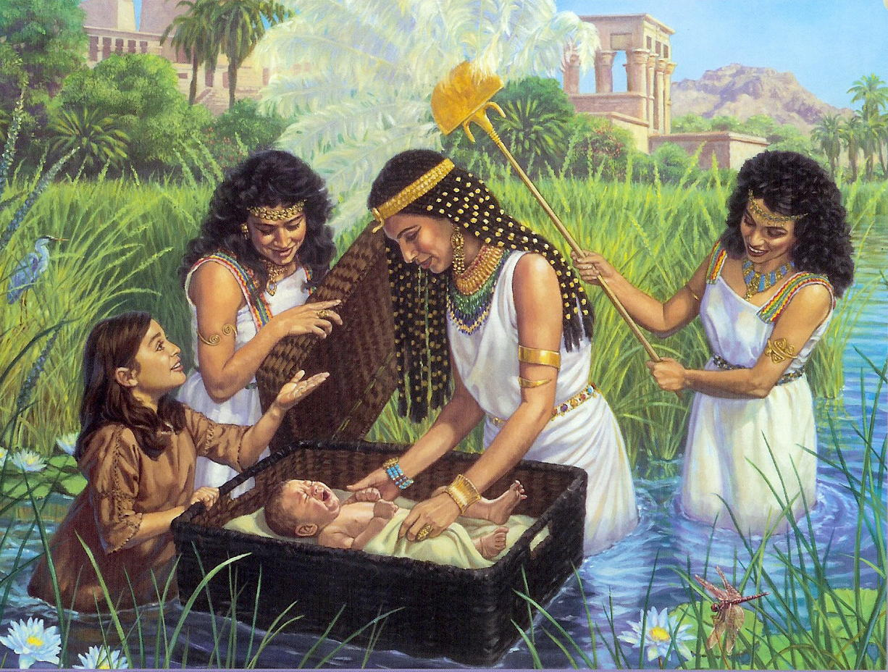
Intro
Moses is an amazing story of faith and courage
His birth occurred during Egypt’s oppression and enslavement of the Hebrew people.
Heb. 11:23: Moses was born to godly parents who refused to let the Egyptians kill their son along with all the other newborn Hebrew boys.
Heb. 11:23
23. By faith Moses, when he was born, was hidden for three months by his parents, because they saw he was a beautiful child; and they were not afraid of the king's edict.

Slide 4
Intro
Ex. 2:1-10: A hint as to the kind of instruction Moses received from his mother while she raised him
What Moses learned in his parents’ home left a lifelong
impression on him and influenced the rest of his life!

Slide 5
Moses’ Upbringing
Wisdom of the world
Acts 7:22: Moses was highly educated in the wisdom of his day
The Egyptians were noted for their knowledge and worldly wisdom.
I Kings 4:30: Solomon’s wisdom exceeded the wisdom of Egypt.
Moses was educated by worldly men who did not know God
They were pantheistic – worshiped many gods (Rom. 1:21-25).
Acts 7:22
22. "Moses was educated in all the learning of the Egyptians, and he was a man of power in words and deeds.

Slide 6
Moses’ Upbringing
False knowledge
I Tim. 6:20-21: The false knowledge, speculations, and theories of his teachers could not shipwreck his faith (I Tim. 1:19).
Rom. 1:25: They exchanged truth for a lie!
II Cor. 10:4-5: His faith overthrew their speculation
I Tim. 6:20-21
20. O Timothy, guard what has been entrusted to you, avoiding worldly and empty chatter and the opposing arguments of what is falsely called "knowledge"--
21. which some have professed and thus gone astray from the faith. Grace be with you.

Slide 7
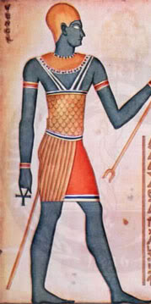
Moses’ Upbringing
Moral Corruption
Rom. 1:18-25: He lived in an idolatrous world, which leads to a wicked and sinful society (1:26-32: Idolatry leads to gross immorality).
Col. 3:5: Christians warned not to practice such things!
Col. 3:5
5. Therefore consider the members of your earthly body as dead to immorality, impurity, passion, evil desire, and greed, which amounts to idolatry.

Slide 8
Moses’ Upbringing
Wisdom of the world
Similar to some educational
institutions today!
False knowledge
Moral Corruption
Although educated in a system of science and religion, which neither acknowledged nor revered God, he remained true to God!

Slide 9
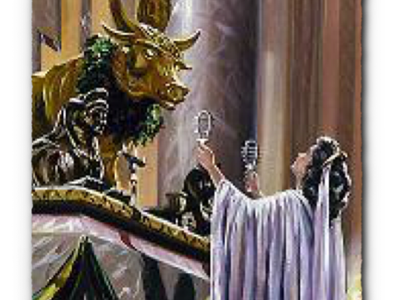
Moses’ World Compared With Ours
Worldly wisdom, false knowledge, and moral
corruption are prevalent in our society and taught in
educational institutions!
Humanism
Mankind no more than an animal, must rely on our own powers
Atheism
The denial of God
Evolution
Life spontaneously arose out of non-living matter (Without a Creator)
Relative Truth
Truth is relative, no absolutes
Saints and young people today must still choose like Moses to overcome the world!

Slide 10
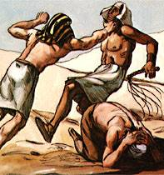
Moses’ Decision
Slavery or Royalty?
(Rom. 6:16-18; 8:14-17)
There is a price to be paid for commitment and doing the right thing.
Even Jesus paid the price of obedience (Heb. 5:8-9).
Heb. 11:24-26: With nothing to gain (physically) & everything to lose, Moses descended from the loftiest throne in the world to join the Israelites!
Heb. 11:24-26 (Acts 7:23-25)
24. By faith Moses, when he had grown up, refused to be called the son of Pharaoh's daughter,
25. choosing rather to endure ill-treatment with the people of God than to enjoy the passing pleasures of sin,
26. considering the reproach of Christ greater riches than the treasures of Egypt; for he was looking to the reward.

Slide 11
Moses’ Decision
Pain or Pleasure? (II Cor. 4:16-18)
He could have continued enjoying the luxuries that only the king’s court could provide for him (any sin he desired without reprisal).
Heb. 11:25: Moses made the decision to do what was right, because it was right!
Whatever consequences followed were immaterial! (Acts 7:35-36)
Acts 7:35-36
35. "This Moses whom they disowned, saying, 'WHO MADE YOU A RULER AND A JUDGE?' is the one whom God sent to be both a ruler and a deliverer with the help of the angel who appeared to him in the thorn bush.
36. "This man led them out, performing wonders and signs in the land of Egypt and in the Red Sea and in the wilderness for forty years.

Slide 12
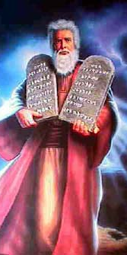
Moses’ Decision
Eternal Reward or Earthly Reward? (I Cor. 9:24-27)
Why did Moses make this difficult decision? What swayed him?
He was already a rich man!
From his childhood he had everything a man could want or dream of having! (Acts 7:21-22)
Heb. 11:26-27: Moses saw beyond the temporary and the material!
He saw a God who offered him more than Egypt could!
Heb. 11:26-27 (Acts 7:37-38)
26. considering the reproach of Christ greater riches than the treasures of Egypt; for he was looking to the reward.
27. By faith he left Egypt, not fearing the wrath of the king; for he endured, as seeing Him who is unseen.

Slide 13
Moses’ Decision
Slavery or Royalty?
Same choices people must make today!
Pain or pleasure?
Eternal Reward or Earthly Reward?
Moses was in a hostile spiritual environment
(no home is more corrupt than a reigning king)
and yet he retained his spiritual priorities!

Slide 14
Conclusion
Phil. 2:15
15. so that you will prove yourselves to be blameless and innocent, children of God above reproach in the midst of a crooked and perverse generation, among whom you appear as lights in the world,

Slide 15
Conclusion
Moses chose the spiritual path with eternal rewards
that outweighed the physical!
II Cor. 4:16-18 (Rom. 8:18)
16. Therefore we do not lose heart, but though our outer man is decaying, yet our inner man is being renewed day by day.
17. For momentary, light affliction is producing for us an eternal weight of glory far beyond all comparison,
18. while we look not at the things which are seen, but at the things which are not seen; for the things which are seen are temporal, but the things which are not seen are eternal.

Slide 16
Conclusion
Parents: Remember Moses’ upbringing began in the
home with his parents!
Young people: As you head back to
school, be wise decision-makers!
Choose like Moses!

Slide 17
“What Must I Do To Be Saved?”
Hear The Gospel (Jn. 5:24; Rom. 10:17)
Believe In Christ (Jn. 3:16-18; Jn. 8:24)
Repent Of Sins (Lk. 13:35; Acts 2:38)
Confess Christ (Mt. 10:32; Rom. 10:10)
Be Baptized (Mk. 16:16; Acts 22:16)
Remain Faithful (Jn. 8:31; Rev. 2:10)
For The Erring Saint:
Repent (Acts 8:22), Confess (I Jn. 1:9),
Pray (Acts 8:22)

