Slide 1
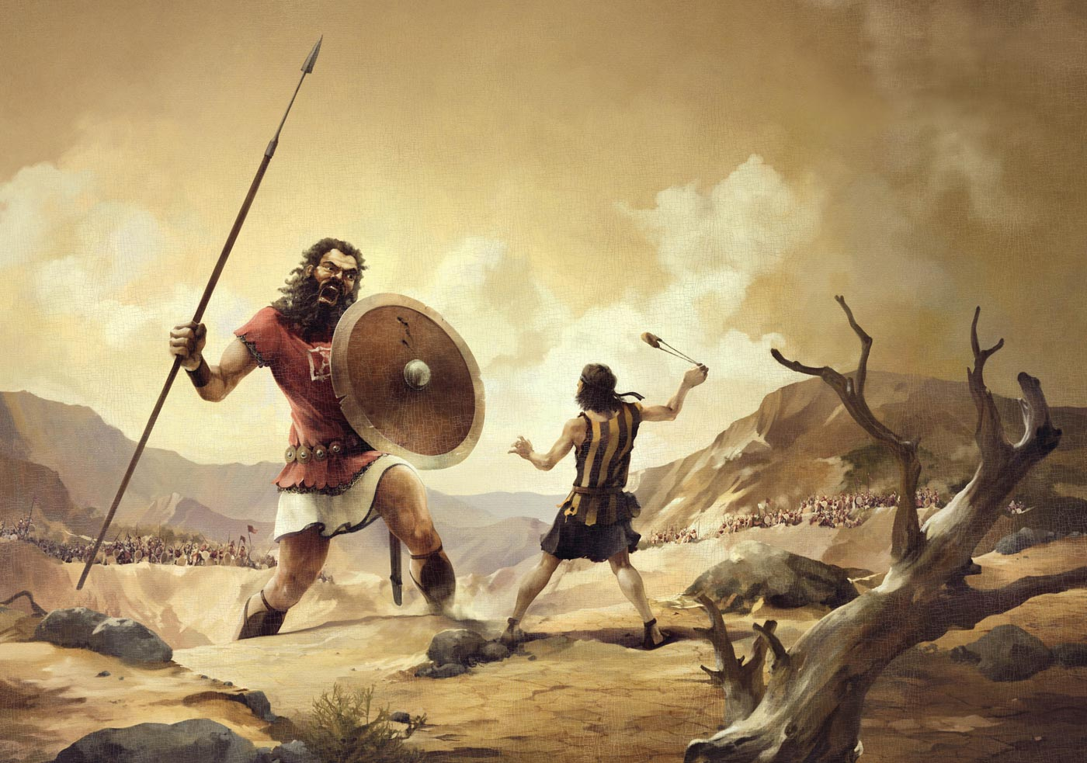
“The Battle Belongs To The Lord!”
Text: I Sam. 17
Notes:
By Nathan L Morrison
All Scripture given is from NASB unless otherwise stated
For further study, or if questions, please Call: 804-277-1983 or Visit: www.courthousechurchofchrist.com

Slide 2
Intro
Eph. 6:12
12. For our struggle is not against flesh and blood, but against the rulers, against the powers, against the world forces of this darkness, against the spiritual forces of wickedness in the heavenly places.
Sometimes our lives find us in a fight (spiritual) where we
are outnumbered, outgunned, overpowered,
overwhelmed, and outsmarted
What do we do?
“The battle belongs to the Lord!”
Josh. 5:13-16; 6:1-27: The fall of Jericho – fortified city fell by the power of God! (6:2)
Jud. 7: Innumerable Midianites & Amalekites fell to Gideon by the power of God! (7:9)
II Chr. 20: Innumerable Moab & Ammon defeated by God for King Jehoshaphat! (20:15)

Slide 3
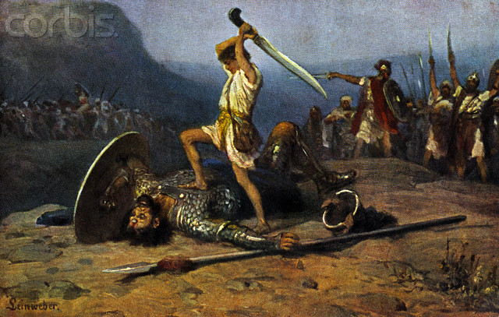
Intro
David is a great example of showing us that despite the odds against us, “The Battle Belongs to the Lord!”

Slide 4
The Contest of David and Goliath (I Sam. 17:1-51)
“David, Goliath, and Smiley's People” by Dr. David Rabin, Dr. Pauline Rabin, Wednesday, October 26, 1983, Letter to New England Journal of Medicine:
Goliath was a sickly giant weakened by glandular problems and probably didn’t notice David hurling the fatal pebble at his head
Goliath might have suffered from a combination of ailments which made him physically vulnerable to the small rocks David loaded into his slingshot.
HE DIDN’T DUCK or raise his shield and consequently, David apparently had little trouble striking him with the stone
Goliath suffered from giantism and possibly a rare disorder called endocrine neoplasia, which causes tumors to grow in the endocrine gland.
“It would explain why Goliath was so large, why he couldn’t really see David and why he was felled by a small rock from a slingshot”
One reason Goliath probably took little notice of David was because the disease had put pressure on his optic nerve, resulting in diminished vision.
“He could see but it was sort of like a horse with blinders. He had to turn his whole head. He also probably had a bone defect in the skull and probably had a lot of cysts”
Notes:
Sources:
“David, Goliath, and Smiley's People” by Dr. David Rabin, Dr. Pauline Rabin, Wednesday, October 26, 1983, Letter to New England Journal of Medicine, 309:992 DOI: 10.1056/NEJM198310203091626

Slide 5
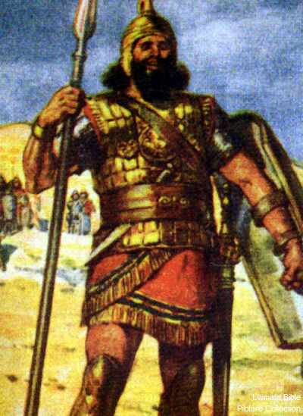
The Contest of David and Goliath
Goliath’s challenge (I Sam. 17:1–11):
He is referred to as a “champion” three times (I Sam. 17:4, 23, 51).
He was a giant at 9 ft. 9 in. tall (17:4)
His scale armor weighed at least 125-156 lbs. (17:5-6).
His spear head weighed at least 18 lbs. (17:7).
He was a trained warrior (17:33).
His eyesight wasn’t poor; He could see David was a “youth” (17:42)
His challenge made Israel “greatly afraid” (17:11, 24).
He had a high price on his head (17:25).
Saul, a great warrior in his own right, would not fight him and urged David not to fight him (17:33).
He was a giant, and a ferocious warrior who defied an entire army! (17:26)
At first, no champion was found in the camp of Saul!
Notes:
Sources:
• https://www.convert-me.com/en/convert/history_weight/bibshekel.html?u=bibshekel&v=1
• http://answers.wikia.com/wiki/How_much_did_Goliath%27s_armor_weigh
• http://ministerfortson.com/goliath-philistine-giant-fought-king-david/

Slide 6
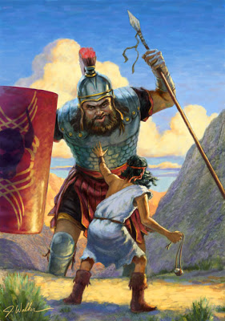
The Contest of David and Goliath
David hears of Goliath’s challenge (I Sam. 17:12–27)
David accepts Goliath’s challenge and
Saul sends David out to meet Goliath:
David was not afraid to answer the challenge—he based his judgment on his past experiences with the power of God.
By faith in God he had been able to defend his father’s sheep when they were attacked by lions or bears (I Sam. 17:32–37).
To David, Goliath was as the lion and bear he had fought (17:36-37).
I Sam. 17:36-37
36. "Your servant has killed both the lion and the bear; and this uncircumcised Philistine will be like one of them, since he has taunted the armies of the living God."
37. And David said, "The LORD who delivered me from the paw of the lion and from the paw of the bear, He will deliver me from the hand of this Philistine." And Saul said to David, "Go, and may the LORD be with you."

Slide 7
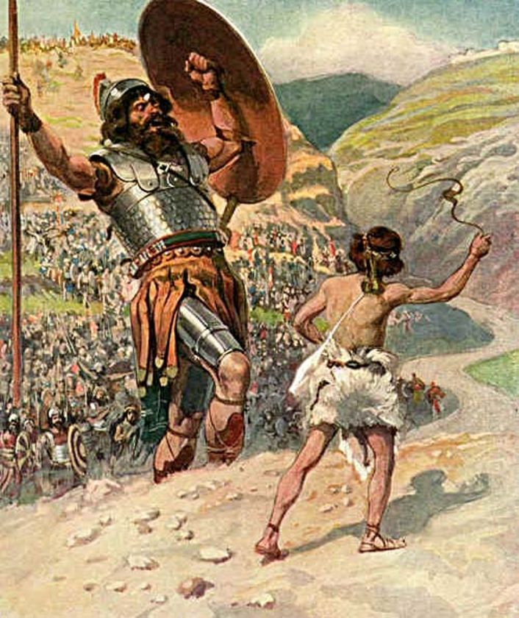
The Contest of David and Goliath
David gains the victory and slays Goliath
(I Sam. 17:40-51):
David did not use Saul’s personal armor (I Sam. 17:38–39)
He did not face him as an armed soldier, but prepared to face him as a shepherd! (I Sam. 17:40) – promised to cut off the giant’s head! (17:46)

Slide 8
The Contest of David and Goliath
I Sam. 17:48-51
48. Then it happened when the Philistine rose and came and drew near to meet David, that David ran quickly toward the battle line to meet the Philistine.
49. And David put his hand into his bag and took from it a stone and slung it, and struck the Philistine on his forehead. And the stone sank into his forehead, so that he fell on his face to the ground.
50. Thus David prevailed over the Philistine with a sling and a stone, and he struck the Philistine and killed him; but there was no sword in David's hand.
51. Then David ran and stood over the Philistine and took his sword and drew it out of its sheath and killed him, and cut off his head with it. When the Philistines saw that their champion was dead, they fled.

Slide 9
The Contest of David and Goliath
There were three things David wanted the
Philistines, the Israelites and all the earth
to know:
“That there is a God in Israel” (I Sam. 17:46).
“That the Lord does not save with sword and spear; for the battle is the Lord’s” (I Sam. 17:47).
He was fighting by faith and for the glory of God (17:37)
I Sam. 17:45-47
45. Then David said to the Philistine, "You come to me with a sword, a spear, and a javelin, but I come to you in the name of the LORD of hosts, the God of the armies of Israel, whom you have taunted.
46. "This day the LORD will deliver you up into my hands, and I will strike you down and remove your head from you. And I will give the dead bodies of the army of the Philistines this day to the birds of the sky and the wild beasts of the earth, that all the earth may know that there is a God in Israel,
47. and that all this assembly may know that the LORD does not deliver by sword or by spear; for the battle is the LORD'S and He will give you into our hands."

Slide 10
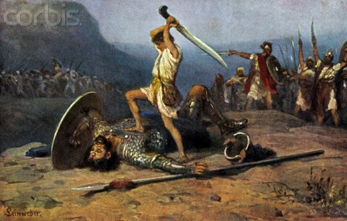
The Contest of David and Goliath
Rom. 8:31
31. What then shall we say to these things? If God is for us, who is against us?

Slide 11
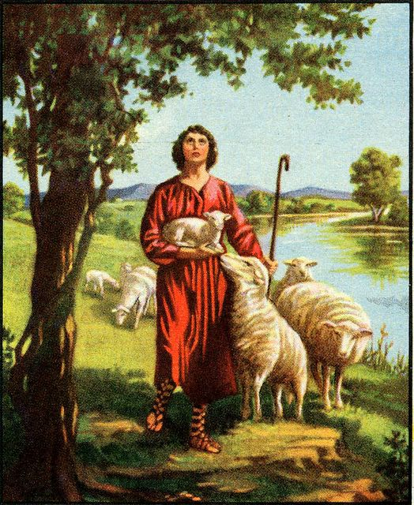
Lessons From David’s Victory
David fought as a shepherd defending his
flock – contrast that with King Saul!
David saved Israel and showed them the
kind of king they really needed!
David became a pattern for God’s people
today by exhibiting the spirit we should
have in our spiritual warfare (Eph. 6:12)
David did not neglect the use of weapons altogether and
then sit back and wait for God to fight the battle for him,
and neither can we!
(I Tim. 6:11-12; II Cor. 10:3-5; II Tim. 2:24-26; Jude 3)

Slide 12
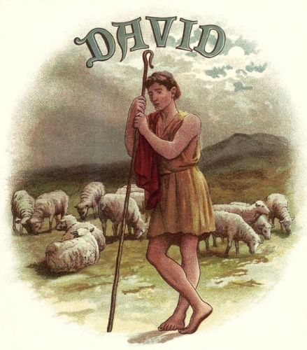
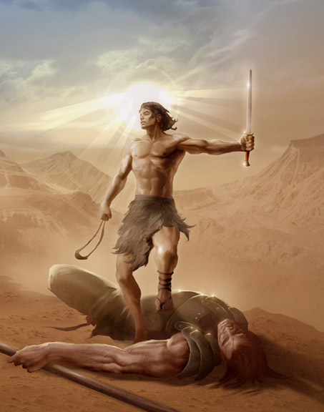
Lessons From David’s Victory
Characteristics of David:
Faith in God, not doubt (I Sam. 17:45; Is. 54:17)
Humility, not vain pride (I Pet. 5:5-6)
Zeal, rather than apathy (I Sam. 17:32)
Courage, in contrast to fear (I Sam. 17:11, 24)
In every victory we have over sin we grow stronger in faith and give glory to God!

Slide 13
How Do We Know If Our Battle Is “Of The Lord”?
The “battle belongs to the Lord…”
If we are doing what God has authorized (Col. 3:17; II Tim. 4:16–17).
If the truth of God’s word is at stake and being taught, practiced or defended against error (Phil. 1:17; Jude 3; Acts 15:1–11).
If it is a spiritual conflict (Eph. 6:10–12; II Cor. 10:3–5; Mt. 4:1–11).
If it is being done in the name of the Lord and God is being glorified (Mk. 9:36-41; Mt. 25:34-40; Col. 3:17).
If we are fighting in faith, not just fighting (I Tim. 6:12; Rom. 10:17).
If spiritual armor can be properly employed (Eph. 6:13–18).
If one suffers for “righteousness’ sake” (Mt. 5:10–12; I Pet. 4:12–16).
If it can rightly be said we are on the Lord’s side (Josh. 24:15).
When we fight on the side of right, it can be said of us,
we are “more than conquerors through Him who loved us!” (NKJ: Rom. 8:37-39)
Rom. 8:37 (NKJ)
37. Yet in all these things we are more than conquerors through Him who loved us.

Slide 14
Conclusion
In our spiritual battles, “The battle is the Lord’s!”
Christ has overcome evil by the power of His blood (Heb. 2:14-15)
There is a need for people of courage and faith to go out against the “giants” of today!

Slide 15
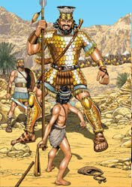
Conclusion
The “giants” of today include:
Worldliness
Compromise
Indifference
False doctrine
Lack of growth
As in the days of Israel, the “giants” of
today are not bigger than God!
We need to have the courage of David to overcome
and enjoy the blessings of God! (Rev. 21:7)
When we, like David, recognize “there is a God,” and
that “the Lord does not save with sword and spear,” and
we fight by faith in God and for His glory,
the battle will always “be the Lord’s!”

Slide 16
“What Must I Do To Be Saved?”
Hear The Gospel (Jn. 5:24; Rom. 10:17)
Believe In Christ (Jn. 3:16-18; Jn. 8:24)
Repent Of Sins (Lk. 13:35; Acts 2:38)
Confess Christ (Mt. 10:32; Rom. 10:10)
Be Baptized (Mk. 16:16; Acts 22:16)
Remain Faithful (Jn. 8:31; Rev. 2:10)
For The Erring Child:
Repent (Acts 8:22), Confess (I Jn. 1:9),
Pray (Acts 8:22)

