Slide 1
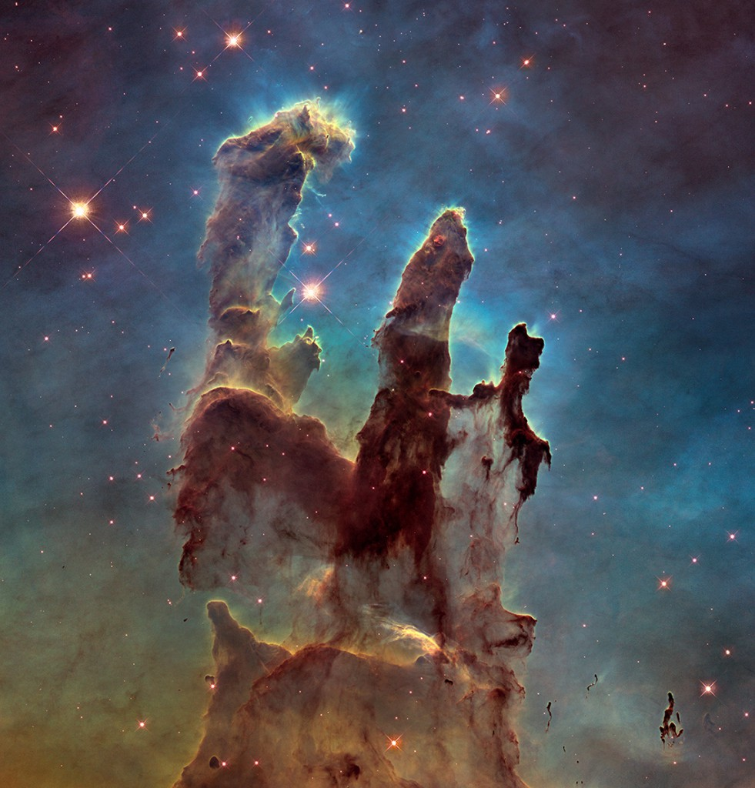
Harmony Of Scriptures & Science Part 2
Text: Ps. 19:1; Is 40:8; Rom. 1:20
Notes:
Prepared by Nathan L Morrison
All Scripture given is from NASB unless otherwise stated!
For further study, or if questions, please Call: 804-277-1983 or Visit: www.courthousechurchofcrist.com
Image: “Pillars of Creation” in the Eagle Nebula taken by the Hubbble Telescope in 2014

Slide 2
PART 2
Harmony Of Scriptures & Science
Notes:
Image Top-Right: Painting, “Hands of Creation,” by Evelyn Patrick

Slide 3
Intro (Part 2)
Creation alone declares God’s majesty and glory – Psalm 19:1
If the Scriptures are the word of God, one would expect it to be accurate – Is. 40:8
Creation alone leaves man without excuse – Rom. 1:20
Notes:
Image Top-Right: Painting, “Hands of Creation,” by Evelyn Patrick

Slide 4
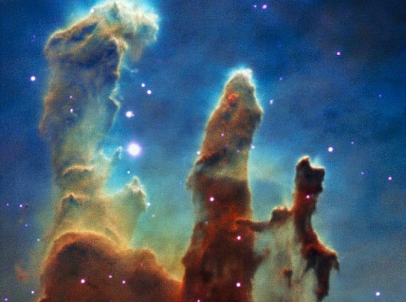
Intro
Wall Street Journal article 12/25/14, Science Increasingly Makes the Case for God by Eric Mataxas, declares that scientists are increasingly having to change their previous thoughts!
Over time science has become a god to itself, where the choice seems to be God or science)
Notes:
Science Increasingly Makes the Case for God, Wall Street Journal Article by Eric Mataxas, 12/25/14: http://www.wsj.com/articles/eric-metaxas-science-increasingly-makes-the-case-for-god-1419544568
Image Top-Right: “Pillars of Creation” in the Eagle Nebula taken by the Hubbble Telescope in 1995

Slide 5
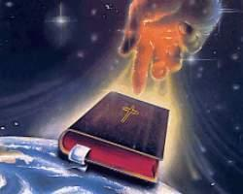
Intro
Throughout time, Science had to “catch up” with God’s word!
We can see God in science as He has provided the Creator’s Handbook to Science in His word!

Slide 6
The Water Cycle
Job 36:27-28
27. For he draws up the drops of water; they distill his mist in rain,
28. which the skies pour down and drop on mankind abundantly.
Notes:
Water Cycle: http://en.wikipedia.org/wiki/Raoult%27s_law; http://en.wikipedia.org/wiki/Fran%C3%A7ois-Marie_Raoult

Slide 7
The Water Cycle
Eccl. 1:7 (Written around 950 BC); Eccl. 11:3; Ps. 135:7; Amos 9:6
1882 AD: Raoult’s (1830-1901) Law of Evaporation (Thermodynamics)
Notes:
Water Cycle: http://en.wikipedia.org/wiki/Raoult%27s_law; http://en.wikipedia.org/wiki/Fran%C3%A7ois-Marie_Raoult
http://ga.water.usgs.gov/edu/watercycle.html

Slide 8
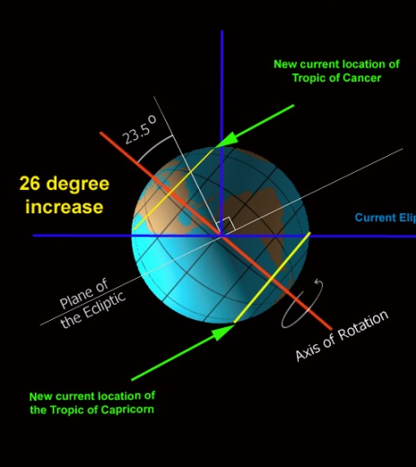
Earth’s Axis
Job 38:12, 14
12. Have you ever in your life commanded the morning, And caused the dawn to know its place,
14. "It [the earth – Vs. 13] is changed like clay under the seal; And they stand forth like a garment.
Notes:
Earth’s Axis: http://en.wikipedia.org/wiki/Foucault_Pendulum; http://en.wikipedia.org/wiki/L%C3%A9on_Foucault

Slide 9
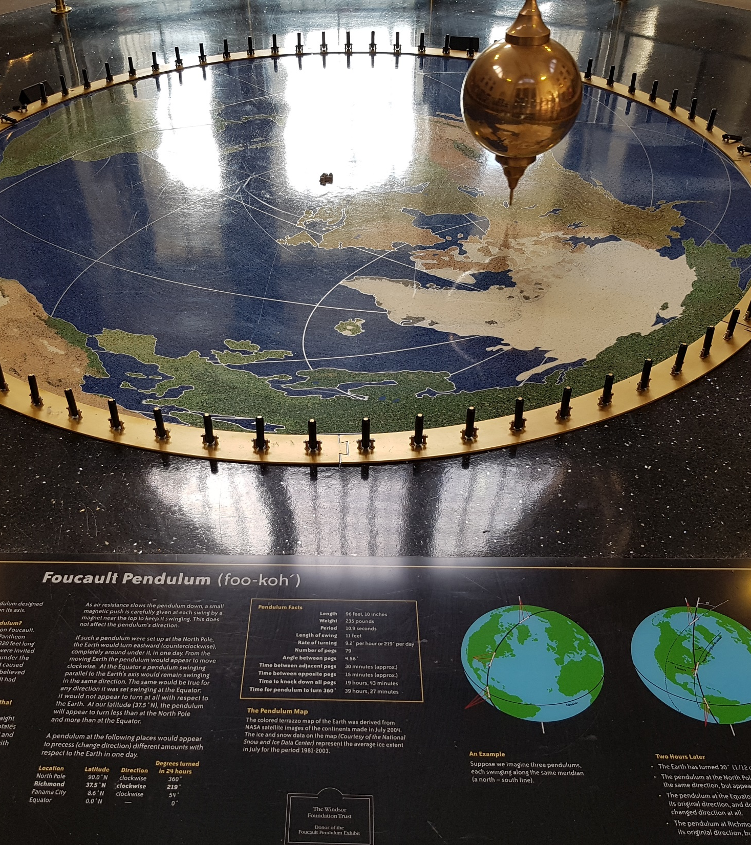
Earth’s Axis
Modern science has come to understand that the earth’s rotation on its axis is responsible for the sun’s “rising and setting.”
Kepler, Galileo and Newton gathered support for the theory of the rotation of the Earth.
1851: Foucault Pendulum by physicist Léon Foucault
Notes:
Earth’s Axis: http://en.wikipedia.org/wiki/Foucault_Pendulum; http://en.wikipedia.org/wiki/L%C3%A9on_Foucault
Image: Author’s photo in the entrance at the Science Museum of Virginia

Slide 10
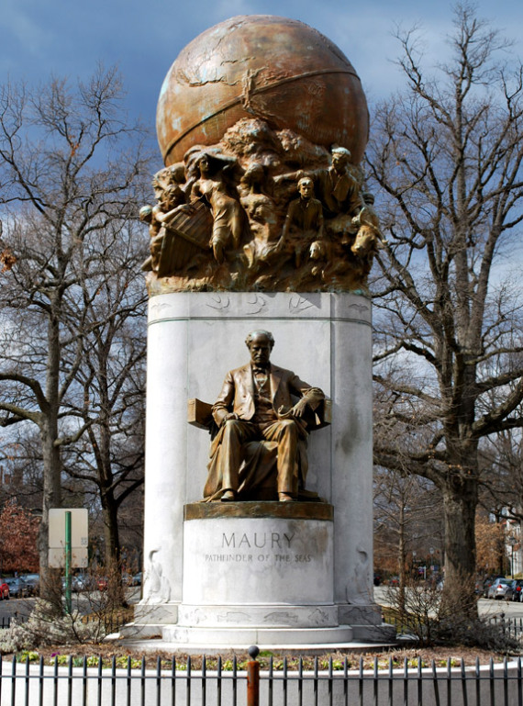
Paths of the Seas
Ps. 8:6-8 (NKJ)
6. You have made him to have dominion over the works of Your hands; You have put all things under his feet,
7. All sheep and oxen— Even the beasts of the field,
8. The birds of the air, And the fish of the sea That pass through the paths of the seas.
Notes:
Paths of the Seas: http://en.wikipedia.org/wiki/Matthew_Fontaine_Maury
Image: Matthew Fontaine Maury "Pathfinder of the Seas" monument on Monument Ave, Richmond, VA. Dedicated November 11, 1929 (Holds in in his right hand Sea-Charts, left hand Maps, and by his left foot a Bible)
Further Memorials: Maury Hall, the home of the Naval Science Department at the University of Virginia and headquarters of the University's Navy ROTC battalion, was named in his honor. The original building of the College of William & Mary Virginia Institute of Marine Science is named Maury Hall as well. Another Maury Hall, named after him, houses the Electrical and Computer Engineering Department and the Systems Engineering Department at the United States Naval Academy in Annapolis, Maryland.
Statue and Monument to him stands on Monument Ave in the intersection with Belmont Avenue in Richmond, VA. He is buried in the President’s Circle at Hollywood Cemetery, Richmond, VA

Slide 11
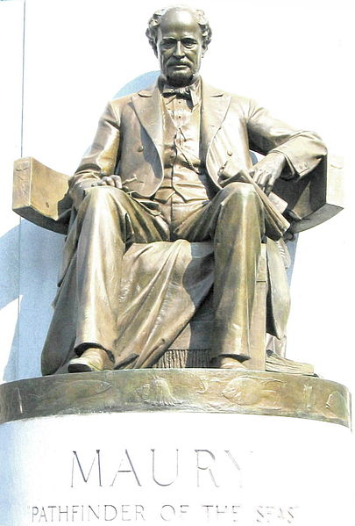
Paths of the Seas
1840-1860 AD: Discovered by Cmdr. (USN, CSN) Matthew F Maury (1806-1873)
Ps. 8: Knew they were there, just needed to find them!
“Pathfinder of the Seas”
Notes:
Paths of the Seas: http://en.wikipedia.org/wiki/Matthew_Fontaine_Maury
Image: Matthew Fontaine Maury "Pathfinder of the Seas" monument on Monument Ave, Richmond, VA. Dedicated November 11, 1929 (Holds in in his right hand Sea-Charts, left hand Maps, and by his left foot a Bible)
Further Memorials: Maury Hall, the home of the Naval Science Department at the University of Virginia and headquarters of the University's Navy ROTC battalion, was named in his honor. The original building of the College of William & Mary Virginia Institute of Marine Science is named Maury Hall as well. Another Maury Hall, named after him, houses the Electrical and Computer Engineering Department and the Systems Engineering Department at the United States Naval Academy in Annapolis, Maryland.
Statue and Monument to him stands on Monument Ave in the intersection with Belmont Avenue in Richmond, VA. He is buried in the President’s Circle at Hollywood Cemetery, Richmond, VA

Slide 12
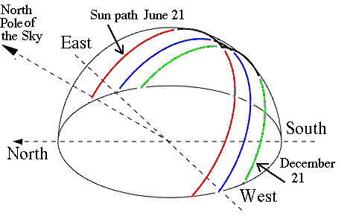
Sun’s Ecliptic Path
Ps. 19:4-6
4. …In them He has placed a tent for the sun,
5. Which is as a bridegroom coming out of his chamber…
6. Its rising is from one end of the heavens, And its circuit to the other end of them; And there is nothing hidden from its heat.
Notes:
Sun’s Ecliptic Path: http://en.wikipedia.org/wiki/Ecliptic; http://en.wikipedia.org/wiki/Ecliptic_coordinate_system; http://earthsky.org/space/what-is-the-ecliptic

Slide 13
Sun’s Ecliptic Path
Scientists once thought the sun was stationary.
The Sun moves through space at approx. 600,000 miles per hour and could take 200 million years to complete one orbit
The ecliptic is the apparent path of the Sun on the celestial sphere, and is the basis for the Ecliptic Coordinate System (not recognized till the 1800’s).
Notes:
Sun’s Ecliptic Path: http://en.wikipedia.org/wiki/Ecliptic; http://en.wikipedia.org/wiki/Ecliptic_coordinate_system; http://earthsky.org/space/what-is-the-ecliptic

Slide 14
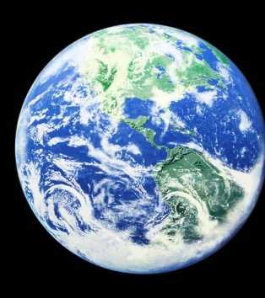
Earth is a Circle
Is. 40:22
22. It is He who sits above the circle of the earth, and its inhabitants are like grasshoppers; Who stretches out the heavens like a curtain, And spreads them like a tent to dwell in.
Notes:
Earth is a Circle: http://en.wikipedia.org/wiki/Ferdinand_Magellan

Slide 15
Earth is a Circle
Is. 40:22 (Written around 700 BC)
1519-1522 AD: Magellan (1480-1521) sailed around the world! (His crew finished the voyage after his death in April 1521)
Notes:
Earth is a Circle: http://en.wikipedia.org/wiki/Ferdinand_Magellan
https://en.wikipedia.org/wiki/Juan_Sebasti%C3%A1n_Elcano

Slide 16
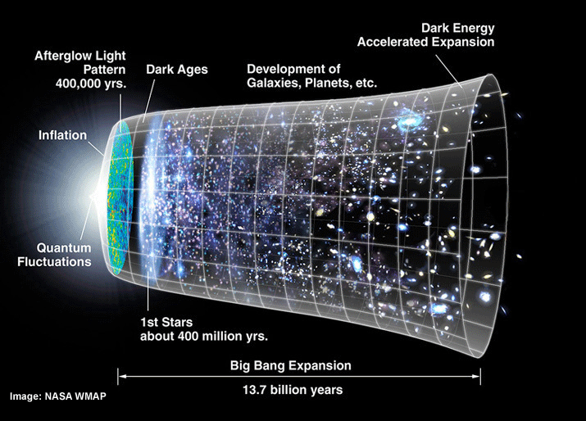
Universe Expansion
Is. 40:22
22. It is He who sits above the circle of the earth, and its inhabitants are like grasshoppers; Who stretches out the heavens like a curtain, And spreads them like a tent to dwell in.
Notes:
Universe Expansion: http://www.bbc.com/news/science-environment-15165371; Nobel physics prize honors accelerating Universe find; BBC News; October 4, 2011; http://en.wikipedia.org/wiki/Accelerating_universe; Image at: http://www.universetoday.com/89449/accelerating-expansion-of-universe-discovery-wins-2011-noble-prize-in-physics/

Slide 17
Universe Expansion
Scientists now know the universe is expanding, or stretching out.
2006 Shaw Prize in Astronomy and the 2011 Nobel Prize in Physics were both awarded to Saul Perlmutter, Brian P. Schmidt, and Adam G. Riess, who in 1998 discovered the accelerating expansion of the Universe.
At least 9 times in Scripture it says God stretches out the heavens!
(Job 26:7; Is. 40:22; 42:5; 44:24; 48:13; 51:13; Jer. 10:12; 51:15; Zech. 12:1)
Notes:
Universe Expansion: http://www.bbc.com/news/science-environment-15165371; Nobel physics prize honors accelerating Universe find; BBC News; October 4, 2011; http://en.wikipedia.org/wiki/Accelerating_universe; Image at: http://www.universetoday.com/89449/accelerating-expansion-of-universe-discovery-wins-2011-noble-prize-in-physics/

Slide 18
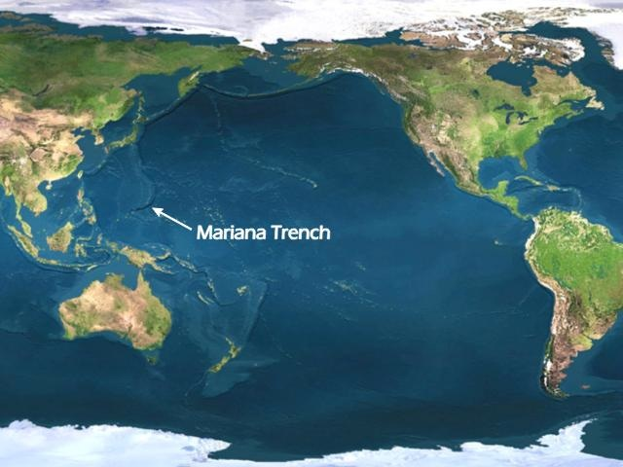
Underwater Mountains
Jonah 2:6
6. "I descended to the roots of the mountains. The earth with its bars was around me forever, But You have brought up my life from the pit, O LORD my God.
Notes:
Underwater Mountains: http://en.wikipedia.org/wiki/Underwater_mountain_range; http://www.marianatrench.com/; http://en.wikipedia.org/wiki/Mariana_Trench

Slide 19
Underwater Mountains
Only in recent years (1950’s) has man discovered that there are mountains on the ocean floor.
The greatest ocean depth has been measured in the Mariana Trench, at around 36,000 feet below sea level. By contrast, Mount Everest is only about 29,000 feet high!
Notes:
Underwater Mountains: http://en.wikipedia.org/wiki/Underwater_mountain_range; http://www.marianatrench.com/; http://en.wikipedia.org/wiki/Mariana_Trench

Slide 20
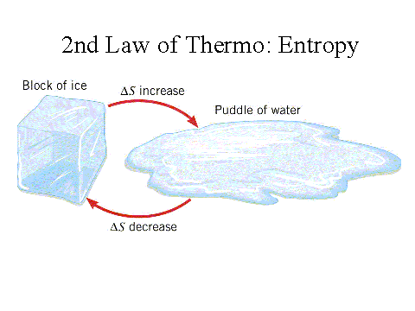
2nd Law of Thermodynamics
Heb. 1:10-11 (NKJ)
10. “You, Lord, in the beginning laid the foundation of the earth, and the heavens are the work of Your hands.
11. They will perish, but You remain; and they will all grow old like a garment
Notes:
2nd Law of Thermodynamics: http://en.wikipedia.org/wiki/Nicolas_L%C3%A9onard_Sadi_Carnot; http://en.wikipedia.org/wiki/Second_law_of_thermodynamics

Slide 21
2nd Law of Thermodynamics
God says the earth is wearing out. (Ps. 102:25-27; Is. 34:4; 51:6)
2nd Law of Thermodynamics (1800’s): “That in all physical processes, every ordered system over time tends to become more disordered.”
Notes:
2nd Law of Thermodynamics: http://en.wikipedia.org/wiki/Nicolas_L%C3%A9onard_Sadi_Carnot; http://en.wikipedia.org/wiki/Second_law_of_thermodynamics

Slide 22
Harmony of Scripture & Science
Harmony of Scriptures & Science
Scientific Fact | Scriptures | Fact Discovered
Water Cycle | Job 36:27-28 | 1882 AD by François-Marie Raoult
Earth’s Axis | Job 38:12,14 | 1851 AD by Leon Foucault
Paths of the Seas | Ps. 8:6-8 | 1840-1860 AD by Matthew F. Maury
Sun’s Ecliptic | Ps. 19:4-6 | 1800's AD
Earth is a Circle | Is. 40:22 | 1519-1522 AD by Magellan and crew
Universe Expansion | Is. 40:22 | 1998 AD by Perlmutter, Schmidt, & Reiss
Underwater Mountains | Jonah 2:6 | 1950's AD
2nd Law of Thermodynamics | Heb. 1:10-11 | 1800's AD (Stated in 1824)
Extra Fun Fact
Radio Waves | Job 38:35 | 1864 AD by James Clerk Maxwell
Notes:
Resources:
Science Increasingly Makes the Case for God, Wall Street Journal Article by Eric Mataxas, 12/25/14: http://www.wsj.com/articles/eric-metaxas-science-increasingly-makes-the-case-for-god-1419544568
http://www.evidencebible.com/witnessingtool/scientificfactsintheBible.shtml
• 5 Terms of the Universe: http://www.spaceandmotion.com/cosmos-space-time-matter-motion.htm
• 1st Law of Thermodynamics: http://en.wikipedia.org/wiki/1st_law_of_thermodynamics
• Female “Seed of Life”: http://www.custance.org/Library/SOTW/Part_II/chapter15.html; http://en.wikipedia.org/wiki/Hermann_Henking
• Life is in the Blood/Bloodletting: http://en.wikipedia.org/wiki/Pierre_Charles_Alexandre_Louis; http://www.pbs.org/wnet/redgold/basics/bloodlettinghistory.html; Childbed Fever: A scientific biography of Ignaz Semmelweis, by Codell K. & Barbara R. Carter, 2005
• Circumcision on 8th Day: http://en.wikipedia.org/wiki/Vitamin_K#History_of_discovery; http://en.wikipedia.org/wiki/Carl_Peter_Henrik_Dam; None of These Diseases by S.I. McMillen, M.D., p. 93, 1984
• Hand-washing in Running Water: http://en.wikipedia.org/wiki/Ignaz_Semmelweis; http://en.wikipedia.org/wiki/Louis_Pasteur
• Suspension of the Earth: http://en.wikipedia.org/wiki/Ptolemaic_System#Ptolemaic_system; http://en.wikipedia.org/wiki/Copernican_system
• Air Has Weight: http://superbeefy.com/who-discovered-air-pressure-and-that-the-atmosphere-has-weight-and-presses-down-on-us/; https://en.wikipedia.org/wiki/Evangelista_Torricelli; http://www.kids-fun-science.com/air-pressure-experiments.html
• Water Cycle: http://en.wikipedia.org/wiki/Raoult%27s_law; http://en.wikipedia.org/wiki/Fran%C3%A7ois-Marie_Raoult ; http://ga.water.usgs.gov/edu/watercycle.html
• Earth’s Axis: http://en.wikipedia.org/wiki/Foucault_Pendulum; http://en.wikipedia.org/wiki/L%C3%A9on_Foucault
• Paths of the Seas: http://en.wikipedia.org/wiki/Matthew_Fontaine_Maury
• Sun’s Ecliptic Path: http://en.wikipedia.org/wiki/Ecliptic; http://en.wikipedia.org/wiki/Ecliptic_coordinate_system; http://earthsky.org/space/what-is-the-ecliptic
• Earth is a Circle: http://en.wikipedia.org/wiki/Ferdinand_Magellan ; https://en.wikipedia.org/wiki/Juan_Sebasti%C3%A1n_Elcano
• Universe Expansion: http://www.bbc.com/news/science-environment-15165371; Nobel physics prize honors accelerating Universe find; BBC News; October 4, 2011; http://en.wikipedia.org/wiki/Accelerating_universe; Image at: http://www.universetoday.com/89449/accelerating-expansion-of-universe-discovery-wins-2011-noble-prize-in-physics/
• Underwater Mountains: http://en.wikipedia.org/wiki/Underwater_mountain_range; http://www.marianatrench.com/; http://en.wikipedia.org/wiki/Mariana_Trench
• 2nd Law of Thermodynamics: http://en.wikipedia.org/wiki/Second_law_of_thermodynamics; http://en.wikipedia.org/wiki/Nicolas_L%C3%A9onard_Sadi_Carnot

Slide 23
Harmony of Scripture & Science
The Scriptures were proven right, often hundreds or more years after it was written, and have been used to
discover or prove certain facts throughout time!

Slide 24
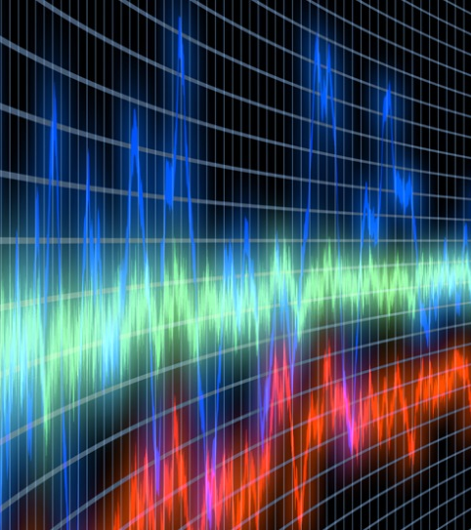
EXTRA FUN FACT: Radio Waves
Job 38:35
35. "Can you send forth lightnings that they may go And say to you, 'Here we are'?
Notes:
Radio Waves: http://en.wikipedia.org/wiki/James_Clerk_Maxwell; Modern Century Illustrated Encyclopedia, Vol. 12

Slide 25
EXTRA FUN FACT: Radio Waves
Not “discovered” until 1864 when Scottish (“British citizenship”) scientist James Clerk Maxwell suggested that electricity and light waves were two forms of the same thing
It was discovered that stars emit radio waves, which are received on earth as a high pitch. Job 38:7: “When the morning stars sang together...”
Notes:
Radio Waves: http://en.wikipedia.org/wiki/James_Clerk_Maxwell; Modern Century Illustrated Encyclopedia, Vol. 12

Slide 26
Conclusion (Part 2)
God’s word does not conflict or contradict science, but coincides in harmony with it (Defines it!)
There is no other book in any of the world’s religions that contain perfectly accurate prophetic and scientific truth
– In fact, they contain statements that are clearly
erroneous and unscientific!

Slide 27
Conclusion
Js. 1:22-25
22. But prove yourselves doers of the word, and not merely hearers who delude themselves.
23. For if anyone is a hearer of the word and not a doer, he is like a man who looks at his natural face in a mirror;
24. for once he has looked at himself and gone away, he has immediately forgotten what kind of person he was.
25. But one who looks intently at the perfect law, the law of liberty, and abides by it, not having become a forgetful hearer but an effectual doer, this man will be blessed in what he does.

Slide 28
Conclusion
The truth is before us, let us not be blinded to it but proclaim it!

Slide 29
Conclusion
Let us strengthen our faith and be the examples of the truth to the dark world around us!

Slide 30
“What Must I Do To Be Saved?”
Hear The Gospel (Jn. 5:24; Rom. 10:17)
Believe In Christ (Jn. 3:16-18; Jn. 8:24)
Repent Of Sins (Lk. 13:35; Acts 2:38)
Confess Christ (Mt. 10:32; Rom. 10:10)
Be Baptized (Mk. 16:16; Acts 22:16)
Remain Faithful (Jn. 8:31; Rev. 2:10)
For The Erring Child:
Repent (Acts 8:22), Confess (I Jn. 1:9), Pray (Acts 8:22)

Slide 31
EXTRA RESOURCE SLIDES

Slide 32
Harmony of Scripture & Science Editable Table 1
Harmony of Scriptures & Science
Scientific Fact | Scriptures | Fact Discovered
5 Terms of the Universe | Gen. 1:1-2 | Over Time – Taught Now
1st Law of Thermodynamics | Gen. 2:1 | 1800's AD (Stated in 1850)
Female “Seed of Life” | Gen. 3:15 | 1890 AD by Hermann Henking
Life is in the Blood | Gen. 9:4 | 1830's AD by Pierre Louis
Circumcision on 8th Day | Gen. 17:12 | 1939 AD by Henrik Dam
Hand-washing in Running Water | Lev. 15:13 | 1845 AD by Ignaz Semmelweis
Suspension of the Earth | Job 26:7 | 1610 AD by Galileo
Air Has Weight | Job 28:25 | 1643 AD by Evangelista Torricelli
Notes:
Resources:
Science Increasingly Makes the Case for God, Wall Street Journal Article by Eric Mataxas, 12/25/14: http://www.wsj.com/articles/eric-metaxas-science-increasingly-makes-the-case-for-god-1419544568
http://www.evidencebible.com/witnessingtool/scientificfactsintheBible.shtml
• 5 Terms of the Universe: http://www.spaceandmotion.com/cosmos-space-time-matter-motion.htm
• 1st Law of Thermodynamics: http://en.wikipedia.org/wiki/1st_law_of_thermodynamics
• Female “Seed of Life”: http://www.custance.org/Library/SOTW/Part_II/chapter15.html; http://en.wikipedia.org/wiki/Hermann_Henking
• Life is in the Blood/Bloodletting: http://en.wikipedia.org/wiki/Pierre_Charles_Alexandre_Louis; http://www.pbs.org/wnet/redgold/basics/bloodlettinghistory.html; Childbed Fever: A scientific biography of Ignaz Semmelweis, by Codell K. & Barbara R. Carter, 2005
• Circumcision on 8th Day: http://en.wikipedia.org/wiki/Vitamin_K#History_of_discovery; http://en.wikipedia.org/wiki/Carl_Peter_Henrik_Dam; None of These Diseases by S.I. McMillen, M.D., p. 93, 1984
• Hand-washing in Running Water: http://en.wikipedia.org/wiki/Ignaz_Semmelweis; http://en.wikipedia.org/wiki/Louis_Pasteur
• Suspension of the Earth: http://en.wikipedia.org/wiki/Ptolemaic_System#Ptolemaic_system; http://en.wikipedia.org/wiki/Copernican_system
• Air Has Weight: http://superbeefy.com/who-discovered-air-pressure-and-that-the-atmosphere-has-weight-and-presses-down-on-us/; https://en.wikipedia.org/wiki/Evangelista_Torricelli; http://www.kids-fun-science.com/air-pressure-experiments.html
• Water Cycle: http://en.wikipedia.org/wiki/Raoult%27s_law; http://en.wikipedia.org/wiki/Fran%C3%A7ois-Marie_Raoult ; http://ga.water.usgs.gov/edu/watercycle.html
• Earth’s Axis: http://en.wikipedia.org/wiki/Foucault_Pendulum; http://en.wikipedia.org/wiki/L%C3%A9on_Foucault
• Paths of the Seas: http://en.wikipedia.org/wiki/Matthew_Fontaine_Maury
• Sun’s Ecliptic Path: http://en.wikipedia.org/wiki/Ecliptic; http://en.wikipedia.org/wiki/Ecliptic_coordinate_system; http://earthsky.org/space/what-is-the-ecliptic
• Earth is a Circle: http://en.wikipedia.org/wiki/Ferdinand_Magellan ; https://en.wikipedia.org/wiki/Juan_Sebasti%C3%A1n_Elcano
• Universe Expansion: http://www.bbc.com/news/science-environment-15165371; Nobel physics prize honors accelerating Universe find; BBC News; October 4, 2011; http://en.wikipedia.org/wiki/Accelerating_universe; Image at: http://www.universetoday.com/89449/accelerating-expansion-of-universe-discovery-wins-2011-noble-prize-in-physics/
• Underwater Mountains: http://en.wikipedia.org/wiki/Underwater_mountain_range; http://www.marianatrench.com/; http://en.wikipedia.org/wiki/Mariana_Trench
• 2nd Law of Thermodynamics: http://en.wikipedia.org/wiki/Second_law_of_thermodynamics; http://en.wikipedia.org/wiki/Nicolas_L%C3%A9onard_Sadi_Carnot

Slide 33
Harmony of Scripture & Science Editable Table 2
Harmony of Scriptures & Science
Scientific Fact | Scriptures | Fact Discovered
Water Cycle | Job 36:27-28 | 1882 AD by François-Marie Raoult
Earth’s Axis | Job 38:12,14 | 1851 AD by Leon Foucault
Paths of the Seas | Ps. 8:6-8 | 1840-1860 AD by Matthew F. Maury
Sun’s Ecliptic | Ps. 19:4-6 | 1800's AD
Earth is a Circle | Is. 40:22 | 1519-1522 AD by Magellan and crew
Universe Expansion | Is. 40:22 | 1998 AD by Perlmutter, Schmidt, & Reiss
Underwater Mountains | Jonah 2:6 | 1950's AD
2nd Law of Thermodynamics | Heb. 1:10-11 | 1800's AD (Stated in 1824)
Extra Fun Fact
Radio Waves | Job 38:35 | 1864 AD by James Clerk Maxwell
Notes:
Resources:
Science Increasingly Makes the Case for God, Wall Street Journal Article by Eric Mataxas, 12/25/14: http://www.wsj.com/articles/eric-metaxas-science-increasingly-makes-the-case-for-god-1419544568
http://www.evidencebible.com/witnessingtool/scientificfactsintheBible.shtml
• 5 Terms of the Universe: http://www.spaceandmotion.com/cosmos-space-time-matter-motion.htm
• 1st Law of Thermodynamics: http://en.wikipedia.org/wiki/1st_law_of_thermodynamics
• Female “Seed of Life”: http://www.custance.org/Library/SOTW/Part_II/chapter15.html; http://en.wikipedia.org/wiki/Hermann_Henking
• Life is in the Blood/Bloodletting: http://en.wikipedia.org/wiki/Pierre_Charles_Alexandre_Louis; http://www.pbs.org/wnet/redgold/basics/bloodlettinghistory.html; Childbed Fever: A scientific biography of Ignaz Semmelweis, by Codell K. & Barbara R. Carter, 2005
• Circumcision on 8th Day: http://en.wikipedia.org/wiki/Vitamin_K#History_of_discovery; http://en.wikipedia.org/wiki/Carl_Peter_Henrik_Dam; None of These Diseases by S.I. McMillen, M.D., p. 93, 1984
• Hand-washing in Running Water: http://en.wikipedia.org/wiki/Ignaz_Semmelweis; http://en.wikipedia.org/wiki/Louis_Pasteur
• Suspension of the Earth: http://en.wikipedia.org/wiki/Ptolemaic_System#Ptolemaic_system; http://en.wikipedia.org/wiki/Copernican_system
• Air Has Weight: http://superbeefy.com/who-discovered-air-pressure-and-that-the-atmosphere-has-weight-and-presses-down-on-us/; https://en.wikipedia.org/wiki/Evangelista_Torricelli; http://www.kids-fun-science.com/air-pressure-experiments.html
• Water Cycle: http://en.wikipedia.org/wiki/Raoult%27s_law; http://en.wikipedia.org/wiki/Fran%C3%A7ois-Marie_Raoult ; http://ga.water.usgs.gov/edu/watercycle.html
• Earth’s Axis: http://en.wikipedia.org/wiki/Foucault_Pendulum; http://en.wikipedia.org/wiki/L%C3%A9on_Foucault
• Paths of the Seas: http://en.wikipedia.org/wiki/Matthew_Fontaine_Maury
• Sun’s Ecliptic Path: http://en.wikipedia.org/wiki/Ecliptic; http://en.wikipedia.org/wiki/Ecliptic_coordinate_system; http://earthsky.org/space/what-is-the-ecliptic
• Earth is a Circle: http://en.wikipedia.org/wiki/Ferdinand_Magellan ; https://en.wikipedia.org/wiki/Juan_Sebasti%C3%A1n_Elcano
• Universe Expansion: http://www.bbc.com/news/science-environment-15165371; Nobel physics prize honors accelerating Universe find; BBC News; October 4, 2011; http://en.wikipedia.org/wiki/Accelerating_universe; Image at: http://www.universetoday.com/89449/accelerating-expansion-of-universe-discovery-wins-2011-noble-prize-in-physics/
• Underwater Mountains: http://en.wikipedia.org/wiki/Underwater_mountain_range; http://www.marianatrench.com/; http://en.wikipedia.org/wiki/Mariana_Trench
• 2nd Law of Thermodynamics: http://en.wikipedia.org/wiki/Second_law_of_thermodynamics; http://en.wikipedia.org/wiki/Nicolas_L%C3%A9onard_Sadi_Carnot

Slide 34
Harmony of Scriptures & Science Editable Table
5 Terms of the Universe – Gen. 1:1-2 | Water Cycle – Job 36:27-28
1st Law of Thermodynamics – Gen. 2:1 | Earth’s Axis – Job 38:12, 14
Female “Seed of Life” – Gen. 3:15 | Paths of the Seas – Ps. 8:6-8
Life is in the Blood – Gen. 9:4 | Sun’s Ecliptic – Ps. 19:4-6
Circumcision on 8th Day – Gen. 17:12 | Earth is a Circle – Is. 40:22
Hand-washing in Running Water – Lev. 15:13 | Universe Expansion – Is. 40:22
Suspension of the Earth – Job 26:7 | Underwater Mountains – Jonah 2:6
Air Has Weight – Job 28:25 | 2nd Law of Thermodynamics – Heb. 1:10-11
Notes:
Resources:
Science Increasingly Makes the Case for God, Wall Street Journal Article by Eric Mataxas, 12/25/14: http://www.wsj.com/articles/eric-metaxas-science-increasingly-makes-the-case-for-god-1419544568
http://www.evidencebible.com/witnessingtool/scientificfactsintheBible.shtml
• 5 Terms of the Universe: http://www.spaceandmotion.com/cosmos-space-time-matter-motion.htm
• 1st Law of Thermodynamics: http://en.wikipedia.org/wiki/1st_law_of_thermodynamics
• Female “Seed of Life”: http://www.custance.org/Library/SOTW/Part_II/chapter15.html; http://en.wikipedia.org/wiki/Hermann_Henking
• Life is in the Blood/Bloodletting: http://en.wikipedia.org/wiki/Pierre_Charles_Alexandre_Louis; http://www.pbs.org/wnet/redgold/basics/bloodlettinghistory.html; Childbed Fever: A scientific biography of Ignaz Semmelweis, by Codell K. & Barbara R. Carter, 2005
• Circumcision on 8th Day: http://en.wikipedia.org/wiki/Vitamin_K#History_of_discovery; http://en.wikipedia.org/wiki/Carl_Peter_Henrik_Dam; None of These Diseases by S.I. McMillen, M.D., p. 93, 1984
• Hand-washing in Running Water: http://en.wikipedia.org/wiki/Ignaz_Semmelweis; http://en.wikipedia.org/wiki/Louis_Pasteur
• Suspension of the Earth: http://en.wikipedia.org/wiki/Ptolemaic_System#Ptolemaic_system; http://en.wikipedia.org/wiki/Copernican_system
• Air Has Weight: http://superbeefy.com/who-discovered-air-pressure-and-that-the-atmosphere-has-weight-and-presses-down-on-us/; https://en.wikipedia.org/wiki/Evangelista_Torricelli; http://www.kids-fun-science.com/air-pressure-experiments.html
• Water Cycle: http://en.wikipedia.org/wiki/Raoult%27s_law; http://en.wikipedia.org/wiki/Fran%C3%A7ois-Marie_Raoult ; http://ga.water.usgs.gov/edu/watercycle.html
• Earth’s Axis: http://en.wikipedia.org/wiki/Foucault_Pendulum; http://en.wikipedia.org/wiki/L%C3%A9on_Foucault
• Paths of the Seas: http://en.wikipedia.org/wiki/Matthew_Fontaine_Maury
• Sun’s Ecliptic Path: http://en.wikipedia.org/wiki/Ecliptic; http://en.wikipedia.org/wiki/Ecliptic_coordinate_system; http://earthsky.org/space/what-is-the-ecliptic
• Earth is a Circle: http://en.wikipedia.org/wiki/Ferdinand_Magellan ; https://en.wikipedia.org/wiki/Juan_Sebasti%C3%A1n_Elcano
• Universe Expansion: http://www.bbc.com/news/science-environment-15165371; Nobel physics prize honors accelerating Universe find; BBC News; October 4, 2011; http://en.wikipedia.org/wiki/Accelerating_universe; Image at: http://www.universetoday.com/89449/accelerating-expansion-of-universe-discovery-wins-2011-noble-prize-in-physics/
• Underwater Mountains: http://en.wikipedia.org/wiki/Underwater_mountain_range; http://www.marianatrench.com/; http://en.wikipedia.org/wiki/Mariana_Trench
• 2nd Law of Thermodynamics: http://en.wikipedia.org/wiki/Second_law_of_thermodynamics; http://en.wikipedia.org/wiki/Nicolas_L%C3%A9onard_Sadi_Carnot

Slide 35
Harmony of Scripture & Science Pic
Notes:
Resources:
Science Increasingly Makes the Case for God, Wall Street Journal Article by Eric Mataxas, 12/25/14: http://www.wsj.com/articles/eric-metaxas-science-increasingly-makes-the-case-for-god-1419544568
http://www.evidencebible.com/witnessingtool/scientificfactsintheBible.shtml
• 5 Terms of the Universe: http://www.spaceandmotion.com/cosmos-space-time-matter-motion.htm
• 1st Law of Thermodynamics: http://en.wikipedia.org/wiki/1st_law_of_thermodynamics
• Female “Seed of Life”: http://www.custance.org/Library/SOTW/Part_II/chapter15.html; http://en.wikipedia.org/wiki/Hermann_Henking
• Life is in the Blood/Bloodletting: http://en.wikipedia.org/wiki/Pierre_Charles_Alexandre_Louis; http://www.pbs.org/wnet/redgold/basics/bloodlettinghistory.html; Childbed Fever: A scientific biography of Ignaz Semmelweis, by Codell K. & Barbara R. Carter, 2005
• Circumcision on 8th Day: http://en.wikipedia.org/wiki/Vitamin_K#History_of_discovery; http://en.wikipedia.org/wiki/Carl_Peter_Henrik_Dam; None of These Diseases by S.I. McMillen, M.D., p. 93, 1984
• Hand-washing in Running Water: http://en.wikipedia.org/wiki/Ignaz_Semmelweis; http://en.wikipedia.org/wiki/Louis_Pasteur
• Suspension of the Earth: http://en.wikipedia.org/wiki/Ptolemaic_System#Ptolemaic_system; http://en.wikipedia.org/wiki/Copernican_system
• Air Has Weight: http://superbeefy.com/who-discovered-air-pressure-and-that-the-atmosphere-has-weight-and-presses-down-on-us/; https://en.wikipedia.org/wiki/Evangelista_Torricelli; http://www.kids-fun-science.com/air-pressure-experiments.html
• Water Cycle: http://en.wikipedia.org/wiki/Raoult%27s_law; http://en.wikipedia.org/wiki/Fran%C3%A7ois-Marie_Raoult ; http://ga.water.usgs.gov/edu/watercycle.html
• Earth’s Axis: http://en.wikipedia.org/wiki/Foucault_Pendulum; http://en.wikipedia.org/wiki/L%C3%A9on_Foucault
• Paths of the Seas: http://en.wikipedia.org/wiki/Matthew_Fontaine_Maury
• Sun’s Ecliptic Path: http://en.wikipedia.org/wiki/Ecliptic; http://en.wikipedia.org/wiki/Ecliptic_coordinate_system; http://earthsky.org/space/what-is-the-ecliptic
• Earth is a Circle: http://en.wikipedia.org/wiki/Ferdinand_Magellan ; https://en.wikipedia.org/wiki/Juan_Sebasti%C3%A1n_Elcano
• Universe Expansion: http://www.bbc.com/news/science-environment-15165371; Nobel physics prize honors accelerating Universe find; BBC News; October 4, 2011; http://en.wikipedia.org/wiki/Accelerating_universe; Image at: http://www.universetoday.com/89449/accelerating-expansion-of-universe-discovery-wins-2011-noble-prize-in-physics/
• Underwater Mountains: http://en.wikipedia.org/wiki/Underwater_mountain_range; http://www.marianatrench.com/; http://en.wikipedia.org/wiki/Mariana_Trench
• 2nd Law of Thermodynamics: http://en.wikipedia.org/wiki/Second_law_of_thermodynamics; http://en.wikipedia.org/wiki/Nicolas_L%C3%A9onard_Sadi_Carnot

