Slide 1
Three Calls To Saints
Text: Romans 12:1-2
Notes:
Prepared by Nathan L Morrison
All Scripture given is from NASB unless otherwise stated
For further study, or if questions, please Call: 804-277-1983 or Visit www.courthousechurchofcrist.com

Slide 2
INTRO
Every individual has been called by God to live a life that brings honor and glory to Him!
(Col. 3:17, 23-24; II Thess. 2:13-14; II Pet. 1:3)
II Thess. 2:13-14
13. But we should always give thanks to God for you, brethren beloved by the Lord, because God has chosen you from the beginning for salvation through sanctification by the Spirit and faith in the truth.
14. It was for this He called you through our gospel, that you may gain the glory of our Lord Jesus Christ.
Once obeyed the gospel, the saint must change from
a child of the world to a child of God!

Slide 3
Intro
Rom. 12:1-2
1. Therefore I urge you, brethren, by the mercies of God, to present your bodies a living and holy sacrifice, acceptable to God, which is your spiritual service of worship.
2. And do not be conformed to this world, but be transformed by the renewing of your mind, so that you may prove what the will of God is, that which is good and acceptable and perfect.
Transforming happens by the renewal of one’s mind!
(II Cor. 10:5: Taking thoughts captive…)

Slide 4
Call to Attention
Romans 12:1: Therefore I urge you, brethren,
by the mercies of God…
“URGE” (KJV: “Beseech”) is a strong word in Greek and in English!

Slide 5
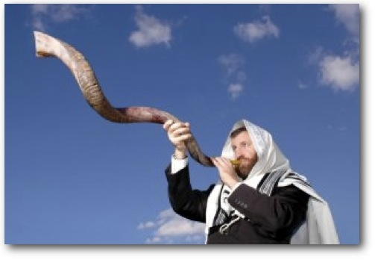
Call to Attention
“Urge” – Rom. 12:1
Greek parakaleō [par-ak-al-eh'-o] (G3870): From G3844 and G2564; to call near, that is, invite, invoke (by imploration, exhortation or consolation); to beg, plead with, or to persuade: - beseech, call for, (be of good) comfort, desire, (give) exhort (-ation), intreat, pray.
Paraphrase: “I beg you brethren, give yourselves to God!”

Slide 6
Call to Attention
Romans 12:1: Therefore I urge you, brethren,
by the mercies of God…
“URGE” (KJV: “Beseech”)
“YOU” – Personal!

Slide 7
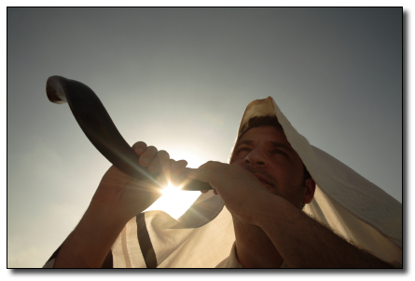
Call to Attention
“You” – Rom. 12:1
The Holy Spirit, through Paul, was speaking to the brethren at Rome and through this letter is speaking to “you” and me!
You must do what God wants you to do!
II Cor. 5:10; Rom. 14:11-12

Slide 8
Call to Attention
Romans 12:1: Therefore I urge you, brethren,
by the mercies of God…
“URGE” (KJV: “Beseech”)
“YOU”
“BRETHREN” – Christians, saints

Slide 9
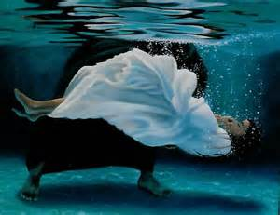
Call to Attention
“Brethren” – Rom. 12:1
This call is for the redeemed, those in the household of God who are fellow heirs with Jesus; His brothers and sisters (Rom. 8:14-17)
If you are not saved, God’s call to you is for salvation first! (Gal. 3:26-29)
You must become part of the household of God (I Tim. 3:15) first before this call applies to you!

Slide 10
Call to Attention
Romans 12:1: Therefore I urge you, brethren,
by the mercies of God…
“URGE” (KJV: “Beseech”)
“YOU”
“BRETHREN”
“BY THE MERCIES OF GOD” (Eph. 2:8)

Slide 11
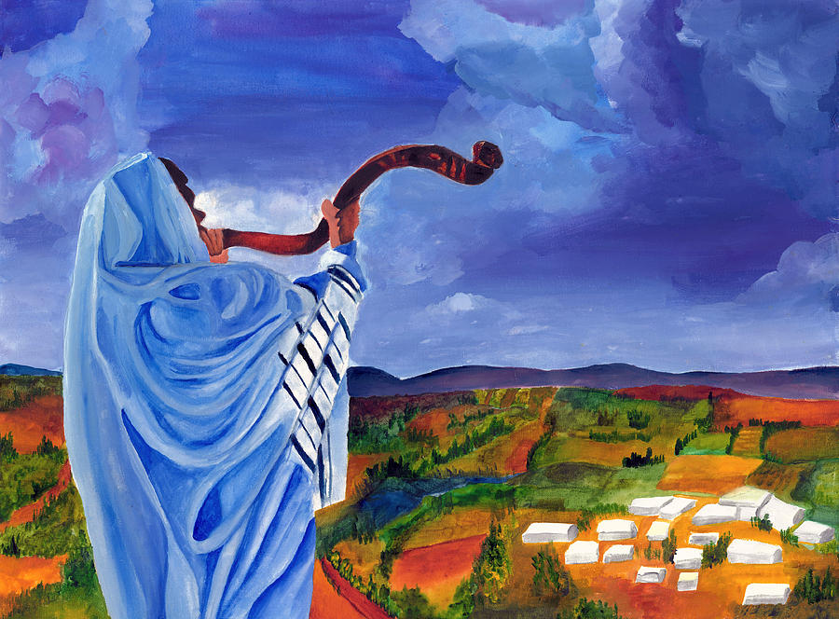
Call to Attention
“By the mercies of God” – Rom. 12:1
Paul’s strong call to attention (“Urge”/”Beseech”) was based on the mercies of God – Eph. 2:5

Slide 12
Call to Attention
Romans 12:1: Therefore I urge you, brethren,
by the mercies of God…
“URGE”
“YOU”
“BRETHREN”
“BY THE MERCIES OF GOD”
God was calling the Roman saints to attention,
and He is calling “you” to attention today!

Slide 13
Call to Sacrifice
Romans 12:1: …to present your bodies a living and holy sacrifice, acceptable to God, which is your spiritual service of worship…
LIVING SACRIFICE – God wants not part of, but all of you now!

Slide 14
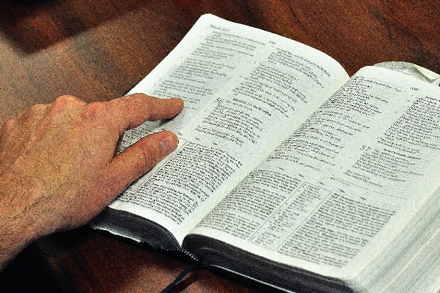
Call to Sacrifice
“Living Sacrifice” – Rom. 12:1
Total commitment (Lk. 9:62: Not a trial basis) – Eph. 4:15-16
Rom. 6:11-13: Saints to offer themselves to God so that their whole bodies would be for God’s glory.
Our bodies are all we have to offer—I Cor. 6:15-17
The body enfolds our emotions, our mind, our thoughts, our desires, and our plans (Rom. 6:13: Be an instrument of righteousness).
In order to live for God, we must give Him all that we are, represented by our body (Gal. 2:20; Rom. 6:4-7)
I Cor. 6:18-20: Glorify God in your body!

Slide 15
Call to Sacrifice
Romans 12:1: …to present your bodies a living and holy sacrifice, acceptable to God, which is your spiritual service of worship…
LIVING SACRIFICE
HOLY SACRIFICE – What is a Holy Sacrifice?

Slide 16
Call to Sacrifice
“Holy Sacrifice” – Rom. 12:1
Holy means “set apart” We are to be set apart from sin!
Col. 3:5; I Jn. 2:15-17
We are to be separated from sin and separated unto God! (Gal. 5:24)
Our new life is a thank-offering to God –completely set apart for God and dedicated to His service (Col. 3:5)
I Peter 1:14-16
14. As obedient children, do not be conformed to the former lusts which were yours in your ignorance,
15. but like the Holy One who called you, be holy yourselves also in all your behavior;
16. because it is written, "YOU SHALL BE HOLY, FOR I AM HOLY."

Slide 17
Call to Sacrifice
Romans 12:1: …to present your bodies a living and holy sacrifice, acceptable to God, which is your spiritual service of worship…
LIVING SACRIFICE
HOLY SACRIFICE
ACCEPTABLE SACRIFICE - What is an Acceptable Sacrifice?

Slide 18
Call to Sacrifice
“Acceptable Sacrifice” – Rom. 12:1
God doesn’t want rituals but obedience!
Sacrifice was important – In O.T. God made it clear that obedience from the heart was much more important (I Sam. 15:22; Ps. 40:6; Amos 5:21-24; Mal. 1:6-14) – Mt. 15:7-9: Jesus says though the Jews worshiped Him, their hearts were far from Him!
God wants us to offer ourselves as living sacrifices
Heb. 13:15-16; I Pet. 2:5

Slide 19
Call to Sacrifice
Romans 12:1: …to present your bodies a living and holy sacrifice, acceptable to God, which is your spiritual service of worship…
LIVING SACRIFICE
HOLY SACRIFICE
ACCEPTABLE SACRIFICE
SPIRITUAL SACRIFICE – What is a Spiritual (NKJ: “Reasonable”) Sacrifice?

Slide 20
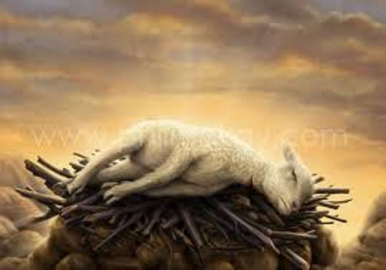
Call to Sacrifice
“Spiritual Sacrifice” – Rom. 12:1
Let’s look at what God has done for you:
Your past sins washed away in the blood of Jesus – Is. 1:18; Acts 22:16; Eph. 1:7
Your future is settled in heaven – John 14:1-3; I Pet. 1:4
Your needs are being provided – Mt. 6:33 (6:25-31); Phil. 4:19
To give yourself to God totally and unselfishly (Mk. 12:30), so that He can use you however He sees fit (Rom. 12:6; I Cor. 12:11) – Eph. 4:15-16 (Heb. 12:2-3)

Slide 21
Call to Sacrifice
Romans 12:1: …to present your bodies a living and holy sacrifice, acceptable to God, which is your spiritual service of worship…
LIVING SACRIFICE
HOLY SACRIFICE
ACCEPTABLE SACRIFICE
SPIRITUAL SACRIFICE
God wants our sacrifice – to put sin to death
and live as a new creature in Christ!

Slide 22
Call to Transform
Romans 12:2: And do not be conformed to this
world, but be transformed by the renewing of
your mind, so that you may prove what the will of
God is, that which is good and acceptable and
perfect.
NEGATIVE PRINCIPLE—“…do not be conformed to this world…”

Slide 23
Call to Transform
“Do not be conformed to this world” –
Rom. 12:2
Stop letting the world and its lifestyle shape your minds and character – Stay with Christ! (Remember you died to sin – Rom. 6:1-4; Col. 3:1-3)
I Jn. 2:15-17: Not to love the world or things of the world!
I John 2:15
15. Do not love the world nor the things in the world. If anyone loves the world, the love of the Father is not in him.

Slide 24
Call to Transform
Romans 12:2: And do not be conformed to this
world, but be transformed by the renewing of
your mind, so that you may prove what the will of
God is, that which is good and acceptable and
perfect.
“…do not be conformed to this world…”
POSITIVE PRINCIPLE—“…be transformed by the renewing of your mind…”

Slide 25
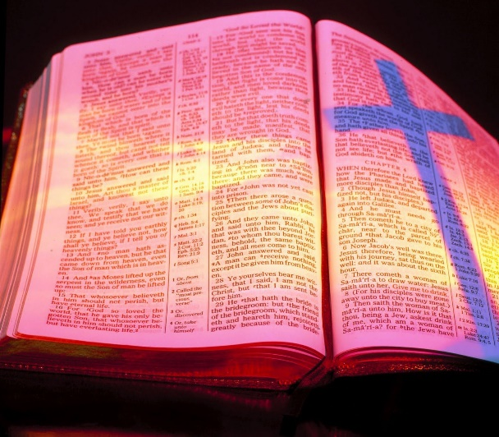
Call to Transform
“Be transformed by the renewing of your mind”
Rom. 12:2
To transform is to be something different than you are!
So many want to transform God’s word, to mold it and conform it to what’s convenient and comfortable to them!
We are to put to death the old self (worldly self and desires) and be a new creature in Christ! (Rom. 6:3-7; Gal. 5:24)
Phil. 4:8
8. Finally, brethren, whatever is true, whatever is honorable, whatever is right, whatever is pure, whatever is lovely, whatever is of good repute, if there is any excellence and if anything worthy of praise, dwell on these things.

Slide 26
Call to Transform
Romans 12:2: And do not be conformed to this
world, but be transformed by the renewing of
your mind, so that you may prove what the will of
God is, that which is good and acceptable and
perfect.
“…do not be conformed to this world…”
“…be transformed by the renewing of your mind…”
The child of God will transform his/her life by the renewing of the mind (thoughts)!

Slide 27
Conclusion
Mark 12:30
30. AND YOU SHALL LOVE THE LORD YOUR GOD WITH ALL YOUR HEART, AND WITH ALL YOUR SOUL, AND WITH ALL YOUR MIND, AND WITH ALL YOUR STRENGTH.'

Slide 28
Conclusion
Rom. 12:1-2: We can only obey the Lord in
giving Him all we are when we answer the
call to:
Attention – Pay heed to what is said!
Sacrifice – Glorify God in our bodies (lives)!
Transform – Change from a child of Satan to a child of God!

Slide 29
Conclusion
Let us be transformed by the word of God and
give glory to Him in the way we live our lives!

Slide 30
“What Must I Do To Be Saved?”
Hear The Gospel (Jn. 5:24; Rom. 10:17)
Believe In Christ (Jn. 3:16-18; Jn. 8:24)
Repent Of Sins (Lk. 13:35; Acts 2:38)
Confess Christ (Mt. 10:32; Rom. 10:10)
Be Baptized (Mk. 16:16; Acts 22:16)
Remain Faithful (Jn. 8:31; Rev. 2:10)
For The Erring Saint:
Repent (Acts 8:22), Confess (I Jn. 1:9),
Pray (Acts 8:22)

