Slide 1
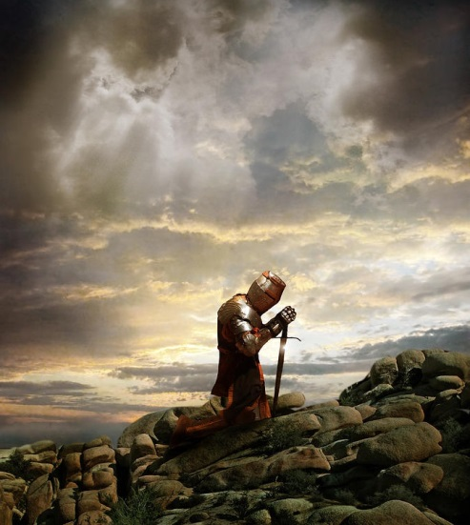
“Know The God Of Your Father”
Text: I Chr. 28:9
Notes:
Prepared by Nathan L Morrison
All Scripture given is from NASB unless otherwise stated
For further study, or if questions, please Call: 804-277-1983 or Visit www.courthousechurchofcrist.com
Based on a lesson by Richard Thetford

Slide 2
Intro
I Chr. 28:1-8
David had a great desire to “build a permanent home for the ark of the covenant of the Lord” (28:2).
He had prepared to build it but God told him since he was a “man of war” he was not permitted to build it (28:3).
David gathered all the people together to announce to them God had chosen Solomon to build the temple, and then he charged the people to keep God’s laws (28:8).
I Chr. 28:9-10
9. "As for you, my son Solomon, know the God of your father, and serve Him with a whole heart and a willing mind; for the LORD searches all hearts, and understands every intent of the thoughts. If you seek Him, He will let you find Him; but if you forsake Him, He will reject you forever.
10. "Consider now, for the LORD has chosen you to build a house for the sanctuary; be courageous and act."
Although made to an ancient king, David’s charge to
his son contains lessons for today!

Slide 3
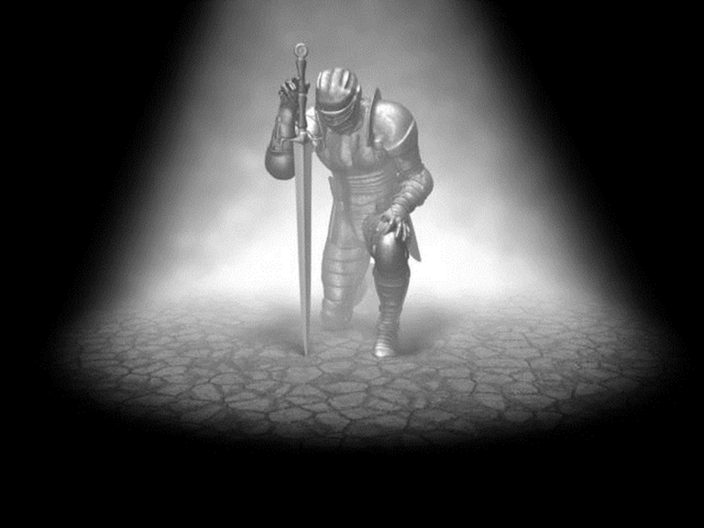
“Know the God of Your Father”
David knew the importance of knowing God!
(Jud. 21:25; Hos. 4:6)
Some today are like those Paul spoke about in Rom. 1:21
He said they did not like to retain God in their knowledge (NKJ: Rom. 1:28)
How can we know God today?
Eph. 6:4; I Jn. 2:3-4
I Jn. 2:3-4
3. By this we know that we have come to know Him, if we keep His commandments.
4. The one who says, "I have come to know Him," and does not keep His commandments, is a liar, and the truth is not in him;
We need to know God & teach others to know Him too!

Slide 4
“Serve Him with a Whole Heart and a Willing Mind”
Service to God has always been required of men!
I Chr. 29:19; Js. 1:21-22; Heb. 5:9
Our service to God must be a wholehearted service!
Mk. 12:30; Mt. 5:48
Mk. 12:30
30. AND YOU SHALL LOVE THE LORD YOUR GOD WITH ALL YOUR HEART, AND WITH ALL YOUR SOUL, AND WITH ALL YOUR MIND, AND WITH ALL YOUR STRENGTH.'
We need to be willing to serve
God, and serve Him with our whole hearts!

Slide 5
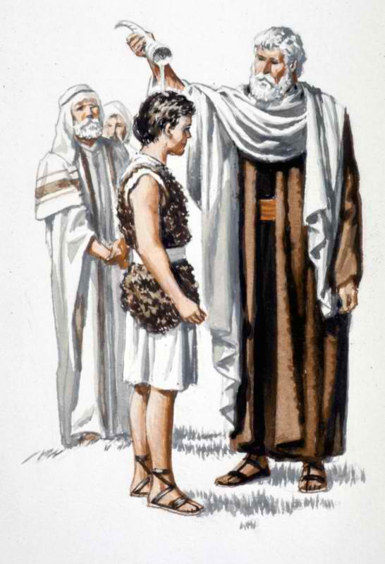
“The Lord Searches (& Understands) All Hearts”
God said this to Samuel when choosing David as king…
I Sam. 16:7 (16:12-13; I Sam. 13:14)
7. But the LORD said to Samuel, "Do not look at his appearance or at the height of his stature, because I have rejected him; for God sees not as man sees, for man looks at the outward appearance, but the LORD looks at the heart."
David welcomed the search of God!
(Ps. 139:23-24)

Slide 6
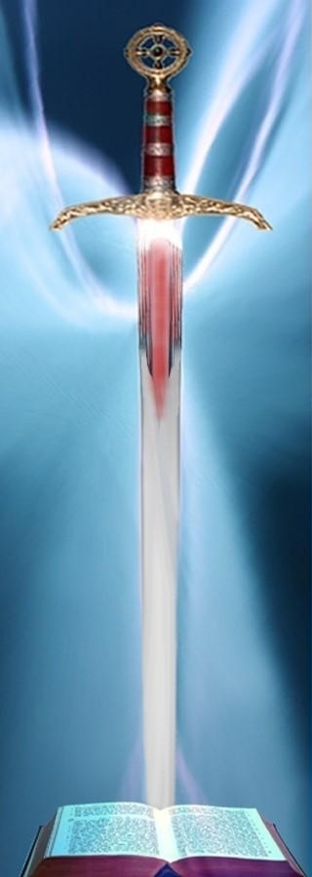
“The Lord Searches (& Understands) All Hearts”
God knows mankind’s heart
and holds them accountable
Gen. 6:5; Mt. 15:19-20;
Rom. 14:12; II Cor. 5:10
Heb. 4:12
12. For the word of God is living and active and sharper than any two-edged sword, and piercing as far as the division of soul and spirit, of both joints and marrow, and able to judge the thoughts and intentions of the heart.
God sees us for what we are – Let us adorn our hearts with righteousness in all our ways!

Slide 7
“If You Seek Him, He Will Let You Find Him”
Jer. 29:13
13. 'You will seek Me and find Me when you search for Me with all your heart.
Ps. 119:2: David said a blessing is in store for those that “seek Him with all their heart.” (II Chr. 34:3: Josiah)
Jn. 6:26: Jesus rebuked those who searched for Him for wrong reasons!
Acts 17:27
The apostle Paul told the Athenians to seek for God and they could find Him (Mt. 7:7-8)
Notes:
Emphasis in Scriptures mine!

Slide 8
“If You Seek Him, He Will Let You Find Him”
What is promised to those who seek after the Lord?
Rom. 2:7 (II Tim. 1:1)
7. to those who by perseverance in doing good seek for glory and honor and immortality, eternal life;
Who or what are YOU seeking?!
Notes:
Emphasis in Scriptures mine!

Slide 9
“If You Forsake Him, He Will Reject You Forever”
Joshua 24:20
20. "If you forsake the LORD and serve foreign gods, then He will turn and do you harm and consume you after He has done good to you."
I Sam. 13:13-14; 15:26: Samuel taught this harsh lesson to Saul!
Mt. 10:32-33: Must confess Christ, not deny Him
Jn. 12:42-43: The Jewish rulers denied Him, though they knew Him!
Mt. 26:74-75: Peter sinned when he denied Jesus 3 times!
Jn. 12:48: Jesus’ word will judge those who reject Him!
II Thess. 1:7-9: Penalty for rejecting God is an eternity away from Him!

Slide 10
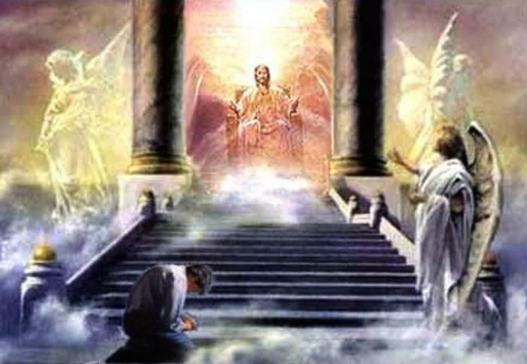
“If You Forsake Him, He Will Reject You Forever”
Heb. 13:5 (Heb. 5:9)
5. Make sure that your character is free from the love of money, being content with what you have; for He Himself has said, "I WILL NEVER DESERT YOU, NOR WILL I EVER FORSAKE YOU,"
It is man who rejects God, and when
one does this, he is judged accordingly!

Slide 11
Conclusion
David’s charge to Solomon in I Chr. 28:9 is still great
advice today!
Rom. 15:4
4. For whatever was written in earlier times was written for our instruction, so that through perseverance and the encouragement of the Scriptures we might have hope.

Slide 12
Conclusion
We need to study God’s word so
that we can know:
The God of our fathers
How to serve Him with a whole heart and willing mind
That the Lord searches all of our hearts and understands our thoughts
That if we seek Him, we will find Him
That if we forsake Him, we will be cast off forever
David’s charge to Solomon sums up
the life of a faithful child of God no
matter what time period it is!
When we do these things we will have a home in
Heaven with the Lord forever!

Slide 13
“What Must I Do To Be Saved?”
Hear The Gospel (Jn. 5:24; Rom. 10:17)
Believe In Christ (Jn. 3:16-18; Jn. 8:24)
Repent Of Sins (Lk. 13:35; Acts 2:38)
Confess Christ (Mt. 10:32; Rom. 10:10)
Be Baptized (Mk. 16:16; Acts 22:16)
Remain Faithful (Jn. 8:31; Rev. 2:10)
For The Erring Child:
Repent (Acts 8:22), Confess (I Jn. 1:9),
Pray (Acts 8:22)

