Slide 1
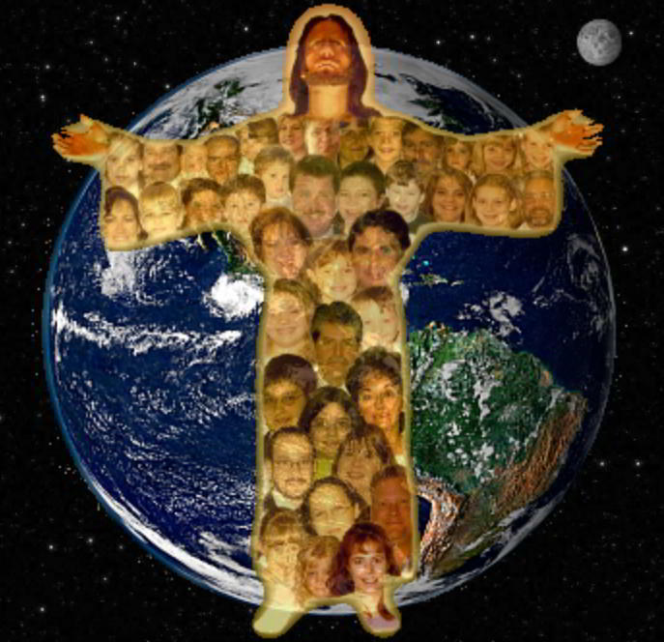
The Church Jesus Died To Save
Text: Mt. 16:16-19; Is. 2:1-3
Notes:
By Nathan L Morrison
All Scripture given is from the NASB, unless otherwise stated
For further study, or if questions, please Call: 804-277-1983 or Visit www.courthousechurchofcrist.com
Some points from a lesson by Richard Thetford

Slide 2
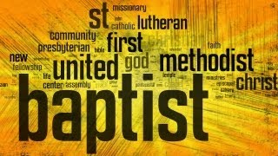
Intro
There are many misconceptions about the church which Jesus established
The misconceptions are from confusion over the religious
world’s many churches all claiming to have been
the one Jesus founded!

Slide 3
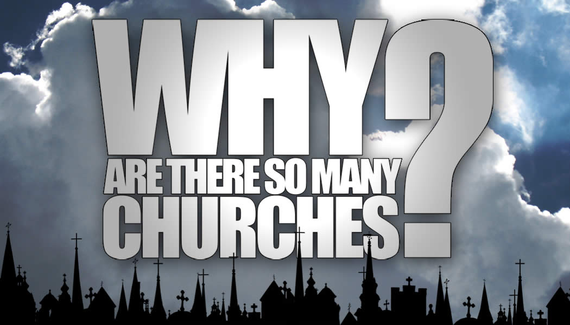
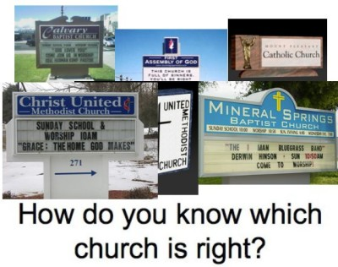
Intro
Notes:
Image: http://www.wvbs.org/

Slide 4
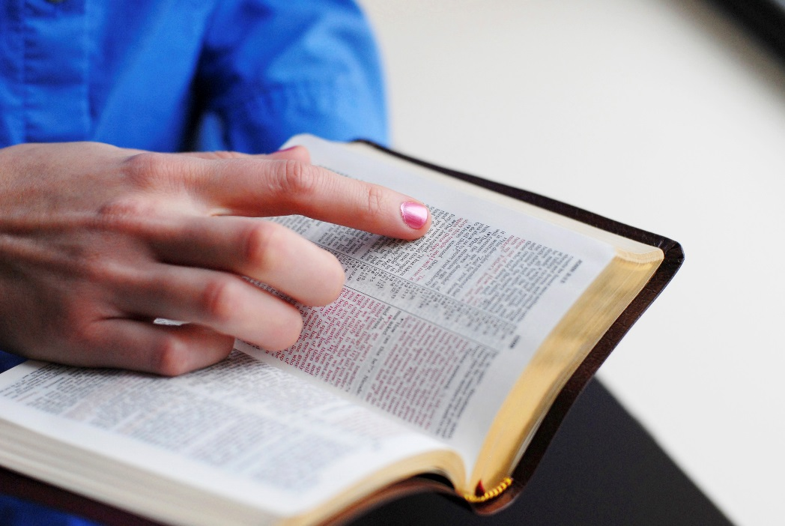
Intro
The question people should be asking is,
“Is it the church Jesus died to build & save?”
If one church is as good as another, then Christ’s blood was spilled in vain, for He said He would build His church (singular, not plural) – Mt. 16:18; Acts 20:28; Eph. 4:4
In a world full of
many churches,
how can I identify the church that Jesus died to
build and save?

Slide 5
The Church Jesus Died to Save
Built By the Right Founder
Jeremiah 23:5-6 (Malachi 3:1-3)
5. "Behold, the days are coming," declares the LORD, "When I will raise up for David a righteous Branch; And He will reign as king and act wisely And do justice and righteousness in the land.
6. "In His days Judah will be saved, And Israel will dwell securely; And this is His name by which He will be called, 'The LORD our righteousness.'
Matthew 16:18
18. "I also say to you that you are Peter, and upon this rock I will build My church; and the gates of Hades will not overpower it.

Slide 6
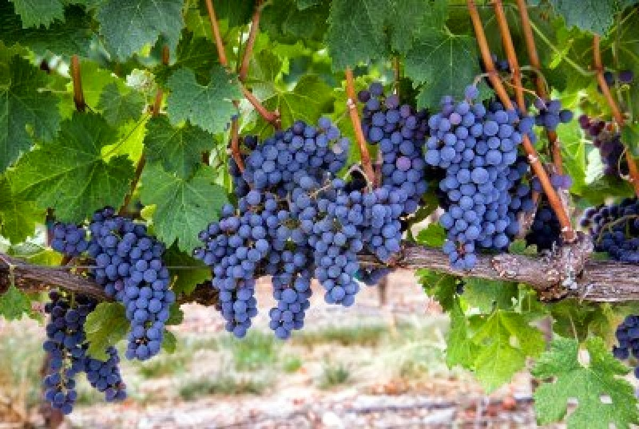
It Was Built By the Right Founder
There is only one church Jesus built! (Jn. 15:1-8) –
Jesus is the Vine & saints the branches
“My church” (Mt. 16:18) indicates possession, so the church He is Savior of (Eph. 5:23) is the church that belongs to Christ (or, church of Christ)
Mark 9:1; Acts 2:47; 20:28: Jesus built His church as promised in the 1st century on the Day of Pentecost!
He gave His blood to build His church (Acts 20:28).
He never promised any other church – just His own church, bought with blood, and Spirit-filled all over the world! (Mt. 28:18-20; Mk. 16:15-16)
He promised to save those in His church (body) – Eph. 5:23 (Eph. 1:22-23)

Slide 7
It Was Built By the Right Founder
Mt. 15:13-14: Jesus also said any “plant” not planted by God will be uprooted”
There have been many people who have founded churches (They are the vine of their own religion),
but if built by men then not built by Jesus & will be uprooted!
If not built by Jesus Christ, then that church
is from man, and not from God!
Notes:
Uproot Photograph - Uprooted Tree by Andrzej Wojcicki

Slide 8
The Church Jesus Died to Save
Built by the Right Founder
Built in the Right Place
Isaiah 2:1-3
1. The word which Isaiah the son of Amoz saw concerning Judah and Jerusalem.
2. Now it will come about that In the last days The mountain of the house of the LORD Will be established as the chief of the mountains, And will be raised above the hills; And all the nations will stream to it.
3. And many peoples will come and say, "Come, let us go up to the mountain of the LORD, To the house of the God of Jacob; That He may teach us concerning His ways And that we may walk in His paths." For the law will go forth from Zion And the word of the LORD from Jerusalem.

Slide 9
It Was Built In the Right Place
Mark 9:1; Acts 1:9-12; 2:1-5, 47:
The church was founded in Jerusalem!
Ps. 127:1: Unless God builds the house it is in vain!
Any church that had its beginning in any place other than
Jerusalem is not the church Isaiah prophesied about
being built in Jerusalem, nor the church Jesus built!
The church Jesus built started in Jerusalem
as was foretold!

Slide 10
The Church Jesus Died to Save
Built by the Right Founder
Built in the Right Place
Built at the Right Time
Daniel 2:44 (Gal. 4:4: “Fullness of time came”)
4. "In the days of those kings the God of heaven will set up a kingdom which will never be destroyed, and that kingdom will not be left for another people; it will crush and put an end to all these kingdoms, but it will itself endure forever.

Slide 11
It Was Built At the Right Time
Acts 11:15: “…as upon us at the beginning”
This points back to the day of Pentecost (Pente = 50; cost = day) in Acts 2.
The church was established 50 days after Christ rose from the dead.
This was long before the denominations came into being!
Any church not built in Jerusalem on the day of Pentecost in the 1st c. is not the church Jesus built!
(The days of the Romans are long gone – Gal. 4:4: When the “fullness of time came”)
The church Jesus built was in the 1st century (“days of those kings” – the Romans) as God foretold through the prophets!

Slide 12
The Church Jesus Died to Save
Built by the Right Founder
Built in the Right Place
Built at the Right Time
Built on the Right Foundation & Doctrine
Isaiah 28:16
16. Therefore thus says the Lord GOD, "Behold, I am laying in Zion a stone, a tested stone, A costly cornerstone for the foundation, firmly placed. He who believes in it will not be disturbed.

Slide 13
It Was Built On the Right Foundation
Scriptures teach Christ is the foundation!
I Cor. 3:10-11: The foundation is Christ, and no other foundation can be laid!
I Pet. 2:4-6: A living foundation upon which living stones are being built! (Quotes from Is. 28:16)
From the time of its establishment the church of Christ teaches the correct doctrine!
Acts 2:42: They continued “steadfastly in the apostles’ doctrine.”
II Tim. 3:16-17: The Scriptures are “profitable for doctrine.”
Jn. 8:31; II Jn. 9: Must continue (abide) in the words (doctrine, teaching) of Jesus Christ! (I Tim. 4:6, 16; Titus 2:1: Hold fast to “sound doctrine” and “Continue in them” [NKJ] to save both teacher & hearer!)
II Pet. 1:3: God’s word, through the knowledge of Jesus, provides “everything pertaining to life and godliness.”

Slide 14
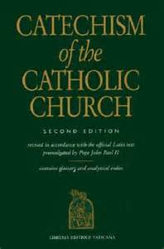
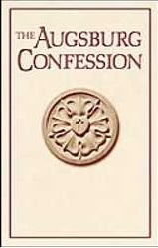
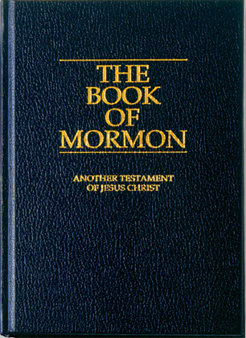
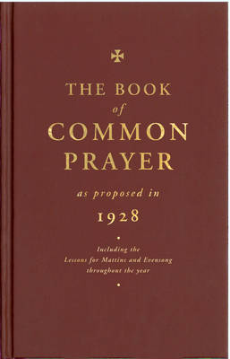
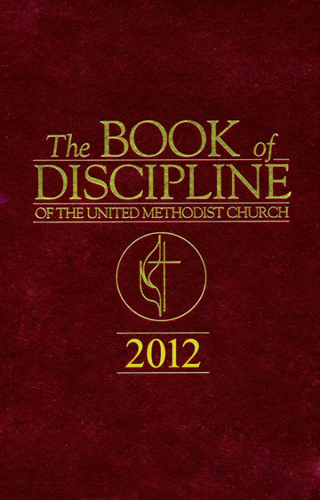
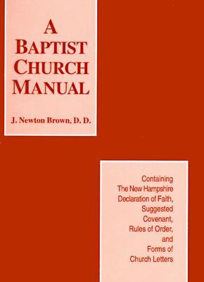
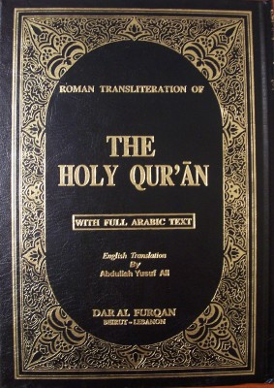
It Was Built On the Right Foundation
No other man-made creeds or manuals needed!
The church built by Jesus was founded by and
on Jesus (no other foundation can be laid) &
the church that belongs to Jesus teaches
no other doctrine than that of Christ (II Jn. 9)!

Slide 15
The Church Jesus Died to Save
Built by the Right Founder
Built in the Right Place
Built at the Right Time
Built on the Right Foundation & Doctrine
Wears the Right Name
Romans 16:16
16. Greet one another with a holy kiss. All the churches of Christ greet you.

Slide 16
It Wears the Right Name
Mt. 16:18
18. "I also say to you that you are Peter, and upon this rock I will build My church; and the gates of Hades will not overpower it.
“MY” is a personal pronoun that denotes possession –
the church belongs to Christ!
“Christians are the “branches” to Christ’s “Vine”
(Jn. 15:1-8) – Eph. 4:4: One body!
Names given for the church:
Church(es) of Christ (Rom. 16:16)
Church of God (Acts 20:28)
Church of the Living God (I Tim. 3:15)
Church of the firstborn (Heb. 12:23)
Any church called by a different name is not the church
that belongs to Jesus!
Notes:
Emphasis in Scripture mine!

Slide 17
It Wears the Right Name
Founder | Place | Time | Foundation | Name
Christ | Jerusalem | Pentecost – 1st c. AD | Christ | church of Christ
Pope Boniface III | Rome | 606 AD | Catholic Catechism & Apostle’s, Nicene & Athanasian Creeds | Catholic Church
Muhammad | Medina | 610 AD | Koran (Others) | Islam
Martin Luther | Germany | 1517/1526 | Augsburg Confessions (1530) | Lutherans
King Henry VIII | England | 1534 | Book of Common Prayer, Catholic Creeds & Thirty-Nine Articles of Religion | Church of England
John Knox | Geneva & Scotland | 1560 | Book of Common Prayer & Calvinism | Presbyterians
John Smyth | Holland | 1609 | Baptist’s Manual | Baptists
John Wesley | England | 1739 | The Book of Discipline | Methodists
King Henry VIII/Samuel Seabury | U.S.A. | 1783 | Book of Common Prayer, Catholic Creeds & Thirty-Nine Articles of Religion (Tailored to USA) | Episcopal

Slide 18
It Wears the Right Name
Founder | Place | Time | Foundation | Name
Christ | Jerusalem | Pentecost – 1st c. AD | Christ | church of Christ
Joseph Smith | U.S.A. | 1830 | Book of Mormon (Others) | Mormons
Ellen G. White | U.S.A. | 1844-1863 | The Great Controversy (Others) | Seventh Day Adventists
Charles Taze Russell | U.S.A. | 1870 | The Watchtower Society | Jehovah’s Witnesses
Mary Baker Eddy | U.S.A. | 1875 | Science and Health (1875) | Christian Scientists
Charles Parham | U.S.A. | 1901 | Assemblies of God Statement of Fundamental Truths (Direct operation of Holy Spirit) | Pentecostals (Many Variations: Assemblies of God (Church of God) Church of the Nazarene
L. Ron Hubbard | U.S.A. | 1953 | Dianetics | Church of Scientology (Scientology)
Chuck Smith | U.S.A. | 1965 | Broke from Pentecostals | Calvary Chapel

Slide 19
It Wears the Right Name
These churches were built by men 600-1900 years after Christ built His church:
The members who call themselves after men are their “branches!”
The church of Christ is too old to be a
denomination, and the oldest
denomination is too young to be the
church Jesus built!
The church built by Jesus wears no other name
than what is given in Scripture!
Notes:
Emphasis in Scripture mine!

Slide 20
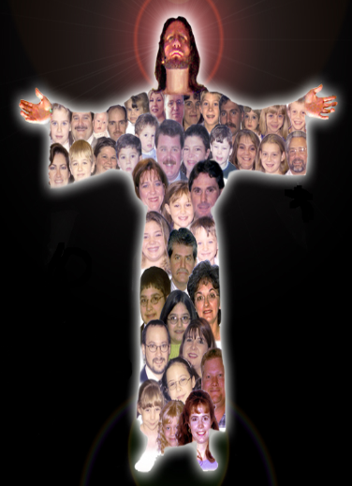
The Church Jesus Died to Save
Has the Right Head
Ephesians 5:23
23. For the husband is the head of the wife, as Christ also is the head of the church, He Himself being the Savior of the body.
Colossians 1:18
18. He is also head of the body, the church; and He is the beginning, the firstborn from the dead, so that He Himself will come to have first place in everything.

Slide 21
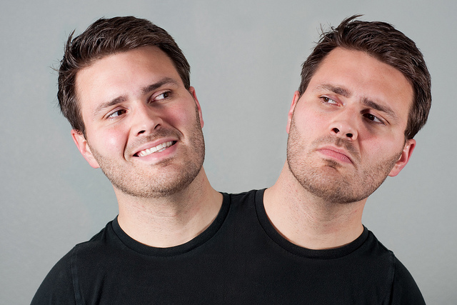
It Has the Right Head
The church built by Jesus neither recognizes
nor submits to any other Head than Christ!

Slide 22
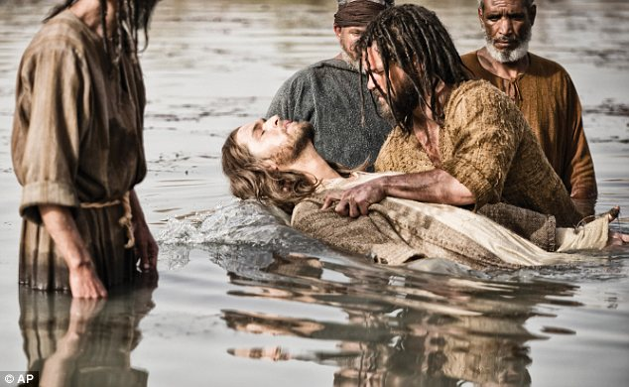
The Church Jesus Died to Save
Has the Right Head
Practices the Right Baptism
Mark 16:16 (G907 baptizo: To immerse; submerge)
16. "He who has believed and has been baptized shall be saved; but he who has disbelieved shall be condemned.

Slide 23
It Practices the Right Baptism
When the church of Christ was established Peter answered the question, “What shall we do?” with, “Repent, and each of you be baptized in the name of Jesus Christ for the forgiveness of your sins” (Acts 2:37-38)
Acts 2:47 (NKJ): After being baptized, God added them to the church.
Acts 10:47-48: Peter “ordered” (NKJ: “commanded”) the household of Cornelius to be baptized!
Gal. 3:27: Baptism is how one gets “into” Christ!
I Cor. 12:13: Baptism is means to enter the “body,” the church!
The church built by Jesus teaches the means of
salvation and entrance into the church is baptism
as Christ and the apostles did! (I Cor. 12:13)

Slide 24
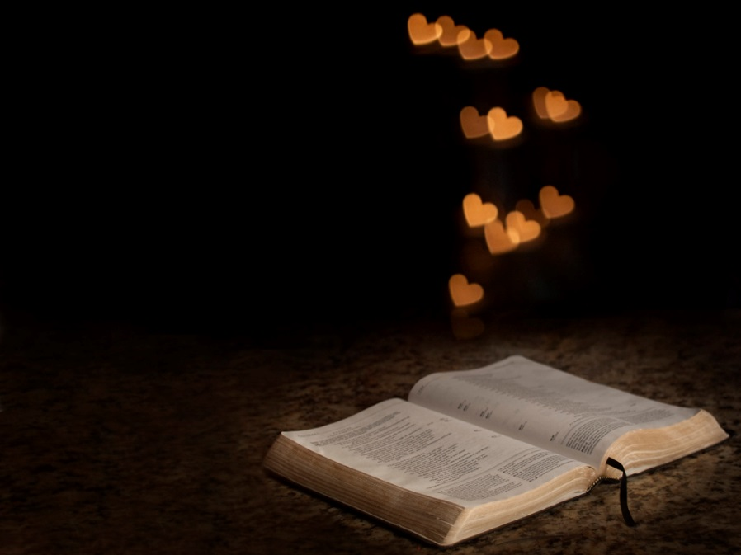
The Church Jesus Died to Save
Has the Right Head
Practices the Right Baptism
Is Grounded in Love & Truth
Ephesians 4:15
15. but speaking the truth in love, we are to grow up in all aspects into Him who is the head, even Christ,

Slide 25
It Is Grounded in Love & Truth
I Cor. 16:14: “Let all that you do be done in love”
(I Tim. 1:5)
I Tim. 3:15: The church is the “pillar and support of the truth”
We are to defend and support the truth (Jude 3) out of love!
(Eph. 4:15)
The church that belongs to Jesus ought to be known by
our love for God and for one another –
Jn. 13:34-35; 15:12; Col. 1:4; 3:14; Phil. 1:9; III Jn. 5-6
The church that belongs to Jesus will be known for their love and steadfastness to the truth!

Slide 26
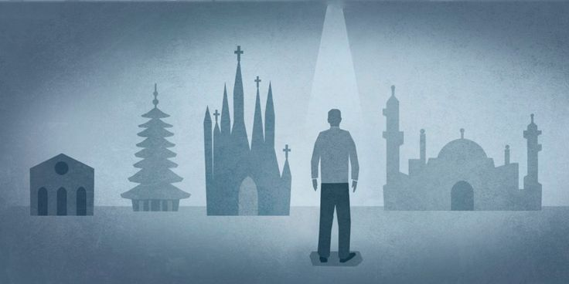
Conclusion
Despite the many “churches” in the world (confusion)
we can search the Scriptures and know if we have found the right one!
Eph. 4:4-6: One body!

Slide 27
Conclusion
It is important to know if we are in the church Jesus built and died to save!
Acts 20:28
28. "Be on guard for yourselves and for all the flock, among which the Holy Spirit has made you overseers, to shepherd the church of God which He purchased with His own blood.
Eph. 5:23
23. For the husband is the head of the wife, as Christ also is the head of the church, He Himself being the Savior of the body.

Slide 28
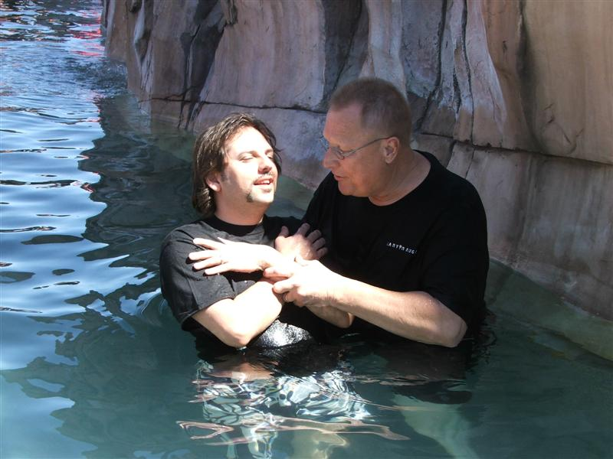
Conclusion
Obey the gospel God’s way and enter the church Jesus built and will one day reward!

Slide 29
“What Must I Do To Be Saved?”
Hear The Gospel (Jn. 5:24; Rom. 10:17)
Believe In Christ (Jn. 3:16-18; Jn. 8:24)
Repent Of Sins (Lk. 13:35; Acts 2:38)
Confess Christ (Mt. 10:32; Rom. 10:10)
Be Baptized (Mk. 16:16; Acts 22:16)
Remain Faithful (Jn. 8:31; Rev. 2:10)
For The Erring Child:
Repent (Acts 8:22), Confess (I Jn. 1:9),
Pray (Acts 8:22)

