Slide 1
Playing House: No Longer
MARRIED!
Text:
Hebrews 13:4
Nathan L Morrison Courthouse church of Christ – Chesterfield, VA Sunday, April 14, 2024
Notes:
By Nathan L Morrison for Sunday 04/14/2024: Playing House Part 3: No Longer (Married!)
All Scripture given is from NAS95 unless otherwise stated
For further study, or if questions, please Call: 804-277-1983 or Visit: www.courthousechurchofchrist.com
Image: Nathan & Becky Morrison Wedding at Thornewood Castle, Tacoma, WA, 09/08/2001
Logo art provided by www.vecteezy.com

Slide 2
Intro
Hebrews 13:4
Marriage is to be held in honor among all, and the marriage bed is to be undefiled; for fornicators and adulterers God will judge.

Slide 3
Intro
Fornication is sinful, can keep one out of Heaven, and is harmful (I Corinthians 6:9-10, 13, 18).
Cohabiting is sinful, and despite the various “defenses” for it, people engaged in such are “playing house” and have deluded themselves into thinking they are a real family.
Times have changed and people’s opinions have changed, but God’s will and His opinion has not changed (Matthew 24:35; Isaiah 40:8).
Notes:
Image created by AI (Copilot Designer)

Slide 4
Intro
I Corinthians 5:9-13
I wrote you in my letter not to associate with immoral people;
I did not at all mean with the immoral people of this world, or with the covetous and swindlers, or with idolaters, for then you would have to go out of the world.
But actually, I wrote to you not to associate with any so-called brother if he is an immoral person, or covetous, or an idolater, or a reviler, or a drunkard, or a swindler—not even to eat with such a one.
For what have I to do with judging outsiders? Do you not judge those who are within the church?
But those who are outside, God judges. REMOVE THE WICKED MAN FROM AMONG YOURSELVES.

Slide 5
Intro
Hebrews 13:4
Marriage is to be held in honor among all, and the marriage bed is to be undefiled; for fornicators and adulterers God will judge.

Slide 6
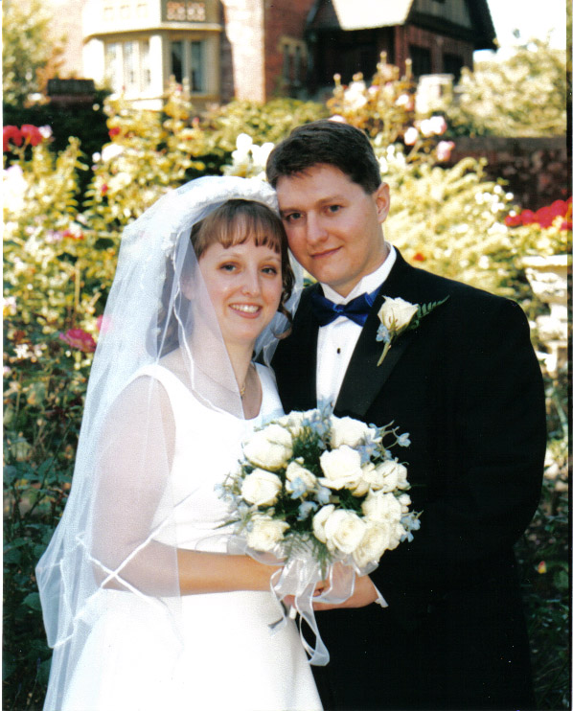
Intro
Men and women need to wake up and “play house” no longer – get married and be the family God designed!

Slide 7
Purpose for Marriage
God created mankind to have certain appetites such as the sexual urges.
God also instituted marriage—one man for one woman until death.
An examination of the topic of marriage in the Bible reveals that there are four purposes which God ordained in marriage…
Marriage

Slide 8
Purpose for Marriage
Companionship
God created a “helper” for him—a woman to be his companion. Someone to share his joys and his sorrows.
Ecclesiastes 4:9-12: Two are better than one: To work together, protection from falling, warmth, and power.
Genesis 2:18
Then the LORD God said, “It is not good for the man to be alone; I will make him a helper suitable for him.”

Slide 9
Purpose for Marriage
Hebrews 13:4: “Marriage is to be held in honor among all, and the marriage bed is to be undefiled; for fornicators and adulterers God will judge.”
I Corinthians 7:2 (ESV): “But because of the temptation to sexual immorality, each man should have his own wife and each woman her own husband.”
In marriage, a man and a woman can be intimate and be spiritually and morally pure.
Sexual Satisfaction
Genesis 2:24
For this reason a man shall leave his father and his mother, and be joined to his wife; and they shall become one flesh.

Slide 10
Purpose for Marriage
Marriage is where the home begins for God blessed the first union and said, “Be fruitful, and multiply, and replenish the earth…”
In this light, “children are a gift of the LORD, The fruit of the womb is a reward” (Psalm 127:3-5).
Genesis 4:1, 25: Eve gave thanks to God for her sons.
Reproduction
Genesis 1:27-28
God created man in His own image, in the image of God He created him; male and female He created them. God blessed them; and God said to them, "Be fruitful and multiply, and fill the earth, and subdue it; and rule over the fish of the sea and over the birds of the sky and over every living thing that moves on the earth.

Slide 11
Purpose for Marriage
Since marriage is for reproduction, it is only natural that marriage be used for the training of those that are procreated.
A home with a father and a mother is the best place to raise children.
Ephesians 6:4: Paul exhorts parents to “bring them up in the discipline and instruction of the Lord.”
II Timothy 3:2: Children who grow up “disobedient to parents” are part of the problem of any fall of society (3:1: “Difficult times will come”).
Training of Children
Proverbs 1:8-9
Hear, my son, your father's instruction And do not forsake your mother's teaching; Indeed, they are a graceful wreath to your head And ornaments about your neck.

Slide 12
Purpose for Marriage
Mark 10:6-9
"But from the beginning of creation, God MADE THEM MALE AND FEMALE.
"FOR THIS REASON A MAN SHALL LEAVE HIS FATHER AND MOTHER,
AND THE TWO SHALL BECOME ONE FLESH; so they are no longer two, but one flesh.
"What therefore God has joined together, let no man separate."

Slide 13
Purpose for Marriage
Marriage is God’s definition of a family and has been since the beginning of creation!

Slide 14
What the Scriptures Say About Marriage
Genesis 2:7, 18-23
God declares His intentions for male and female relationships at the beginning of creation.
Man created from dust of ground; woman created from man’s rib as a “helper suitable for him.”
God’s blueprint for marriage was given before sin messed things up in the Garden (Paradise); Before the fall (Genesis 3).
Genesis 2:7, 18
Then the LORD God formed man of dust from the ground, and breathed into his nostrils the breath of life; and man became a living being.
Then the LORD God said, “It is not good for the man to be alone; I will make him a helper suitable for him.”

Slide 15
What the Scriptures Say About Marriage
Genesis 2:24
Leaving: Father & Mother
Joining: Husband & Wife
Oneness: The two shall become one flesh!
Genesis 2:24
For this reason a man shall leave his father and his mother, and be joined to his wife; and they shall become one flesh.

Slide 16
What the Scriptures Say About Marriage
Genesis 2:25
The sexual relationship between a husband and a wife delivers perfect intimacy without shame or regret! (Hebrews 13:4)
Genesis 2:25
And the man and his wife were both naked and were not ashamed.

Slide 17
What the Scriptures Say About Marriage
Lawfully married if man & woman – Matthew 19:4-6; Mark 10:6-9
Lawfully married if either spouse is a widower or widow) – Romans 7:1-3; I Corinthians 7:39
Lawfully married if any previous marriage ended with putting a spouse away for adultery (man, woman, or both) – Matthew 19:8-9
Lawfully if not a polygamous marriage– Matthew 19:5-6; Mark 10:6-9
Neither spouse engaged in an adulterous affair – Romans 13:9; Hebrews 13:4
To be Scripturally (Lawfully in God’s eyes) wed
Hebrews 13:4
Marriage is to be held in honor among all, and the marriage bed is to be undefiled; for fornicators and adulterers God will judge.

Slide 18
What the Scriptures Say About Marriage
Mark 10:6-9: Man & woman.
I Corinthians 7:2: Avoid sexual sin by getting married.
Hebrews 13:4: Marriage to be honored, undefiled.
Ephesians 5:22-25, 33: The husband is the head of the family and the wife is to be in subjection to her husband.
I Peter 3:1-6: Wives to be in subjection -- Sarah a godly example.
I Peter 3:7: Husbands to live with their wives in an understanding way, to value them as fellow heirs of the grace of life. His prayers could be hindered if he fails!
A few N.T. texts that confirm God’s blueprint for marriage
Mark 10:6-9
"But from the beginning of creation, God MADE THEM MALE AND FEMALE.
"FOR THIS REASON A MAN SHALL LEAVE HIS FATHER AND MOTHER,
AND THE TWO SHALL BECOME ONE FLESH; so they are no longer two, but one flesh.
"What therefore God has joined together, let no man separate."

Slide 19
What the Scriptures Say About Marriage
Marriage is honorable, but all forms of fornication are sinful (Defiling) and will be judged!

Slide 20
Conclusion
Fornication is sin, no matter what it’s called: “living together” or “Co-habitation.”
Cohabitation: The very purpose for living together declares its most basic weakness…
If its purpose is sexual, then it is opposed to God and morality.
If its purpose is a trial for marriage, then it lacks commitment.
This lack of commitment causes it to fail from its onset!

Slide 21
Conclusion
Living together (“Playing House”) sets up a relationship for failure.
There is no real or clear commitment.
It involves no legal or social responsibilities.
It is for the moment while marriage is “until death do us part.”

Slide 22
Conclusion
What can one do that is in this sinful lifestyle?
You are not wrecked beyond repair! You can be forgiven.
Repent and turn away from evil!
There are sinful practices that can cost one their soul, and fornication and adultery are among them – I Corinthians 6:9-10
If not a Christian, it begins with the right relationship with God – Acts 2:38; 22:16

Slide 23
Conclusion
God forgave the Corinthian saints (I Corinthians 1:2) so He can forgive you!
I Corinthians 6:11
Such were some of you; but you were washed, but you were sanctified, but you were justified in the name of the Lord Jesus Christ and in the Spirit of our God.

Slide 24
Conclusion
I Corinthians 7:2, 9 (ESV)
But because of the temptation to sexual immorality, each man should have his own wife and each woman her own husband.
But if they cannot exercise self-control, they should marry. For it is better to marry than to burn with passion.
I Corinthians 7:2, 9: To avoid the sin of fornication (sexual immorality) let them marry!
If a Christian in this situation, if you but repent God will forgive you!
Either stop or get married!

Slide 25
Conclusion
“Play house” no longer but hold marriage as honorable
(Hebrews 13:4) and “Flee sexual immorality”
(NKJV: I Corinthians 6:18)!

Slide 26
Conclusion
Make a plan, and a covenant, with the one you love and with God that you will not sin.
Don’t let society tell you what is right and acceptable, but seek to do things in the right way according to God.
Teach your children and others to seek God’s way in having the right relationships!

Slide 27
“What Must I Do To Be Saved?”
Hear The Gospel (John 5:24; Romans 10:17)
Believe In Christ (John 3:16-18; John 8:24)
Repent Of Sins (Luke 13:3-5; Acts 2:38)
Confess Christ (Matthew 10:32; Romans 10:10)
Be Baptized (Mark 16:16; Acts 22:16)
Remain Faithful (John 8:31; Revelation 2:10)
For The Erring Saint:
Repent (Acts 8:22), Confess (I John 1:9),
Pray (Acts 8:22)

