Slide 1
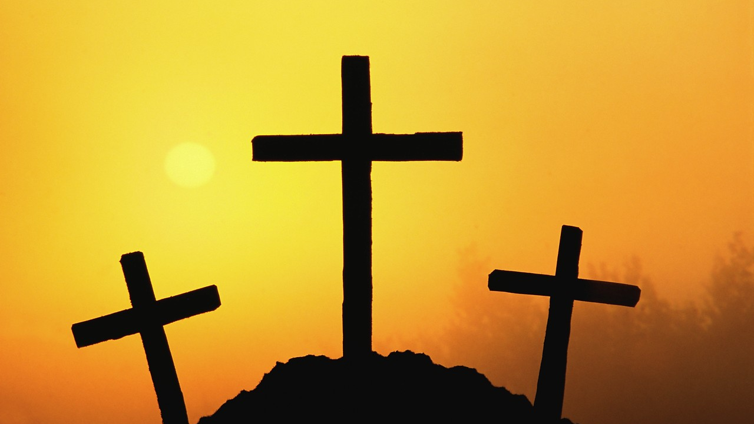
Jesus In The Center
Text:
Philippians 1-4
Nathan L Morrison Courthouse church of Christ – Chesterfield, VA Sunday, April 28, 2024
Notes:
By Nathan L Morrison for Sunday April 28th, 2024
All Scripture given is from NASB unless otherwise stated
For further study, or if questions, please Call: 804-277-1983 or Visit www.courthousechurchofchrist.com
Logo art provided by www.vecteezy.com

Slide 2
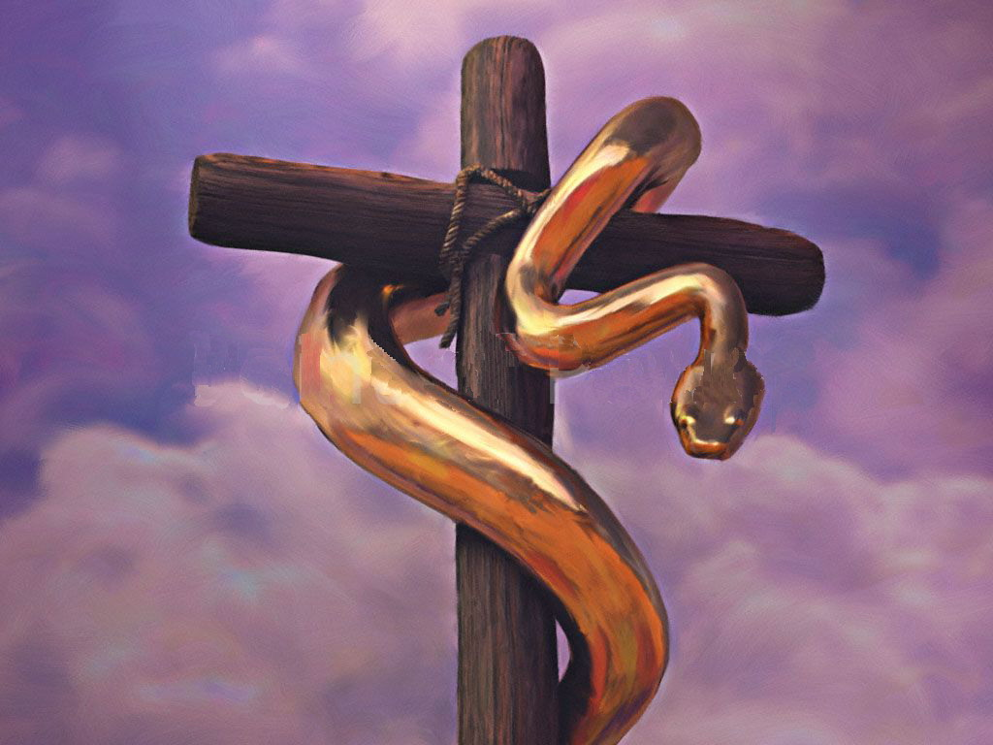
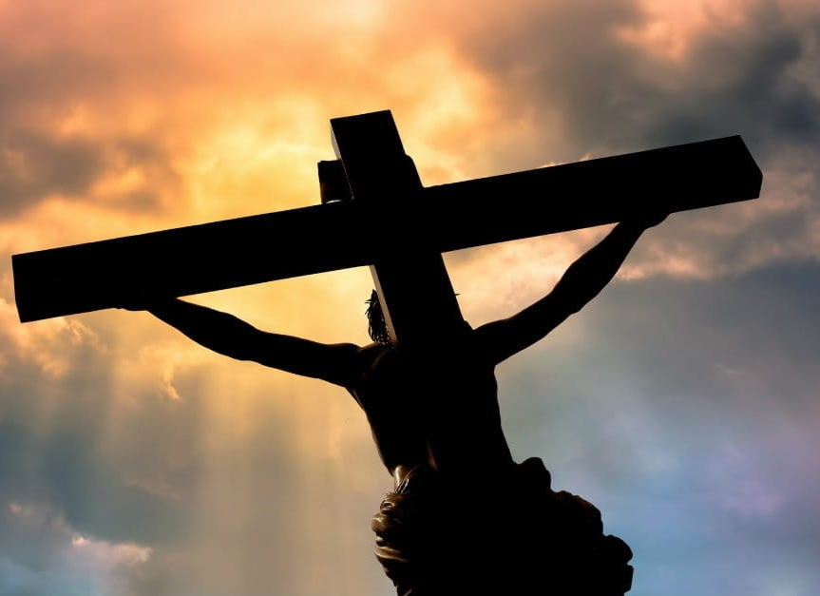
John 3:13-15 NAS95
13. "No one has ascended into heaven, but He who descended from heaven: the Son of Man.
14. "As Moses lifted up the serpent in the wilderness, even so must the Son of Man be lifted up;
15. so that whoever believes will in Him have eternal life.
Notes:
Joh 3:13 "No one has ascended into heaven, but He who descended from heaven: the Son of Man.
Joh 3:14 "As Moses lifted up the serpent in the wilderness, even so must the Son of Man be lifted up;
Joh 3:15 so that whoever believes will in Him have eternal life.
Joh 12:32 "And I, if I am lifted up from the earth, will draw all men to Myself."
John 3:13-15; 12:32: As Israel was to look to the brazen serpent to be healed, so are we to look to Jesus!
Numbers 21:4-9: When the Israelites grumbled and complained about no food and water in the wilderness and said they hated the manna that God provided, God sent fiery serpents among them.
When the people repented, God told Moses to erect a bronze serpent on a pole and said that all who look at the bronze serpent will be healed.
In that camp, where 24,000 people died, the bronze serpent was center of attention!
In the world of sin and darkness and the second death, all who look to Jesus and obey Him will be saved!

Slide 3
John 12:32 NAS95
"And I, if I am lifted up from the earth, will draw all men to Myself."
Notes:
Joh 3:13 "No one has ascended into heaven, but He who descended from heaven: the Son of Man.
Joh 3:14 "As Moses lifted up the serpent in the wilderness, even so must the Son of Man be lifted up;
Joh 3:15 so that whoever believes will in Him have eternal life.
Joh 12:32 "And I, if I am lifted up from the earth, will draw all men to Myself."
John 3:13-15; 12:32: As Israel was to look to the brazen serpent to be healed, so are we to look to Jesus!
Numbers 21:4-9: When the Israelites grumbled and complained about no food and water in the wilderness and said they hated the manna that God provided, God sent fiery serpents among them.
When the people repented, God told Moses to erect a bronze serpent on a pole and said that all who look at the bronze serpent will be healed.
In that camp, where 24,000 people died, the bronze serpent was center of attention!
In the world of sin and darkness and the second death, all who look to Jesus and obey Him will be saved!

Slide 4
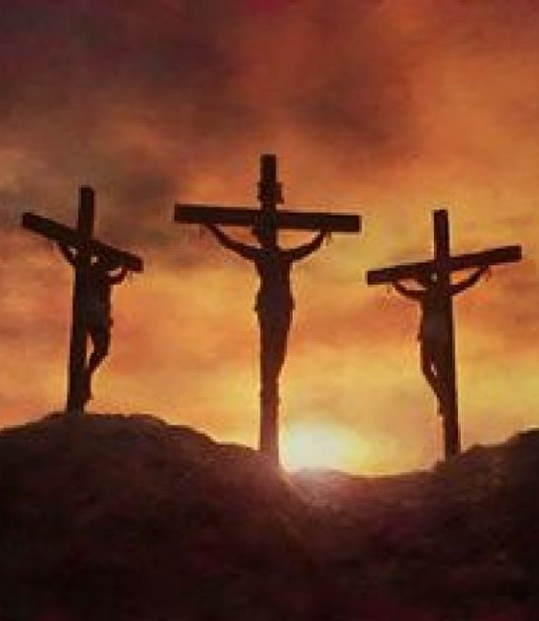
Introduction
Matthew 27:38; Mark 15:27; Luke 23:33; John 19:18: The gospels record there were three crosses at Calvary (Golgotha).
I Corinthians 2:2; Acts 8:35: The gospel focuses on the cross of Christ.
Acts 10:39-43: Jesus was no mere man that death would be the end to His story! He rose from the dead as it was foretold and the heart that believes on Him and obeys the gospel will be saved from sins!
Notes:
Intro
John 3:13-15; 12:32: As Israel was to look to the brazen serpent to be healed, so are we to look to Jesus!
Numbers 21:4-9: When the Israelites grumbled and complained about no food and water in the wilderness and said they hated the manna that God provided, God sent fiery serpents among them.
When the people repented, God told Moses to erect a bronze serpent on a pole and said that all who look at the bronze serpent will be healed.
In that camp, where 24,000 people, died the bronze serpent was center of attention!
In the world of sin and darkness and the second death, all who look to Jesus and obey Him will be saved!
Matthew 27:38; Mark 15:27; Luke 23:33; John 19:18: The gospels record there were three crosses at Calvary (Golgotha).
I Corinthians 2:2; Acts 8:35: Teaching the gospel focuses on the cross of Christ (center in teaching).
Acts 10:39-43: Jesus was no mere man that death would be the end to His story! He rose from the dead as it was foretold (I Corinthians 15:3-4: “According to the Scriptures”) and the heart that believes on Him and obeys the gospel will be saved from sins! (Mark 16:16; Acts 2:38; 10:48)
As the cross of Jesus was center (Luke 23:33; John 19:18), so is Jesus to be the center of our lives!

Slide 5
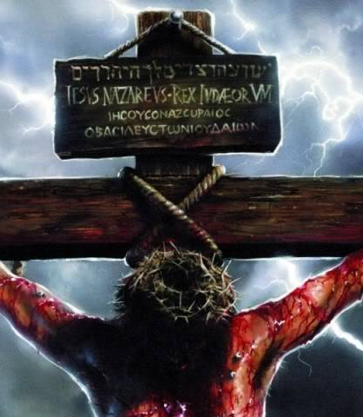
Introduction
As the cross of Jesus was center (Luke 23:33; John 19:18), so is Jesus to be the center of our lives!
Notes:
Intro
John 3:13-15; 12:32: As Israel was to look to the brazen serpent to be healed, so are we to look to Jesus!
Numbers 21:4-9: When the Israelites grumbled and complained about no food and water in the wilderness and said they hated the manna that God provided, God sent fiery serpents among them.
When the people repented, God told Moses to erect a bronze serpent on a pole and said that all who look at the bronze serpent will be healed.
In that camp, where 24,000 people, died the bronze serpent was center of attention!
In the world of sin and darkness and the second death, all who look to Jesus and obey Him will be saved!
Matthew 27:38; Mark 15:27; Luke 23:33; John 19:18: The gospels record there were three crosses at Calvary (Golgotha).
I Corinthians 2:2; Acts 8:35: Teaching the gospel focuses on the cross of Christ (center in teaching).
Acts 10:39-43: Jesus was no mere man that death would be the end to His story! He rose from the dead as it was foretold (I Corinthians 15:3-4: “According to the Scriptures”) and the heart that believes on Him and obeys the gospel will be saved from sins! (Mark 16:16; Acts 2:38; 10:48)
As the cross of Jesus was center (Luke 23:33; John 19:18), so is Jesus to be the center of our lives!

Slide 6
Jesus Is The Purpose Of My Life
Philippians 1:21-24 NAS95
21. For to me, to live is Christ and to die is gain.
22. But if I am to live on in the flesh, this will mean fruitful labor for me; and I do not know which to choose.
23. But I am hard-pressed from both directions, having the desire to depart and be with Christ, for that is very much better;
24. yet to remain on in the flesh is more necessary for your sake.

Slide 7
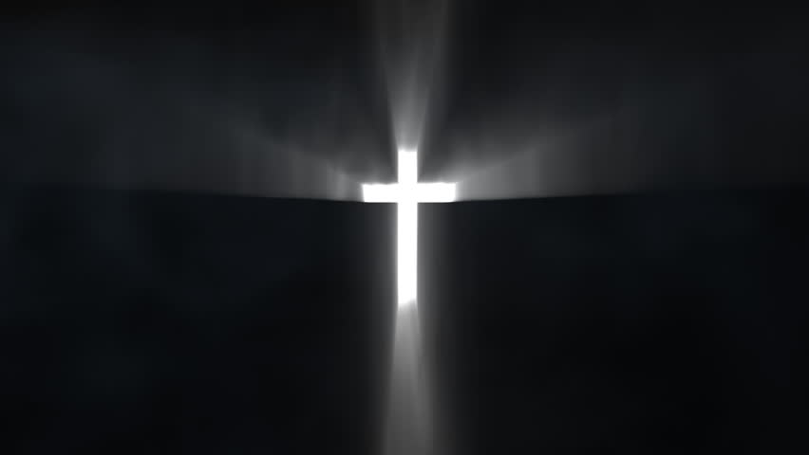
Jesus In The Center
Jesus Is The Purpose Of My Life (Philippians 1:21-24)
Notes:
Jesus Is The Purpose Of My Life
Philippians 1:21-24:
“For to me, to live is Christ and to die is gain.”
Paul’s indifference towards death raises the question of what life and death really mean – The believer has nothing to fear in death, realizing it is but a beginning!
Paul said “to live is Christ” – He is our purpose for living!
Regardless of how others felt, to live was Christ.
With many, life is: money, power, worldly pleasures, & flattery (vanity).
He did not say, “Christ is life,” but said, “Living is Christ, dying is gain.”
While alive, he would live for Christ.
For saints, Jesus is in the center of our lives!
“It is no longer I who live, but Christ lives in me” (Galatians 2:20).
“I have been crucified with Christ” – I live to die for Christ, as He died to make me live!
What about ambition, power, wealth, and stuff?
Jesus said our souls are the most valuable thing we possess and the only thing we will take with us when we die (Luke 9:23-25).
Life is not to be about collecting and hoarding treasures (Matthew 6:19-21) but storing up treasures in Heaven.
We do that by seeking first God’s Kingdom and righteousness (Matthew 6:33).
We do that by being willing to give up everything in life for Jesus. That was the problem with the Rich Young Ruler – He wouldn’t part with his stuff! (Luke 18:18-30). The apostles had to learn to trust Jesus for everything!
As saints, Christ ought to be the purpose of your life!

Slide 8
Jesus Is The Pattern Of My Life
Philippians 2:5-8 NAS95
5. Have this attitude in yourselves which was also in Christ Jesus,
6. who, although He existed in the form of God, did not regard equality with God a thing to be grasped,
7. but emptied Himself, taking the form of a bond-servant, and being made in the likeness of men.
8. Being found in appearance as a man, He humbled Himself by becoming obedient to the point of death, even death on a cross.

Slide 9
Jesus In The Center
Jesus Is The Purpose Of My Life (Philippians 1:21-24)
Jesus Is The Pattern Of My Life (Philippians 2:5-8)
Notes:
Jesus Is The Purpose Of My Life
Jesus Is The Pattern Of My Life
Philippians 2:5-8:
Christ is the pattern for humility and obedience – “Have this attitude…”
Paul uses the human form of Christ to teach a lesson on humility:
John says the Word became flesh. (John 1:14)
Jesus did not consider His state of “equality of God” a thing to hold on to at any cost, meaning He gave up the glory of Heaven to redeem us!
As He possessed the real attributes of Deity, so He also took up the real attributes of a bondservant (Hebrews 4:14-16).
Fully Man, Fully God.
Jesus obediently followed the will of the Father unto death (Hebrews 5:8-9).
The death of Jesus on the cross proved He was human. Fully Man!
He cried aloud when He felt alone on the cross. (Matthew 27:46)
His body on the cross was accursed. (Deuteronomy 21:23; Galatians 3:13-14)
The Jews stumbled at the cross, the Greeks thought it foolishness, but to the believer it is power unto salvation! (I Corinthians 1:20-25)
“He is not here, but He has risen.” The empty tomb proved Jesus was God. Fully God! (Luke 24:6)
Peter says Jesus left for us an example, a pattern for living! (I Peter 2:21-25)
We need to obediently follow Christ in all things: doctrine, practice, conduct and speech!
Christ’s life is the perfect pattern (example) for my life! (I Peter 2:21-25)

Slide 10
Jesus Is The Prize Of My Life
Philippians 3:12-14 NAS95
12. Not that I have already obtained it or have already become perfect, but I press on so that I may lay hold of that for which also I was laid hold of by Christ Jesus.
13. Brethren, I do not regard myself as having laid hold of it yet; but one thing I do: forgetting what lies behind and reaching forward to what lies ahead,
14. I press on toward the goal for the prize of the upward call of God in Christ Jesus.

Slide 11
Jesus In The Center
Jesus Is The Purpose Of My Life (Philippians 1:21-24)
Jesus Is The Prize Of My Life (Philippians 3:12-14)
Jesus Is The Pattern Of My Life (Philippians 2:5-8)
Notes:
Jesus Is The Purpose Of My Life
Jesus Is The Pattern Of My Life
Jesus Is The Prize Of My Life
Philippians 3:12-14:
Paul says he “presses on” toward the prize (has not obtained it yet).
Many people do not understand the word “perfection.”
The word “perfect”:
Perfect: Gr. teleios (Str. 5046) – “Complete; completeness: -- of full age, man, perfect.”
It means to mature, and is applied to the character of a person as well as physical attributes of growth.
Paul says he is not yet complete (or mature) but continues to press ahead that he might attain the prize of Christ!
The verb literally means, “I pursue” or “I follow after.”
Paul was in the pursuit of Christ.
Christ had changed him from a persecutor to an apostle (Acts 22:3-5).
Paul’s goal is still ahead – he pictured it as a chase!
He does not forget his former career, but he does not allow his immediate past to lull him into a sense of false security.
He had no time to look back.
He could not count on former achievements to carry him through life to Christ – but had to continue pressing on!
The prize belongs to those who run! (I Corinthians 9:24)
The prize we seek after is not found here on earth!
Those who seek after wealth and find it receive their full reward here, and often are driven from the faith and fall into ruin (I Timothy 6:6-10).
God never condemned the wealthy for being wealthy but how they viewed their treasures and how they used it. He tells the materially blessed to share with others and use their riches to do good, and not to trust in it (I Timothy 6:17-19).
Paul was thinking of the crown of righteousness (II Timothy 4:8) – Are you?

Slide 12
Jesus Is The Power Of My Life
Philippians 4:12-13 NAS95
12. I know how to get along with humble means, and I also know how to live in prosperity; in any and every circumstance I have learned the secret of being filled and going hungry, both of having abundance and suffering need.
13. I can do all things through Him who strengthens me.

Slide 13
Jesus In The Center
Jesus Is The Purpose Of My Life (Philippians 1:21-24)
Jesus Is The Prize Of My Life (Philippians 3:12-14)
Jesus Is The Pattern Of My Life (Philippians 2:5-8)
Jesus Is The Power Of My Life (Philippians 4:12-13 )
Notes:
Jesus Is The Purpose Of My Life
Jesus Is The Pattern Of My Life
Jesus Is The Prize Of My Life
Jesus Is The Power Of My Life
Philippians 4:12-13:
Despite life’s circumstances, Paul’s strength resides in Christ.
Paul uses the word “strengthens” to describe Christ’s relationship to him.
He recognized that his strength comes from Christ! (I Timothy 1:12)
God strengthened him to endure so that the Gentiles would hear the gospel. He was even rescued from the mouth of the lions! (II Timothy 4:17)
The armor of God is to give strength to all Christians! (Ephesians 6:10)
This strength of God is accessible to all who yield themselves to Christ!
It requires trust in Jesus no matter what one’s circumstances are: adversity or prosperity.
Some saints are “fair weather Christians” – They will trust in and seek after God when things are going good. This is what Satan accused Job of being.
Job 1:9-11; 2:4-5: Satan said God’s servant, Job, was only righteous and obedient because God had placed a hedge around him, and when that hedge was removed Job would curse God to His face (Job 2:5) and exactly what Job’s wife said he should do (Job 2:9).
Job was not a “fair weather” servant of God – He is still an example of what it means to rely on the strength of God as an “all weather” servant! (Job 1:21-22; 42:7-10).
Are you an “All Weather Christian?”
Jesus said there was rocky soil Christians who fall away immediately when persecution arises (Luke 8:13) and thorny soil Christians who fall away because their devotions are divided and they succumb to the pleasures of this life (Luke 8:14).
Jesus says there are good soil Christians who become very fruitful (Luke 8:15).
Paul’s life was victorious because he let the word of Christ dwell within him and rule in his life!

Slide 14
Conclusion
Paul says our lives are enhanced and enriched by the grace of Christ when we submit to His will and live for Him!

Slide 15
Conclusion
Jesus Is The Purpose Of My Life (Philippians 1:21-24)
Jesus Is The Prize Of My Life (Philippians 3:12-14)
Jesus Is The Pattern Of My Life (Philippians 2:5-8)
Jesus Is The Power Of My Life (Philippians 4:12-13 )
Jesus was center at Calvary (Luke 23:33; John 19:18), is center in preaching (Acts 8:35; I Corinthians 2:2) and should be the center of our lives (Galatians 2:20)!

Slide 16
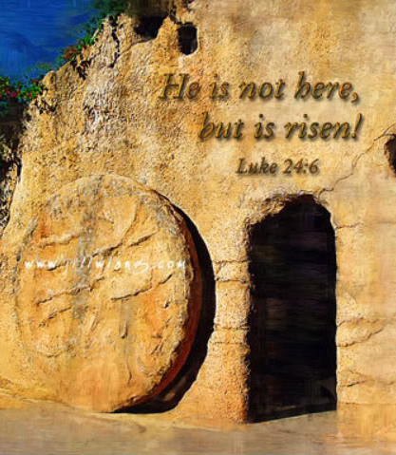
Conclusion
Jesus was crucified at Calvary but the tomb was empty the 3rd day for He had risen (Luke 24:5-7) – There is hope in the Empty Tomb!
Jesus rose from the dead and proclaimed Light to the Jews and Gentiles (Acts 26:23).

Slide 17
Conclusion
To the non-Christians: To share in that glory, to share in Christ’s death, burial and resurrection, you must be baptized, putting to death the old self of sin (Romans 6:6), being buried with Him and raising from the water to walk in newness of life! (Romans 6:3-4)

Slide 18
Conclusion
To Christians: To share in that glory saints need to make Jesus their priority in life, to seek after what God wants above your own wants and desires (Matthew 6:33). You need to, like the apostle Paul, leave the past behind and press forward to the prize, the goal of eternal life with Jesus (Philippians 3:12-14)!

Slide 19
Conclusion
Jesus Is The Purpose Of My Life (Philippians 1:21-24)
Jesus Is The Prize Of My Life (Philippians 3:12-14)
Jesus Is The Pattern Of My Life (Philippians 2:5-8)
Jesus Is The Power Of My Life (Philippians 4:12-13 )
Are you an “All Weather Christian” who has made Jesus Christ the center of your life?

Slide 20
“What Must I Do To Be Saved?”
Hear The Gospel (John 5:24; Romans 10:17)
Believe In Christ (John 3:16-18; John 8:24)
Repent Of Sins (Luke 13:3-5; Acts 2:38)
Confess Christ (Matthew 10:32; Romans 10:10)
Be Baptized (Mark 16:16; Acts 22:16)
Remain Faithful (John 8:31; Revelation 2:10)
For The Erring Saint:
Repent (Acts 8:22), Confess (I John 1:9),
Pray (Acts 8:22)

Slide 24
Jesus In The Center
Jesus Is The Purpose Of My Life (Philippians 1:21-24)
Jesus Is The Prize Of My Life (Philippians 3:12-14)
Jesus Is The Pattern Of My Life (Philippians 2:5-8)
Jesus Is The Power Of My Life (Philippians 4:12-13 )
Nathan L Morrison Courthouse church of Christ – Chesterfield, VA Sunday, April 28, 2024
Notes:
Jesus Is The Purpose Of My Life
Jesus Is The Pattern Of My Life
Jesus Is The Prize Of My Life
Jesus Is The Power Of My Life
Philippians 4:12-13:
Despite life’s circumstances, Paul’s strength resides in Christ.
Paul uses the word “strengthens” to describe Christ’s relationship to him.
He recognized that his strength comes from Christ! (I Timothy 1:12)
God strengthened him to endure so that the Gentiles would hear the gospel. He was even rescued from the mouth of the lions! (II Timothy 4:17)
The armor of God is to give strength to all Christians! (Ephesians 6:10)
This strength of God is accessible to all who yield themselves to Christ!
It requires trust in Jesus no matter what one’s circumstances are: adversity or prosperity.
Some saints are “fair weather Christians” – They will trust in and seek after God when things are going good. This is what Satan accused Job of being.
Job 1:9-11; 2:4-5: Satan said God’s servant, Job, was only righteous and obedient because God had placed a hedge around him, and when that hedge was removed Job would curse God to His face (Job 2:5) and exactly what Job’s wife said he should do (Job 2:9).
Job was not a “fair weather” servant of God – He is still an example of what it means to rely on the strength of God as an “all weather” servant! (Job 1:21-22; 42:7-10).
Are you an “All Weather Christian?”
Jesus said there was rocky soil Christians who fall away immediately when persecution arises (Luke 8:13) and thorny soil Christians who fall away because their devotions are divided and they succumb to the pleasures of this life (Luke 8:14).
Jesus says there are good soil Christians who become very fruitful (Luke 8:15).
Paul’s life was victorious because he let the word of Christ dwell within him and rule in his life!

