Slide 1
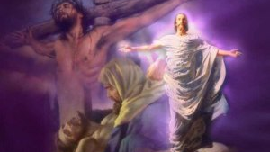
One Day
Text:
I Corinthians 15:1-4
Nathan L Morrison Courthouse church of Christ – Chesterfield, VA Sunday, March 31, 2024
Notes:
By Nathan L Morrison for Sunday March 31, 2024 (Easter Sunday)
All Scripture given is from NASB unless otherwise stated
For further study, or if questions, please Call: 804-277-1983 or Visit www.courthousechurchofchrist.com
Logo art provided by www.vecteezy.com

Slide 2
I Corinthians 15:1-4 NAS95
1. Now I make known to you, brethren, the gospel which I preached to you, which also you received, in which also you stand,
2. by which also you are saved, if you hold fast the word which I preached to you, unless you believed in vain.
3. For I delivered to you as of first importance what I also received, that Christ died for our sins according to the Scriptures,
4. and that He was buried, and that He was raised on the third day according to the Scriptures,
Notes:
Jesus came to accomplish many things and promised to come again!
I Corinthians 15:1-4: The risen Christ is the Good News (gospel)!
15:1: Paul reminds them they heard the gospel from him and they stand in it.
(Gal. 1:11-12: The gospel is not from men; Paul received it from Christ)
15:2: The gospel saves! (Jn. 14:6; Rom. 1:16; Js. 1:21; I Pet. 1:23)
I Corinthians 15:13-19: If Christ wasn’t raised from the dead, our faith is in vain!

Slide 3
I Corinthians 15:16-19 NAS95
16. For if the dead are not raised, not even Christ has been raised;
17. and if Christ has not been raised, your faith is worthless; you are still in your sins.
18. Then those also who have fallen asleep in Christ have perished.
19. If we have hoped in Christ in this life only, we are of all men most to be pitied.
Notes:
Jesus came to accomplish many things and promised to come again!
I Corinthians 15:1-4: The risen Christ is the Good News (gospel)!
15:1: Paul reminds them they heard the gospel from him and they stand in it.
(Gal. 1:11-12: The gospel is not from men; Paul received it from Christ)
15:2: The gospel saves! (Jn. 14:6; Rom. 1:16; Js. 1:21; I Pet. 1:23)
I Corinthians 15:13-19: If Christ wasn’t raised from the dead, our faith is in vain!

Slide 4
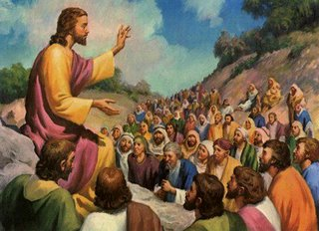
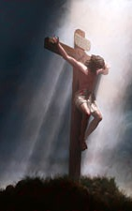
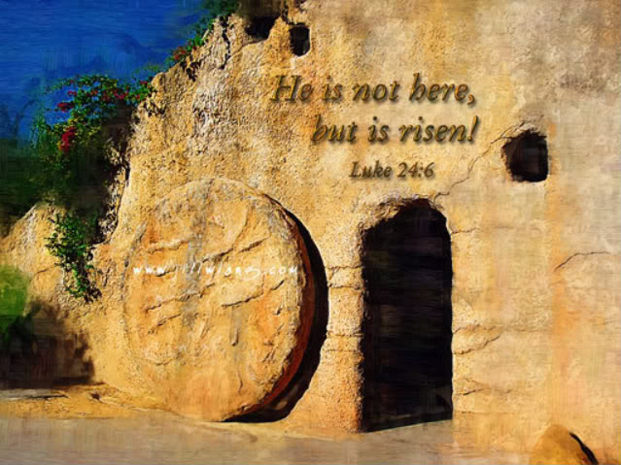
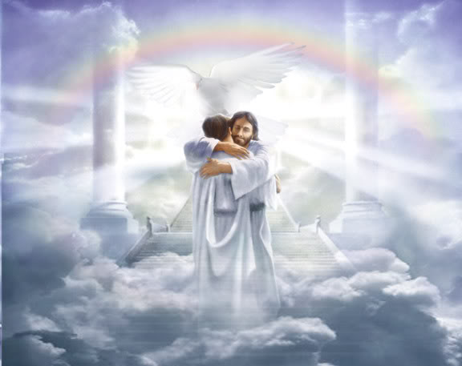
Intro
One day Jesus lived, died, was buried & arose, then promised to return to take His disciples home to Heaven! The good news that brings salvation to all men!
Hymn: “One Day” (1910) by J. Wilbur Chapman (1859-1918)

Slide 5
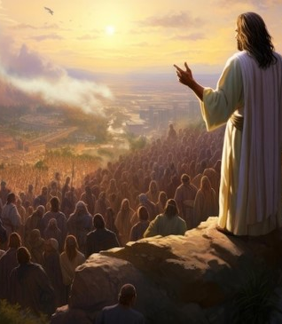
One Day Jesus Lived As Our Example!
“One day when heaven was filled with His praises, One day when sin was as black as could be, Jesus came forth to be born of a virgin: Dwelt among men, my example is He!”
The Scriptures say that Jesus would be born of a virgin: Mt. 1:22-23 (Is. 7:14); Gal. 4:4
As a human being, He dwelt among men: Phil. 2:5-9: He “emptied Himself,” leaving Heaven taking the form of a bond-servant!
The fact that Jesus was born of a woman and lived on earth made it possible for Him to be our perfect example: I Peter 2:21 (Heb. 4:14-16)
Notes:
One Day Jesus Lived As Our Example!
Stanza 1 of Hymn: “One Day” (1910) by J. Wilbur Chapman (1859-1918): We learn about His virgin birth and His life as an example for us!
“One day when heaven was filled with His praises, One day when sin was as black as could be, Jesus came forth to be born of a virgin: Dwelt among men, my example is He!”
The Scriptures say that Jesus would be born of a virgin: Mt. 1:22-23 (Is. 7:14); Gal. 4:4
As a human being, He dwelt among men: Phil. 2:5-9: He “emptied Himself,” leaving Heaven (Hymn: Ivory Palaces by Henry Barraclough, 1915, Chorus: “Out of the ivory palaces into a world of woe”) taking the form of a bond-servant!
The fact that Jesus was born of a woman and lived on earth made it possible for Him to be our perfect example: I Pet. 2:21 (Heb. 4:14-16)
One day Jesus came as the Creator among the created and set the example for godly living!

Slide 6
I Peter 2:21 NET
21. For to this you were called, since Christ also suffered for you, leaving an example for you to follow in His steps.
Notes:
One Day Jesus Lived As Our Example!
Stanza 1 of Hymn: “One Day” (1910) by J. Wilbur Chapman (1859-1918): We learn about His virgin birth and His life as an example for us!
“One day when heaven was filled with His praises, One day when sin was as black as could be, Jesus came forth to be born of a virgin: Dwelt among men, my example is He!”
The Scriptures say that Jesus would be born of a virgin: Mt. 1:22-23 (Is. 7:14); Gal. 4:4
As a human being, He dwelt among men: Phil. 2:5-9: He “emptied Himself,” leaving Heaven (Hymn: Ivory Palaces by Henry Barraclough, 1915, Chorus: “Out of the ivory palaces into a world of woe”) taking the form of a bond-servant!
The fact that Jesus was born of a woman and lived on earth made it possible for Him to be our perfect example: I Pet. 2:21 (Heb. 4:14-16)
One day Jesus came as the Creator among the created and set the example for godly living!

Slide 7
One Day Jesus Lived As Our Example!
One day Jesus came as the Creator among the created and set the example for godly living!
Notes:
One Day Jesus Lived As Our Example!
Stanza 1 of Hymn: “One Day” (1910) by J. Wilbur Chapman (1859-1918): We learn about His virgin birth and His life as an example for us!
“One day when heaven was filled with His praises, One day when sin was as black as could be, Jesus came forth to be born of a virgin: Dwelt among men, my example is He!”
The Scriptures say that Jesus would be born of a virgin: Mt. 1:22-23 (Is. 7:14); Gal. 4:4
As a human being, He dwelt among men: Phil. 2:5-9: He “emptied Himself,” leaving Heaven (Hymn: Ivory Palaces by Henry Barraclough, 1915, Chorus: “Out of the ivory palaces into a world of woe”) taking the form of a bond-servant!
The fact that Jesus was born of a woman and lived on earth made it possible for Him to be our perfect example: I Pet. 2:21 (Heb. 4:14-16)
One day Jesus came as the Creator among the created and set the example for godly living!

Slide 8
One Day Jesus Died On the Cross for Our Sins!
“One day they led Him up Calvary’s mountain; One day they nailed Him to die on the tree, Suffering anguish, despised and rejected, Bearing my sins, my Redeemer is He!”
I Corinthians 15:3: Christ died for our sins ACCORDING to the Scriptures (Not by “accident”).
His death occurred at a place called Golgotha (Hebrew for “the skull;” Calvary in Latin): Luke 23:33; John 19:17-18
There they nailed Him to die on the cross (Acts 2:23)
Because He died on the cross for our sins, He is our Redeemer: Rom. 3:24; Gal. 3:13; Eph. 1:7; 2:13-16
Notes:
One Day Jesus Lived As Our Example!
One Day Jesus Died On the Cross for Our Sins!
Stanza 2 of Hymn: “One Day” (1910) by J. Wilbur Chapman (1859-1918): We learn about His death on the cross for our sins!
“One day they led Him up Calvary’s mountain; One day they nailed Him to die on the tree, Suffering anguish, despised and rejected, Bearing my sins, my Redeemer is He!”
I Corinthians 15:3
Christ died for our sins ACCORDING to the Scriptures (Not by “accident”).
Paul explains the difference of the gospel from the Jewish expectation:
The Jews expected (wanted) the Messiah to establish an earthly, physical kingdom. (Acts 1:6; Jn. 18:36)
The Scriptures never taught that, instead they taught a “suffering Savior” (Is. 53:11-12; Acts 3:18).
Jesus and the apostles taught that the Scriptures pointed to His death:
Lk. 24:44-46; I Pet. 1:10-12
His death occurred at a place called Golgotha (Hebrew for “the skull”) or Calvary (anglicized Latin of G2898 “kranion,” meaning “the skull”): Lk. 23:33; Jn. 19:17-18
There they nailed Him to die on the cross (or “tree” – Gal. 3:13) – none of the accounts of Jesus' crucifixion specifically say that He was nailed to the cross (Mt. 27:35; Mk. 15:24; Lk. 23:33; Jn. 19:18), but we know that He was: Jn. 20:25; Acts 2:23; Col. 2:14
Because He died on the cross for our sins, He is our Redeemer: Rom. 3:24; Gal. 3:13; Eph. 1:7; 2:13-16
One day Jesus died to redeem mankind from their sins and to reconcile man to God!

Slide 9
Ephesians 2:13-16 NAS95
13. But now in Christ Jesus you who formerly were far off have been brought near by the blood of Christ.
14. For He Himself is our peace, who made both groups into one and broke down the barrier of the dividing wall,
15. by abolishing in His flesh the enmity, which is the Law of commandments contained in ordinances, so that in Himself He might make the two into one new man, thus establishing peace,
16. and might reconcile them both in one body to God through the cross, by it having put to death the enmity.
Notes:
One Day Jesus Lived As Our Example!
One Day Jesus Died On the Cross for Our Sins!
Stanza 2 of Hymn: “One Day” (1910) by J. Wilbur Chapman (1859-1918): We learn about His death on the cross for our sins!
“One day they led Him up Calvary’s mountain; One day they nailed Him to die on the tree, Suffering anguish, despised and rejected, Bearing my sins, my Redeemer is He!”
I Corinthians 15:3
Christ died for our sins ACCORDING to the Scriptures (Not by “accident”).
Paul explains the difference of the gospel from the Jewish expectation:
The Jews expected (wanted) the Messiah to establish an earthly, physical kingdom. (Acts 1:6; Jn. 18:36)
The Scriptures never taught that, instead they taught a “suffering Savior” (Is. 53:11-12; Acts 3:18).
Jesus and the apostles taught that the Scriptures pointed to His death:
Lk. 24:44-46; I Pet. 1:10-12
His death occurred at a place called Golgotha (Hebrew for “the skull”) or Calvary (anglicized Latin of G2898 “kranion,” meaning “the skull”): Lk. 23:33; Jn. 19:17-18
There they nailed Him to die on the cross (or “tree” – Gal. 3:13) – none of the accounts of Jesus' crucifixion specifically say that He was nailed to the cross (Mt. 27:35; Mk. 15:24; Lk. 23:33; Jn. 19:18), but we know that He was: Jn. 20:25; Acts 2:23; Col. 2:14
Because He died on the cross for our sins, He is our Redeemer: Rom. 3:24; Gal. 3:13; Eph. 1:7; 2:13-16
One day Jesus died to redeem mankind from their sins and to reconcile man to God!

Slide 10
One Day Jesus Died On the Cross for Our Sins!
One day Jesus died to redeem mankind from their sins and to reconcile man to God!
Notes:
One Day Jesus Lived As Our Example!
One Day Jesus Died On the Cross for Our Sins!
Stanza 2 of Hymn: “One Day” (1910) by J. Wilbur Chapman (1859-1918): We learn about His death on the cross for our sins!
“One day they led Him up Calvary’s mountain; One day they nailed Him to die on the tree, Suffering anguish, despised and rejected, Bearing my sins, my Redeemer is He!”
I Corinthians 15:3
Christ died for our sins ACCORDING to the Scriptures (Not by “accident”).
Paul explains the difference of the gospel from the Jewish expectation:
The Jews expected (wanted) the Messiah to establish an earthly, physical kingdom. (Acts 1:6; Jn. 18:36)
The Scriptures never taught that, instead they taught a “suffering Savior” (Is. 53:11-12; Acts 3:18).
Jesus and the apostles taught that the Scriptures pointed to His death:
Lk. 24:44-46; I Pet. 1:10-12
His death occurred at a place called Golgotha (Hebrew for “the skull”) or Calvary (anglicized Latin of G2898 “kranion,” meaning “the skull”): Lk. 23:33; Jn. 19:17-18
There they nailed Him to die on the cross (or “tree” – Gal. 3:13) – none of the accounts of Jesus' crucifixion specifically say that He was nailed to the cross (Mt. 27:35; Mk. 15:24; Lk. 23:33; Jn. 19:18), but we know that He was: Jn. 20:25; Acts 2:23; Col. 2:14
Because He died on the cross for our sins, He is our Redeemer: Rom. 3:24; Gal. 3:13; Eph. 1:7; 2:13-16
One day Jesus died to redeem mankind from their sins and to reconcile man to God!

Slide 11
One Day Jesus Was Buried & Rose from the Dead!
“One day the grave could conceal Him no longer; One day the stone rolled away from the door. Then He arose; over death He had conquered, Now is ascended, my Lord evermore!”
I Corinthians 15:4: Jesus was buried and rose on the third day ACCORDING to the Scriptures. (Luke 24:1-7)
“Death cannot keep his prey” (“Christ Arose!” by Robert Lowry, 1874): The tomb was found empty! Christ Arose! (Heb. 2:14-15: He broke the power of death for everyone!)
Following His resurrection, He ascended into heaven: Luke 24:6; Acts 1:9-11
Notes:
One Day Jesus Lived As Our Example!
One Day Jesus Died On the Cross for Our Sins!
One Day Jesus Was Buried & Rose from the Dead!
Stanza 3 of Hymn: “One Day” (1910) by J. Wilbur Chapman (1859-1918): We learn about His burial and resurrection! (Org. stanza 3 was about tomb)
“One day the grave could conceal Him no longer; One day the stone rolled away from the door. Then He arose; over death He had conquered, Now is ascended, my Lord evermore!”
I Corinthians 15:4
Jesus was buried and rose on the third day ACCORDING to the Scriptures (Ps. 16:10; Mt. 12:40; Lk. 24:4-7, 44-46; Jn. 2:19-22).
Peter quoted from Ps. 16:10 in his sermon on Day of Pentecost (Acts 2:27).
Paul is strengthening their faith by stating these events were foretold in the Scriptures, and were revealed to him by Christ (I Corinthians 15:3; Gal. 1:12).
“Death cannot keep his prey” (“Christ Arose!” by Robert Lowry, 1874): The tomb was found empty! Christ Arose! (Heb. 2:14-15: He broke the power of death for everyone!)
Original stanza 3: His burial in the tomb
“One day they left Him alone in the garden; One day He rested from suffering free. Angels came down o'er His tomb to keep vigil; Hope of the hopeless, My Savior is He.”
The women were wondering who would roll away the “extremely large” stone but found an angel had already moved it (Mt. 28:1-4; Mk. 16:1-4; Lk. 24:1-3; Jn. 20:1)
Following His resurrection, He ascended into heaven: Luke 24:6; Acts 1:9-11
One day His resurrection from the dead proved that He is both Lord and Christ, the divine Son of God and the Eternal Judge! (Acts 2:36, Rom. 1:3-4; Acts 17:30-31)

Slide 12
Luke 24:6; Acts 1:9-11 NAS95
Luke 24:6 "He is not here, but He has risen. Remember how He spoke to you while He was still in Galilee,
Acts 1:9 And after He had said these things, He was lifted up while they were looking on, and a cloud received Him out of their sight.
Acts 1:10 And as they were gazing intently into the sky while He was going, behold, two men in white clothing stood beside them.
Acts 1:11 They also said, "Men of Galilee, why do you stand looking into the sky? This Jesus, who has been taken up from you into heaven, will come in just the same way as you have watched Him go into heaven."
Notes:
One Day Jesus Lived As Our Example!
One Day Jesus Died On the Cross for Our Sins!
One Day Jesus Was Buried & Rose from the Dead!
Stanza 3 of Hymn: “One Day” (1910) by J. Wilbur Chapman (1859-1918): We learn about His burial and resurrection! (Org. stanza 3 was about tomb)
“One day the grave could conceal Him no longer; One day the stone rolled away from the door. Then He arose; over death He had conquered, Now is ascended, my Lord evermore!”
I Corinthians 15:4
Jesus was buried and rose on the third day ACCORDING to the Scriptures (Ps. 16:10; Mt. 12:40; Lk. 24:4-7, 44-46; Jn. 2:19-22).
Peter quoted from Ps. 16:10 in his sermon on Day of Pentecost (Acts 2:27).
Paul is strengthening their faith by stating these events were foretold in the Scriptures, and were revealed to him by Christ (I Corinthians 15:3; Gal. 1:12).
“Death cannot keep his prey” (“Christ Arose!” by Robert Lowry, 1874): The tomb was found empty! Christ Arose! (Heb. 2:14-15: He broke the power of death for everyone!)
Original stanza 3: His burial in the tomb
“One day they left Him alone in the garden; One day He rested from suffering free. Angels came down o'er His tomb to keep vigil; Hope of the hopeless, My Savior is He.”
The women were wondering who would roll away the “extremely large” stone but found an angel had already moved it (Mt. 28:1-4; Mk. 16:1-4; Lk. 24:1-3; Jn. 20:1)
Following His resurrection, He ascended into heaven: Luke 24:6; Acts 1:9-11
One day His resurrection from the dead proved that He is both Lord and Christ, the divine Son of God and the Eternal Judge! (Acts 2:36, Rom. 1:3-4; Acts 17:30-31)

Slide 13
One Day Jesus Was Buried & Rose from the Dead!
One day His resurrection from the dead proved that He is both Lord and Christ, the divine Son of God and the Eternal Judge!
Notes:
One Day Jesus Lived As Our Example!
One Day Jesus Died On the Cross for Our Sins!
One Day Jesus Was Buried & Rose from the Dead!
Stanza 3 of Hymn: “One Day” (1910) by J. Wilbur Chapman (1859-1918): We learn about His burial and resurrection! (Org. stanza 3 was about tomb)
“One day the grave could conceal Him no longer; One day the stone rolled away from the door. Then He arose; over death He had conquered, Now is ascended, my Lord evermore!”
I Corinthians 15:4
Jesus was buried and rose on the third day ACCORDING to the Scriptures (Ps. 16:10; Mt. 12:40; Lk. 24:4-7, 44-46; Jn. 2:19-22).
Peter quoted from Ps. 16:10 in his sermon on Day of Pentecost (Acts 2:27).
Paul is strengthening their faith by stating these events were foretold in the Scriptures, and were revealed to him by Christ (I Corinthians 15:3; Gal. 1:12).
“Death cannot keep his prey” (“Christ Arose!” by Robert Lowry, 1874): The tomb was found empty! Christ Arose! (Heb. 2:14-15: He broke the power of death for everyone!)
Original stanza 3: His burial in the tomb
“One day they left Him alone in the garden; One day He rested from suffering free. Angels came down o'er His tomb to keep vigil; Hope of the hopeless, My Savior is He.”
The women were wondering who would roll away the “extremely large” stone but found an angel had already moved it (Mt. 28:1-4; Mk. 16:1-4; Lk. 24:1-3; Jn. 20:1)
Following His resurrection, He ascended into heaven: Luke 24:6; Acts 1:9-11
One day His resurrection from the dead proved that He is both Lord and Christ, the divine Son of God and the Eternal Judge! (Acts 2:36, Rom. 1:3-4; Acts 17:30-31)

Slide 14
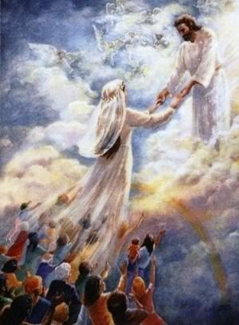
One Day Jesus Will Return to Take His Saints Home!
“One day the trumpet will sound for His coming; One day the skies with His glory will shine. Wonderful day, my beloved ones bringing; Glorious Savior, this Jesus is mine!”
One day the trumpet will sound for His coming: I Thess. 4:16-17
On that day, Jesus will be glorified in His saints and be marveled at by those who believe, and will raise the dead! (II Thess. 1:10; I Corinthians 15:51-52)
Notes:
One Day Jesus Lived As Our Example!
One Day Jesus Died On the Cross for Our Sins!
One Day Jesus Was Buried & Rose from the Dead!
One Day Jesus Will Return to Take His Saints Home!
Stanza 4 of Hymn: “One Day” (1910) by J. Wilbur Chapman (1859-1918): We learn about His about His second coming!
“One day the trumpet will sound for His coming; One day the skies with His glory will shine. Wonderful day, my beloved ones bringing; Glorious Savior, this Jesus is mine!”
One day the trumpet will sound for His coming: I Thess. 4:16-17
On that day, He will be glorified in His saints and be marveled at by those who believe, and will raise the dead! (II Thess. 1:10; I Corinthians 15:51-52)
One day the Lord will be revealed in His fullness as our Savior (Rev. 1:7) because He will be coming not in reference to sin but for salvation! (Heb. 9:27-28)

Slide 15
I Corinthians 15:51-52 NAS95
51. Behold, I tell you a mystery; we will not all sleep, but we will all be changed,
52. in a moment, in the twinkling of an eye, at the last trumpet; for the trumpet will sound, and the dead will be raised imperishable, and we will be changed.
Notes:
One Day Jesus Lived As Our Example!
One Day Jesus Died On the Cross for Our Sins!
One Day Jesus Was Buried & Rose from the Dead!
One Day Jesus Will Return to Take His Saints Home!
Stanza 4 of Hymn: “One Day” (1910) by J. Wilbur Chapman (1859-1918): We learn about His about His second coming!
“One day the trumpet will sound for His coming; One day the skies with His glory will shine. Wonderful day, my beloved ones bringing; Glorious Savior, this Jesus is mine!”
One day the trumpet will sound for His coming: I Thess. 4:16-17
On that day, He will be glorified in His saints and be marveled at by those who believe, and will raise the dead! (II Thess. 1:10; I Corinthians 15:51-52)
One day the Lord will be revealed in His fullness as our Savior (Rev. 1:7) because He will be coming not in reference to sin but for salvation! (Heb. 9:27-28)

Slide 16
One Day Jesus Will Return to Take His Saints Home!
One day the Lord will be revealed in His fullness as our Savior because He will be coming not in reference to sin but for salvation!
Notes:
One Day Jesus Lived As Our Example!
One Day Jesus Died On the Cross for Our Sins!
One Day Jesus Was Buried & Rose from the Dead!
One Day Jesus Will Return to Take His Saints Home!
Stanza 4 of Hymn: “One Day” (1910) by J. Wilbur Chapman (1859-1918): We learn about His about His second coming!
“One day the trumpet will sound for His coming; One day the skies with His glory will shine. Wonderful day, my beloved ones bringing; Glorious Savior, this Jesus is mine!”
One day the trumpet will sound for His coming: I Thess. 4:16-17
On that day, He will be glorified in His saints and be marveled at by those who believe, and will raise the dead! (II Thess. 1:10; I Corinthians 15:51-52)
One day the Lord will be revealed in His fullness as our Savior (Rev. 1:7) because He will be coming not in reference to sin but for salvation! (Heb. 9:27-28)

Slide 17
Conclusion
One Day Jesus Lived As Our Example!
One Day Jesus Died On the Cross for Our Sins!
One Day Jesus Was Buried & Rose from the Dead!
One Day Jesus Will Return to Take His Saints Home!
“Living, He loved me; dying, He saved me; Buried, He carried my sins far away; Rising, He justified, freely forever: One day He's coming--O glorious day!”
Notes:
Conclusion
The chorus recaps these facts about Jesus and makes application of them to our lives:
“Living, He loved me; dying, He saved me; Buried, He carried my sins far away; Rising, He justified, freely forever: One day He's coming--O glorious day!”

Slide 18
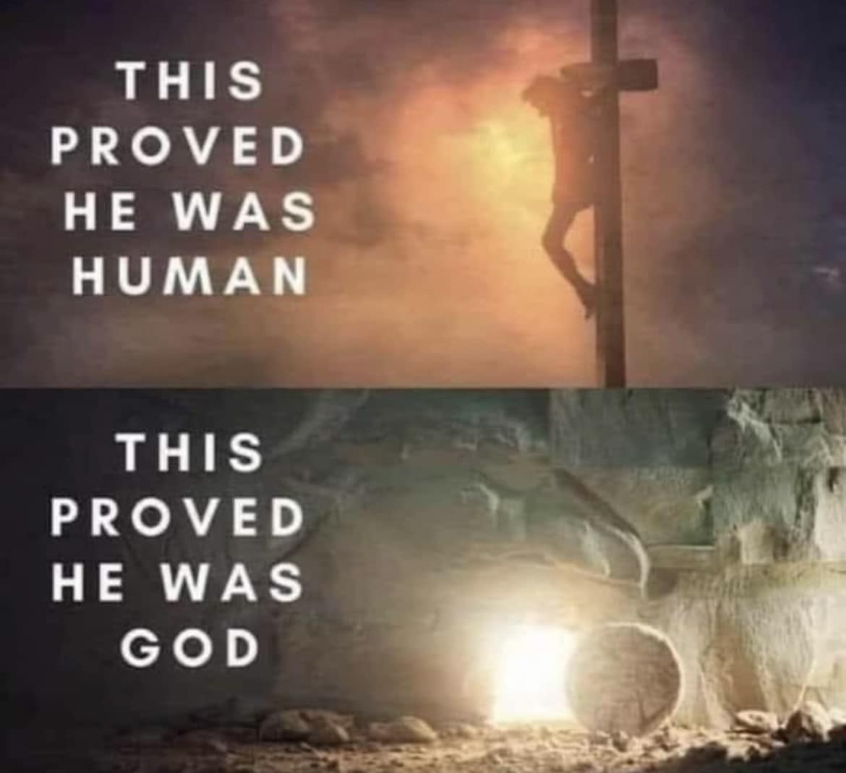
Conclusion
He came to earth because He loved us, He died and was buried to save us & to take our sins away, He arose that we might be justified, and He will come again to take us home
Notes:
Conclusion
The chorus recaps these facts about Jesus and makes application of them to our lives:
“Living, He loved me; dying, He saved me; Buried, He carried my sins far away; Rising, He justified, freely forever: One day He's coming--O glorious day!”
He came to earth because He loved us, He died (proving He was Human) and was buried to save us & to take our sins away, He arose that we might be justified (Proving He is God), and He will come again to take us home!

Slide 19
Romans 6:8-13 NAS95
8. Now if we have died with Christ, we believe that we shall also live with Him,
9. knowing that Christ, having been raised from the dead, is never to die again; death no longer is master over Him.
10. For the death that He died, He died to sin once for all; but the life that He lives, He lives to God.
11. Even so consider yourselves to be dead to sin, but alive to God in Christ Jesus.
12. Therefore do not let sin reign in your mortal body so that you obey its lusts,
13. and do not go on presenting the members of your body to sin as instruments of unrighteousness; but present yourselves to God as those alive from the dead, and your members as instruments of righteousness to God.
Notes:
Conclusion
The chorus recaps these facts about Jesus and makes application of them to our lives:
“Living, He loved me; dying, He saved me; Buried, He carried my sins far away; Rising, He justified, freely forever: One day He's coming--O glorious day!”
He came to earth because He loved us, He died (proving He was Human) and was buried to save us & to take our sins away, He arose that we might be justified (Proving He is God), and He will come again to take us home!
Rom. 6:8-10: Christ overcame death and lives forever with God.
Rom. 6:11-13: The Application – Die to sin and live for Christ!

Slide 20
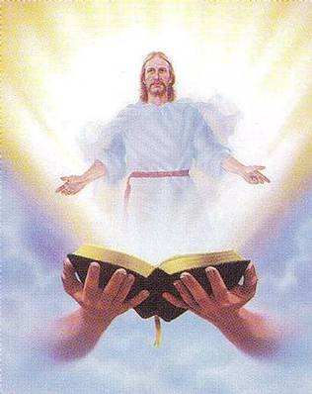
Conclusion
We can, and should, proclaim to the lost what Jesus has done and will do for us “One Day!”
Notes:
Conclusion
The chorus recaps these facts about Jesus and makes application of them to our lives:
“Living, He loved me; dying, He saved me; Buried, He carried my sins far away; Rising, He justified, freely forever: One day He's coming--O glorious day!”
He came to earth because He loved us, He died (proving He was Human) and was buried to save us & to take our sins away, He arose that we might be justified (Proving He is God), and He will come again to take us home!
Rom. 6:8-10: Christ overcame death and lives forever with God.
Rom. 6:11-13: The Application – Die to sin and live for Christ!
We can, and should, proclaim to the lost what Jesus has done and will do for us “One Day!”

Slide 21
“What Must I Do To Be Saved?”
Hear The Gospel (John 5:24; Romans 10:17)
Believe In Christ (John 3:16-18; John 8:24)
Repent Of Sins (Luke 13:3-5; Acts 2:38)
Confess Christ (Matthew 10:32; Romans 10:10)
Be Baptized (Mark 16:16; Acts 22:16)
Remain Faithful (John 8:31; Revelation 2:10)
For The Erring Saint:
Repent (Acts 8:22), Confess (I John 1:9),
Pray (Acts 8:22)

